Slide 1
Cascading Style Sheets
special thanks to Martin Kruliš

Slide 2
Calculating Values
Dynamic Computations in CSS
var()
Reads value of a custom property (CSS variable)
Custom properties must start with --
calc()
A function which can be used to compute CSS values
Works for numeric values only
Limited to basic operators +, -, *, and /
:root { --gap: 20px; }
body { padding: var(--gap); }
#somediv { width: calc(100vh – 2 * var(--gap)); }
Notes:
Note: var() can be used inside calc() and calc() can be used to initialize a variable value.
https://developer.mozilla.org/en-US/docs/Web/CSS/var
https://developer.mozilla.org/en-US/docs/Web/CSS/calc

Slide 3
Counters
Automated Numbering
CSS counters are operated by two properties
counter-reset: counterID [ number ]; Initialize given counter (with default or specified number)
counter-increment: counterID; Increments selected counter by 1
The counter values may be used in ::before and ::after rules in the content property
body { counter-reset: chapter; }
h1::before {
content: counter(chapter) ". ";
counter-increment: chapter;
}
Notes:
Note: var() can be used inside calc() and calc() can be used to initialize a variable value.
https://developer.mozilla.org/en-US/docs/Web/CSS/var
https://developer.mozilla.org/en-US/docs/Web/CSS/calc

Slide 4
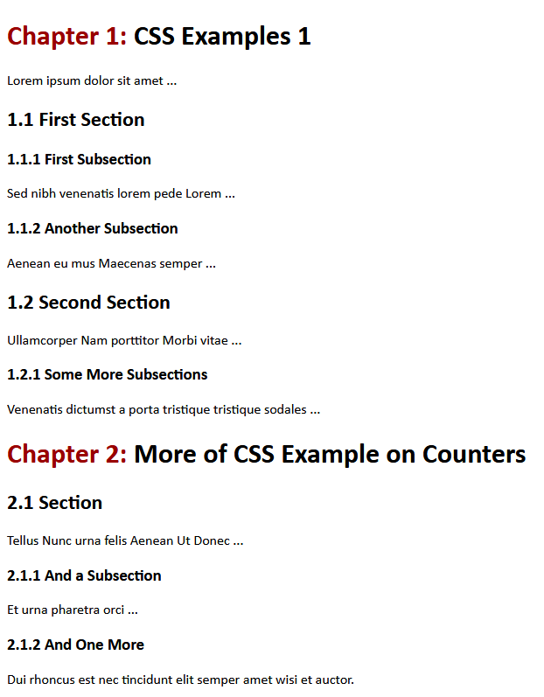
Counters
body { counter-reset: chapter; }
h1 { counter-reset: section; }
h2 { counter-reset: subsection; }
h1::before {
content: "Chapter " counter(chapter) ": ";
counter-increment: chapter;
color: #900;
}
h2::before {
content: counter(chapter) "."counter(section) " ";
counter-increment: section;
}
h3::before {
content: counter(chapter) "." counter(section) "." counter(subsection) " ";
counter-increment: subsection;
}

Slide 5
Content Positioning
Page Rendering Algorithm
The elements and their content are processed from the beginning to the end
Each element is positioned according to its size, margins, and display properties (block, inline, …) Except for the floating elements mentioned before
This behavior can be modified by position property
Static | Default page rendering algorithm is used
relative | Like static, but element is moved relative to its computed position after the layout is created
absolute | Element is positioned inside closest positioning context
fixed | Element is fixed within the browser viewport
sticky | Sticks to ancestor viewport when scrolling
Notes:
https://developer.mozilla.org/en-US/docs/Web/CSS/position

Slide 6
Content Positioning
Positioning-related Properties
Size properties (related to box model)
width, height – size of the element contents
min-/max- width/height – size limits
Location properties (for positioned elements only)
top, bottom, left, right
Distance from the edge at the corresponding side
It does not make sense to set left, width, and right simultaneously
width
Content
right
padding
margin
Notes:
Remember the width sets either the width of content or width of border depending of property box-sizing: content-box | border-box.

Slide 7
Content Positioning
Absolute Positioning
#absDiv {
position: absolute;
left: 10px;
right: 20px;
top: 30px;
height: 50px;
}
30px
absDiv
50px
10px
20px
Determined by parent width
Nearest positioned element or the whole document

Slide 8
Content Positioning
Top
Relative Positioning
Element is positioned by normal rendering algorithm
Afterwards, it is shifted from its computed position relatively
Can be combined with other position-related styles inline-block, floating elements
Often used in combination with absolute positioning Relatively pos. element creates positioning context for its children (i.e., absolutely positioned children use that context)
Fixed Positioning
Similar to absolute, but the frame of reference is the viewport
Relative Div
Left

Slide 9
Content Positioning
Sticky Positioning
Hybrid between relative and fixed positioning
Element is positioned regularly as long as it is entirely visible
When not entirely visible (due to page scrolling) it is positioned relatively to its nearest scrolling viewport
top, right, bottom, or left specify the relative position and also the threshold when the scrolling changes the behavior of the element

Slide 10
Demo
02-sticky

Slide 11
Content Positioning
Additional positioning-related Properties
z-index – depth in the stack of positioned elements Higher number ~ closer to the top
opacity – useful (not only) for overlapping elements 0 ~ fully transparent, 1 ~ opaque
overflow – when contents does not fit its explicitly-sized element
visible – content overflows and may overlap
hidden – content is cropped to the element boundaries
scroll – scroll bars are added and the element has its own viewport in which the whole content is displayed
auto – similar to scroll, but scroll bars are initially hidden

Slide 12
Layout
Visual structure of the content blocks of the whole page or its logical part
Placement of menu-bar, additional sidebar, page header and footer, …
Placement of items in navigation, offered goods in e-shop, …
Many different approaches
Whether the page scrolls as whole or not
How each container handle content overflows
…
header
content
menu bar
side bar
footer

Slide 13
Page Layout
Creating Layout with Sidebars
Tables
Floating Sidebars
Quite easy to design, but
The sidebars must precede main content
It is a little bit tricky to ensure correct sidebar height
Absolute/Fixed Sidebars
Cover the contents underneath
Sidebars can be almost anywhere in the document
More modern approach, which can be used for more complex situations than floating sidebars
Slightly more difficult to design and code

Slide 14
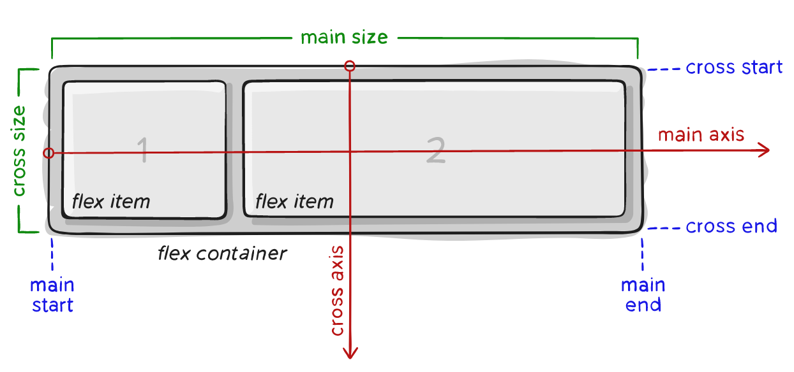
Modern Layout Flex
A way to create flexible smaller layouts (e.g., flow of UI controls)
Notes:
Image was take from https://css-tricks.com/snippets/css/a-guide-to-flexbox/ , which is a very good tutorial for flex layout.

Slide 15
Modern Layout
Flex
display: flex;
Flex - Container Properties
flex-direction – direction of main axis
flex-wrap – whether wrapping is allowed
justify-content – alignment and spacing along the main axis
align-items, align-content Alignment, spacing, and padding along the cross axis

Slide 16
Modern Layout
Flex – Item Properties
order Items are sorted by their order values Items with the same order are sorted by HTML positions
flex-grow, flex-shrink How much should the item grow/shrink if there is space left or not enough space
flex-basis Default size of the item (before growing or shrinking)

Slide 17
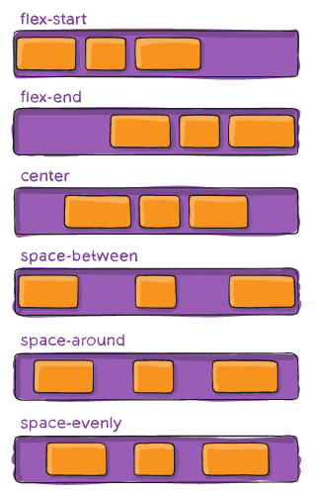
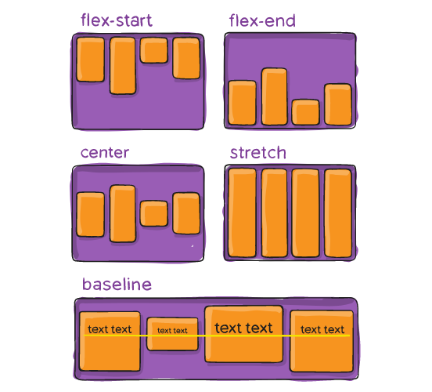
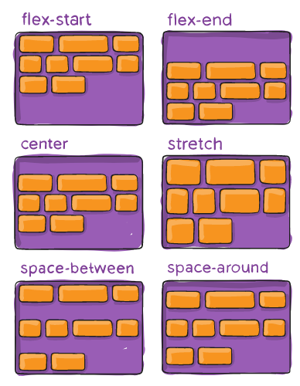
Modern Layout Flex - Examples
justify-content
align-items
align-content
Notes:
Image was taken from https://css-tricks.com/snippets/css/a-guide-to-flexbox/ , which is a very good tutorial for flex layout.

Slide 18
Modern Layout Grid
For larger regular layouts (e.g., entire page)
Container
Defines rectangular grid where items can be placed
Column/row sizes can be specified using various units Including new fr unit (fraction)
Items
Direct descendants (children) of the container
Aligned within grid lines (i.e., inside a rectangle)
Notes:
A good tutorial can be found here: https://css-tricks.com/snippets/css/complete-guide-grid/
Fr unit works as follows: it divides the rest of the space (after removing slots with non-flexible sizes). E.g., grid-template-columns: 1fr 2fr 50px 3fr; divides the rest of the space (without 50px) in ratio 1/6, 1/3, and ½.

Slide 19
Modern Layout
.container {
display: grid;
grid-template-columns: 50px auto 30vh; grid-template-rows:
40px 80px;
}
.item1 {
grid-column: 1 / 2;
grid-row: 1 / 3;
}
.item2 {
grid-column: 2 / 3;
grid-row: 2 / 3;
}
.item3 {
grid-column: 3 / -1;
grid-row: 2 / 3;
}
.item4 {
grid-column: 1 / 2;
grid-row: 2 / 4;
}
Grids – Template Areas
<div class="container">
<div class="item1">…</div> <div class="item2">…</div> <div class="item3">…</div> <div class="item4">…</div> </div>
item1
item4
item2
item3

Slide 20
Modern Layout
.container {
display: grid;
grid-template-columns: ... grid-template-rows: ...
grid-template-areas:
"header header header"
"main . sidebar"
"footer footer footer";
}
.item1 {
grid-area: header;
}
.item2 {
grid-area: main;
}
.item3 {
grid-area: sidebar;
}
.item4 {
grid-area: footer;
}
Grids – Template Areas
<div class="container">
<div class="item1">…</div> <div class="item2">…</div> <div class="item3">…</div> <div class="item4">…</div> </div>
item1
item2
item3
item4
Notes:
Grids are much more complex. See https://css-tricks.com/snippets/css/complete-guide-grid/

Slide 21
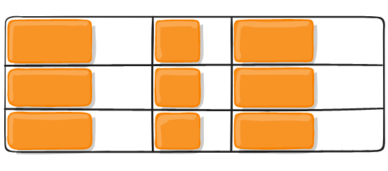
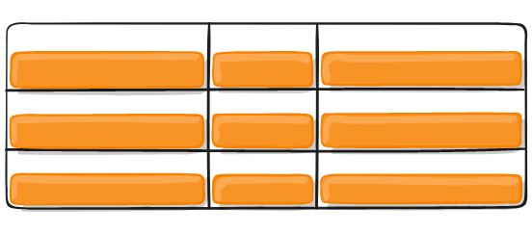
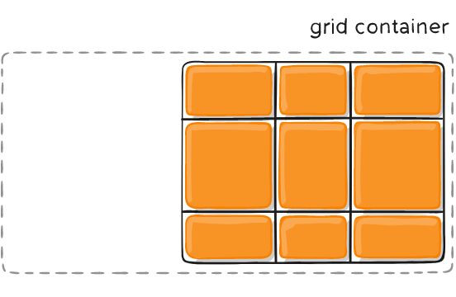
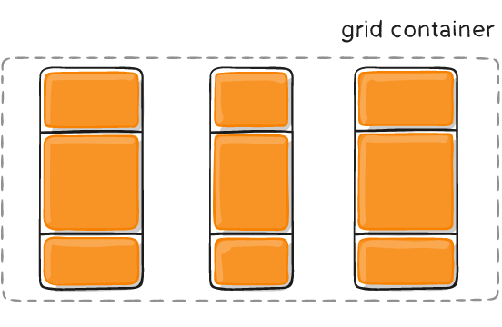
Modern Layout
Grids – Gaps and Alignment
Spacing and alignment can be set for items within the cells as well as for cells themselves
Both horizontally and vertically
Items can be smaller than cells
And the grid may be smaller than container

Slide 22
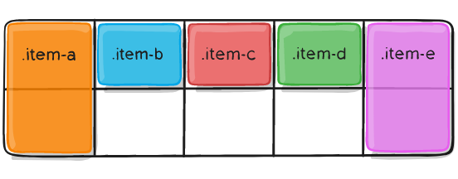
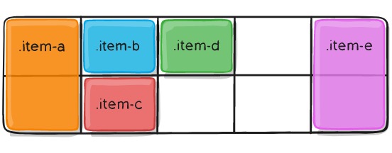
Modern Layout
Grids – Automatic Placement
Automatic placement of items, which has no explicit coordinates
Example (item-a and item-e are placed explicitly)
grid-auto-flow: row;
grid-auto-flow: column;

Slide 23
Layout
Center floating or absolutely positioned elements with fixed width
margin-left: auto; margin-right: auto;

Slide 24
Responsive Frameworks
Predefined styles (and possibly scripts) which automatically handle various screen sizes
Developed intensively in last few years
Many frameworks currently available
Twitter Bootstrap
W3.CSS
Skeleton
Foundation
HTML5 Boilerplate
HTML KickStart
…

Slide 25
DEmo
03-responsive-design

Slide 26
CSS Preprocessing
Major CSS Issues
Selectors are quite powerful but possibly tedious
Limited possibilities of using variables/calculations
Not particularly DRY-friendly
CSS Preprocessing
Styles are written in preprocessing language and generated into CSS files
Several languages/tools available (LESS, SASS)

Slide 27
SASS
Syntactically Awesome Stylesheets
A style sheet language that extends CSS
It is interpreted into CSS files
The most important features are
Variables – allow single definition of a value
Nesting – more logical organization of the styles
Mixins – CSS templates that can be reused
Selector inheritance – simplifies selector construction
Scripting (loops, conditions, expressions, …)
Notes:
SASS is recommended over LESS by multiple individual sources on the Internet, so we have selected this preprocessor as a representative. Some of the following examples are inspired by SASS basic guide: http://sass-lang.com/guide

Slide 28
SASS
SASS Syntax(es)
Original SASS is based on Haml language
Newer SCSS syntax is more similar to CSS Actually, CSS file is also valid SCSS file
$size: 300px;
@mixin mybox($width) {
width: $width;
}
#div1 {
@include mybox($size);
}
Notes:
We use SCSS syntax in our examples since it is more convenient for people who never saw SASS before. It is also the preferred syntax now and the original syntax is considered obsolete.
$size: 300px
=mybox($width)
width: $width
#div1
+mybox($size)
Like YAML, for humans to write structures quickly.

Slide 29
SASS
Variables and Expressions
Allow definition of values which can be used in the whole stylesheet
$width: 900px;
$space: 20px;
main {
width: $width – 2 * $space;
padding: $space;
}
div.box {
width: $width / 2 - $space;
}
Creating boxes organized in two columns (half size of the main)

Slide 30
SASS
Nesting
More logical division of styles
nav {
ul {
margin: 0;
li {
display: inline-block;
}
}
a {
color: green;
}
}
nav ul {
margin...
}
nav ul li {
display...
}
nav a {
color...
}

Slide 31
SASS
Selector Inheritance
Shifts the inheritance from base selectors to derived styles
.message {
padding: 10px;
border: 3px solid yellow;
}
.error {
@extend .message;
border-color: red;
}
Selector is updated to .message, .error
Nothing is actually modified here

Slide 32
SASS
Partials and Includes
Partial files are meant for including only
Naming convention – partial files start with underscore E.g., _partial.scss
Import directive @import is preprocessed
CSS @import leads to another HTTP request
SASS @import works like include in C/C++/PHP
Typically used with partial files @import '_part.scss'
Import is also used for including mixins

Slide 33
SASS
Mixins
Parametrized fragments of code which can be reused (similar to C macros)
@mixin shadow($dist, $blur, $color) {
-moz-box-shadow: $dist $dist $blur $color;
-webkit-box-shadow: $dist $dist $blur $color;
-ms-box-shadow: $dist $dist $blur $color;
box-shadow: $dist $dist $blur $color;
}
#mydiv {
@include shadow(5px, 3px, #999);
}

Slide 34
takeaway
Dynamic computations in CSS
Flex layout
Grid layout
CSS preprocessing

