Slide 1
Javascript AND CLIENT-SIDE SCRIPTING
special thanks to Martin Kruliš

Slide 2
Revision
JavaScript
Document Object Model
Event Model
<html>
<body>
<h1>DOM Example</h1>
<p>Document Object Model is an API …</p>
<img src="url" alt="text">
...
</body>
</html>
Mouse Moved
User Clicked
Event Queue
Loading Finished
Node
Window Resized
Document
Element
Attr
CharacterData
…
Text
Comment

Slide 3
User interface

Slide 4
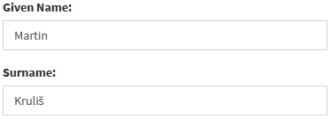
User Interface
Expressed in HTML and CSS
DOM is a data structure that holds part of application state
State (data) synchronization issue
var user = {
givenName: "Martin",
surname: "Kruliš",
};
State in memory
(can be modified by code)
State in DOM (can be modified by user events)
Notes:
We also need to consider what kind of stat is synchronized.

Slide 5
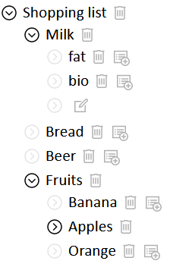
State Synchronization Issue The state is kept only in DOM
Example: Collapsible list
Nested item list
Each item with sub-list is collapsible
Collapsed/Expanded state is defined by a presence of a CSS class
CSS class also hides the sub-list
On-click event toggles the class
Initial state can be encoded in HTML

Slide 6
State Synchronization Issue The state is kept only in DOM
<li>Shopping list <ul> <li class="collapsed">Milk <ul>...
li.collapsed > ul { display: none; }
...addEventListener(click, event => {
event.target.classList.toggle('collapsed');
});

Slide 7
State Synchronization Issue Bi-directional synchronization
Bi-directional synchronization is established
Preferably automated
Connections are defined in declarative manner
Data are kept both in JS memory and in DOM
var user = {
givenName: "Martin",
surname: "Kruliš",
};

Slide 8
Bi-directional Synchronization Example
document.getElementById('givenName').addEventListener('change’, event => {
user.givenName = event.target.value;
});
Binding for other variables may be required
var user = {
givenName: "Martin",
surname: "Kruliš",
};

Slide 9
Bi-directional Synchronization Example
var user = {
_givenName: "Martin";
set givenName(name) {
this._givenName = name;
input.value = name;
}
};
var user = {
givenName: "Martin",
surname: "Kruliš",
};
Notes:
The render function is invoked every time user object is changed. There must be additional mechanism for detecting changes in object easily, the most profound one is using immutable objects and cached components (as React.js does), but this is well beyond the scope of this lecture.
We can not do full re-draw like in other applications.
The code is for illustration only.

Slide 10
Demo
Bi-directional Synchronization
Notes:
https://playcode.io/new/
HTML:
<div>
Name: <span id="name"></span><br/>
<input text id="input"></input>
<button id="clear">Clear</button>
</div>
JS:
let user = {
"_name": "",
set name(value) {
this._name = value;
document.getElementById("name").textContent = value;
document.getElementById("input").value = value;
}
}
document.getElementById("input").addEventListener("input", (event) => user.name = event.target.value);
document.getElementById("clear").addEventListener("click", (event) => user.name = "");

Slide 11
User Interface Design Optimization Tips
Premature optimization is the root of all evil!
Efficient event handlers
Otherwise, the browser may start to lag
Disjoint DOM nodes assembly
When creating DOM subtree, assemble it separately and then insert it to visible DOM all at once
Use cloning when possible
Prefer hiding/showing of existing nodes using CSS
Use CSS classes instead of style attributes
Especially when operating multiple nodes

Slide 12
Single Page Application
Almost everything is handled by JS and AJAX
No traditional forms or browsing is used
…

Slide 13
User interface & Security

Slide 14
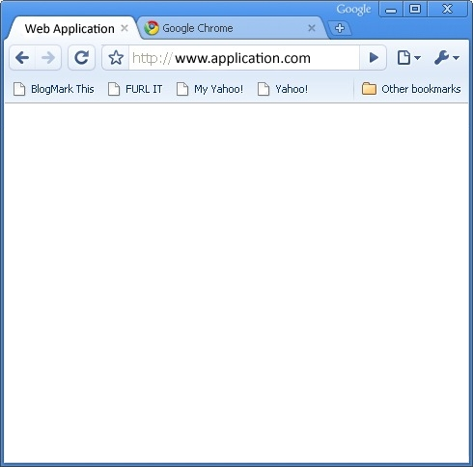
Script Injection Attack
<script>
... find session ID ...
... send it over HTTP ...
</script>
Malicious script gets executed in Admin’s web browser (i.e., in Admin’s context/session)
Attacker’s Browser
Admin’s Browser
Registration
Kapslík
<script>...</>
Fufník
Database

Slide 15
Cross-site Scripting Problem
Cross-site Scripting
User injects malicious JavaScript into regular data fields (registration form, e-mail body, …)
The field is displayed to another user -> the script may steal his/her identity
Prevention
Browser blocks HTTP requests to other domains
Browser hides secured cookies from the script
Programmer’s Discipline
All user inputs must be tested or sanitized

Slide 16
User interface & AJAX

Slide 17
Form Data
Wrapper for Form Data
Can be used as body for AJAX requests
Represents a collection of data (as key-value pairs)
Analogical to data sent by regular form submit
Assembled manually or loaded from <form>
new FormData([ formElement ])
keys(), values(), entries()
has(), get(), getAll()
set(), append(), delete()

Slide 18
AJAX AND User Interface
Let us have a data table, where each item has a delete button that triggers AJAX POST request
Trivial solution
After successful request, JS triggers reload of the page
URL may be in the response body (for location.href)
Slightly more optimized solution
After successful request, JS triggers reload of affected components (table) via separate AJAX GET request
Optimized solution
The POST response sends a HTML fragment or (better yet) component data for re-rendering the table

Slide 19
AJAX AND User Interface
Asynchronous Requests and Page Updates
E.g., item being deleted by AJAX call
How/when remove the related DOM contents
Optimistic Updates
Item is removed (from DOM) when AJAX is started
Problematic if the operation fails
Item has to be returned, user may not notice
Pessimistic Updates
Item is removed after AJAX is completed
May take long time
Progress animation, other operations has to be blocked

Slide 20
HTML5 API
Notes:
Some of the APIs have separate specifications in the terms of W3C standardization, but they are close to HTML5. Thus, we will not distinguish explicitly the HTML5 specification from the related APIs specifications.

Slide 21
HTML5 APIs HISTORY
New feature – script state (history.state)
history.pushState(), history.replaceState()
Captures hidden script-managed state
Allows backward/forward navigation over the states
Notes:
We can use this to simulate navigation in a single page application.

Slide 22
HTML5 APIs Non-visible Data Attributes
Data for scripts, but associated with DOM elements
Special data-* attributes (e.g., data-foo-bar)
Appear in element.dataset collection

Slide 23
HTML5 APIs Data Storage
Persistence key-value data storage accessible from JS
Similar isolation like cookies
LocalStorage - persistent, per web application
SessionStorage - for each window/tab

Slide 24
Demo
Window.localStorage
Notes:
With website https://prankweb.cz/
function load() {
return window.localStorage.getItem("KEY");
}
function save(state) {
try {
window.localStorage.setItem("KEY", state);
} catch (ex) { console.error("Can't save data."); }
}
window.addEventListener("storage", () => console.log("Change:", load()));
---
window.localStorage.clear();

Slide 25
HTML5 APIs Web Workers
Background workers executing JS code
Utilizing multiple cores
Communicate by messages with main loop
// main.js
var worker = new Worker('worker.js’);
worker.postMessage(message);
worker.onmessage = function(event) { /* ... */ }
//worker.js
onmessage = function(e) { /* ... */ }
postMessage(message);
Notes:
postMessage – can not be used to pass messages between workers as worker can not be given to another worker. We can use new MessageChannel() see the link bellow.
In the second example we can use “self”. Also, we can use addEventListener …
https://2ality.com/2017/01/messagechannel.html

Slide 26
Compatibility Issues
Browser’s developers implement the web standards when they want and how they want
Especially problematic with their older versions
Test the functionality, not the browser type/version
Use libraries
Babel – JS transpilling and polyfill
Webpack – bundling the code (JS and CSS)
if ("XMLHttpRequest" in window) { AJAX code } else { no AJAX }
Notes:
Example – to compare features of various browsers see
http://html5test.com/
http://www.webbrowsercompatibility.com/dom/desktop/

Slide 27
jQuery

Slide 28
jQuery
Modern & Lightweight & … JavaScript library for basic operations
Key features
Simplified DOM traversal and manipulation
Event handling
CSS based animations and effects
Unified AJAX API with support for data (de)serialization
Extendable with plugins and UI libraries
Notes:
Attributes: Easy to learn and use, Supports almost all currently used browsers

Slide 29
jQuery
jQuery Object
Function object in global name jQuery and $
Acts as a function that returns set of nodes and as a container object for library functions
“Select and Do” Philosophy
Select a set of DOM nodes
Apply (a sequence of) operation(s) on the whole set of selected nodes
Most methods support invocation chaining
$(selector).doIt().doAnother().doSometingElse();
jQuery Selectors are inspired by CSS3 selectors
Subsequent operations work on the whole set
$(".secret").hide();
Notes:
jQuery selectors:
"div" – select elements of given name
"#id" – select element by its ID
".class" – select elements with specific CSS class
"ancestor descendant" – express DOM relations
:disabled, :visible, :checked, …

Slide 30
jQuery Manipulating HTML Structure
Wrappers for DOM manipulation functions
prepend(), append(), before(), after() – insert content before/after inside/outside selected elements
remove(), empty(), detach() – remove (child) nodes
replaceAll(), replaceWith()
html(), text() – manipulate with content
clone() – create a deep copy of the element
attr(), prop(), removeAttr(), removeProp()
Attr ~ HTML attributes, prop ~ properties (checked, …)
Reading methods take only the first element in set

Slide 31
jQuery … ?TF
Vanilla JS is a fast, lightweight, cross-platform framework for building incredible, powerful JavaScript applications.

Slide 32
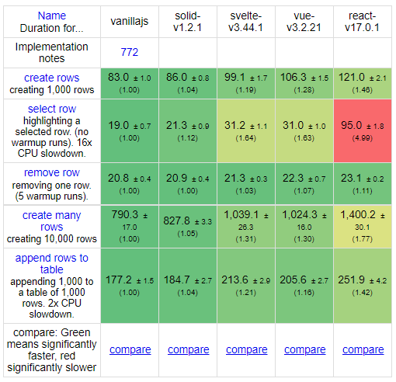
js-framework-benchmark
Source: https://github.com/krausest/js-framework-benchmark , https://github.com/gothinkster/realworld
Notes:
Duration in milliseconds ± 95% confidence interval (Slowdown = Duration / Fastest)
Quote: “
See how the exact same Medium.com clone (called Conduit) is built using different frontends and backends. …
While most "todo" demos provide an excellent cursory glance at a framework's capabilities, they typically don't convey the knowledge & perspective required to actually build real applications with it.t
“

Slide 33
Angular JS
<h1>Hello {{yourName}}!</h1>
<div>
<label>Name:
<input
type="text"
ng-model="yourName">
</label>
</div>
<div>Len: {{nameLen}}</div>
angular.module('app', []).controller('controller', function() {
this.yourName = "petr";
this.nameLen = function() {
return yourName.size;
};
});
Source: https://angularjs.org/
Notes:
Digest cycle is what Angular JS triggers when a value in the model or view is changed.
The cycle sets off the watchers which then match the value of model and view to the newest value.
Digest cycle automatically runs when the code encounters a directive.
The scope of the digest cycle is limited to that of Angular JS context.
Instead, it keeps running until all the variables are set to the right value.
https://www.dotsquares.com/press-and-events/what-is-digest-cycle-in-angular-js-and-how-does-it-make-two-way-data-binding-possible

Slide 34
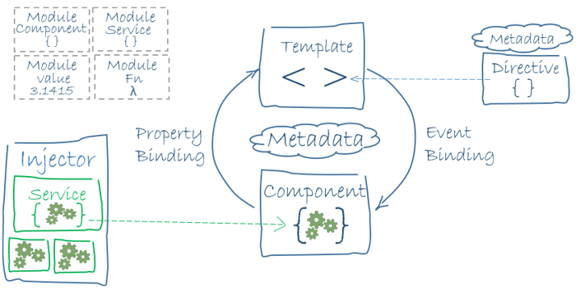
Angular
Source: https://angular.io/

Slide 35
React
Introducing JSX
var element = React.createElement(
“div", null, "Hello, ", name);
const element = <div>Hello, {name}</div>;
React DOM compares the element … and only applies the DOM updates necessary to bring the DOM to the desired state ~ virtual DOM.
Reconciliation, Commit
React is just a library
React 16.8.0 is the first release to support Hooks.
…
Source: https://reactjs.org/
Notes:
By default, React DOM escapes any values embedded in JSX before rendering them.
JSX is not a requirement for using React.
React.createElement( type, [props], [...children] ), setState
virtual DOM – collection of java objects
Reconciliation (asynch) - https://reactjs.org/docs/reconciliation.html , then Commit (synch)
Every React element has a corresponding fiber node. Unlike React elements, fibers aren’t re-created on every render.These are mutable data structures that hold components state and DOM.
Commit : When React gets to this phase, it has 2 trees and the effects list
https://geekflare.com/react-rendering/ , https://dev.to/spukas/react-work-phases-4eaj , https://indepth.dev/posts/1008/inside-fiber-in-depth-overview-of-the-new-reconciliation-algorithm-in-react , https://www.velotio.com/engineering-blog/react-fiber-algorithm , https://andela.com/insights/building-your-own-version-of-react-from-scratch-part-1/

Slide 36
Vue.js
Declarative Rendering
export default({
data: {
message: 'Hello Vue!'
}
}
export default {
data: {
message: 'Hello Vue!’
},
render(createElement) {
return createElement(
'div',
{attrs:{"id":"msg"}},
[this.data.message]
);
}}
<div id=“msg”>
{{ message }}
</div>
Virtual DOM
Reactive Properties Object.defineProperty getter/setter
vm.items[1] = 'x' // is NOT reactivet
Vue.js V3
…
Source: https://vuejs.org/
Notes:
Vue compiles the templates into Virtual DOM render functions. Nodes are called VNode.
Combined with the reactivity system, Vue is able to intelligently figure out the minimal number of components to re-render and apply the minimal amount of DOM manipulations when the app state changes.
You can use createElement(name, attributes, children) directly, there’s a Babel plugin to use JSX with Vue.
Changes from the event loop are stored in queue for asynchronous DOM update. Changes done in “ticks”; important should we need follow-up action (create and select text-input).
The getter/setters are invisible to the user, but under the hood they enable Vue to perform dependency-tracking and change-notification when properties are accessed or modified.
https://v3.vuejs.org/guide/optimizations.html#virtual-dom , https://blog.logrocket.com/how-the-virtual-dom-works-in-vue-js/

Slide 37
Svelte
Build Time
No Virtual DOM
... function create_fragment(ctx) {
... return {
c() { div = element("div"); t = text(/*msg*/ ctx[0]); },
m(target, anchor) {
insert(target, div, anchor); append(div, t);
if (!mounted) {
dispose = listen(div, "click", /* onClick */ ctx[1]); mounted = true;
}
},
p(ctx, [dirty]) { if (dirty & /*msg*/ 1) set_data(t, /*msg*/ ctx[0]); },
...
function instance($$self, $$props, $$invalidate) {
function onClick() { $$invalidate(0, msg += " . "); }
..
<div on:click={onClick}>
{ msg }
</div>
<script>
let msg = "Message";
function onClick() {
msg += " . ";
}
</script>
Source: https://svelte.dev/
Notes:
create(), mount(target, anchor), destroy, u_p_update(current, list of changed variables) – performs update
our update method is moved to “instance” function
https://lihautan.com/compile-svelte-in-your-head-part-1/

Slide 38
The React Framework for Production
…
Notes:
Zero Config – no configuration needed
Hybrid: SSG and SSR - Pre-render pages at build time (SSG) or request time (SSR) in a single project.

Slide 39
takeaway
State Synchronization Issue
…

