Slide 1
Security in Web Applications
special thanks to Martin Kruliš

Slide 2



Crash Course in Cryptography
Make communication (data storage, …) secure
Secure = not readable by 3rd parties, guaranteed to be correct, …
Alice
Bob
Eve (eavesdropper)

Slide 3
Crash Course in Cryptography
Symmetric Ciphers
Both sides need to share the same key
There must be another (secret channel) how they pass on the key
The key is used both for encryption and decryption
Alice
Bob
Eve (eavesdropper)
Notes:
Small shared key (256bits), fast

Slide 4
Crash Course in Cryptography
Advanced Encryption Standard (AES)
Probably the most popular cipher of the day
Can use any sequence of bytes as key
Keys are expanded into 128, 192, or 256bit blocks
Works with 4x4 blocks of bytes
Requires only basic operations (shift, add, xor, …)
…
Notes:
https://en.wikipedia.org/wiki/Advanced_Encryption_Standard

Slide 5
Crash Course in Cryptography
Asymmetric (Public-key) Ciphers
Separate encryption (public) and decryption (private) key
Does not require secure channel for transmitting the key
Alice
Bob
Eve (eavesdropper)
Notes:
Public/private key (2048 bits), slow.

Slide 6
Crash Course in Cryptography
Digital Signature
Reversed application of public-key cipher
  Assumes the decryption/encryption procedures may be swapped
Sender transforms the message using decryption algorithm
(and private key)
Anyone transform it back to original using encryption (and public key)
  And everyone will know that only the person with the corresponding private key could have created the message

Slide 7

Crash Course in Cryptography
Rivest–Shamir–Adleman (RSA)
Based on factorization principle
  Which is believed to be extremely computationally demanding
  Relies on the absence of sufficiently powerful computing machine
Preparing the keys – public (𝑛,𝑒) and private (𝑛,𝑑)
…
Encryption 𝑐= $m^{e}$ mod 𝑛 (where 𝑚 is the message)
Decryption 𝑚= $c^{d}$ mod 𝑛
…
Concept of proof
$c^{d}≡{\left(m^{e}\right)}^{d}≡m^{ed} (mod n)$

Slide 8
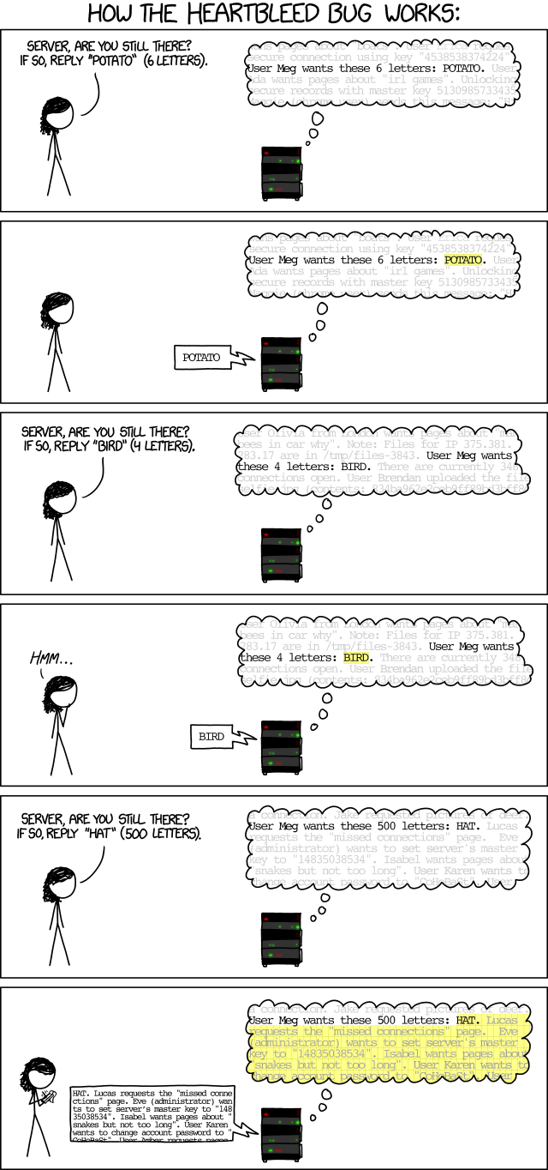
Implementation …
http://xkcd.com/1354/

Slide 9
Crash Course in Cryptography
Hashing
One-way transformation of data into a fingerprint of fixed size
Similar (but different) inputs have completely different hashes
Various applications
  Integrity verification, passwords, security tokens, …
6a d9 06 82 71 cc 73 75 11 63 85 ed c0 f1 b8 10 1f 5d 2f 4f 02 b4 97 6b be 13 36 cc 81 77 c7 f9 28 e8 93 5d 8b 79 dc 6e 8a f0 13 28 27 21 8a b2
84 bd 31 5b 82 05 ...
D0F297FE42

Slide 10
Crash Course in Cryptography
Hash Functions
MD4, MD5, SHA1
  Obsolete algorithms, still applicable for some cases (e.g., deduplication)
SHA-256, SHA-512, … (SHA2)
  Quite old, but probably the most widely used hashing algorithm
SHA3-256, SHA3-512, …
  New revision of SHA family, better than SHA2, but not widely used yet
bcrypt, scrypt
  Specifically designed to be computationally demanding (especially scrypt)
  More resistant to brute-force attacks (guessing the input)

Slide 11
HTTP Secure
Insert SSL/TLS layer between TCP and HTTP
SSL/TLS provides transparent asymmetric encryption
  X.509 Certificates are used
  Certificate carries the public and private key
  Certificate has additional info (e.g., a domain name)
  Every certificate must be signed by another certificate
    By a certificate of a trustworthy authority
    By itself (self-signed certificate)
  Certificate is verified, before its keys are used
  Usually only the server has a certificate

Slide 12



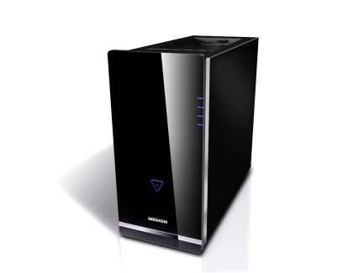
HTTP Secure
The SSL/TLS Handshake
Client verifies the certificate
TCP channel established
Certificate (without private key) is sent to the client
If the certificate is accepted, client finishes SSL/TLS handshake using public key to safely send data to the server
Client
(Browser)
Web Server

Slide 13
X.509 Certificates
Subject name (structured, Common Name = domain)
Issuer (also structured) – who created (and signed) the certificate
Validity (not before, not after)
Optional extensions (e.g., list of alternate domain names)
Certificate must be digitally signed by the issued
  Self-signed certificate (issuer = subject)
  Certificate chain
Well-known certificate
webik
TERENA
DigiCert Root CA

Slide 14
Security Fundamentals
Trusted Base
Secured server (physically), secured data storage, …
May be difficult to ensure (e.g., in Cloud)

Slide 15
Security Fundamentals
Secure Communication
HTTPS (or other encrypted channels) for all communications
  Including requests for unimportant things like styles or images
  Susceptible to common mistakes
  (especially when dealing with absolute URLs)
HTTP Strict Transport Security (HSTS)
  Strict-Transport-Security HTTP header instructs the client that given server must be accessed only by encrypted connections (for given period)

Slide 16
Security Fundamentals
Attack Prevention
Up-to date software (system, libs)
Due validation/sanitization of inputs/outputs
Secure session management
  HTTPS-only cookies, securing session storage or using security tokens, …
Second-level authentication and access denial systems
  Preventing the user to log-in from IP addresses from different countries
  Two phase authentication (e.g., secondary verification by cell phone)
Monitoring
  Attack detection, blacklisting (users, IPs), …
Logging

Slide 17
Security Fundamentals
Authentication
Verifies identity of a user
  E.g., by user credentials, by a certificate, …
User identity must be held despite statelessness
  In a (secured) session, in a cookie, …
Password security
  Password should not be stored in plain text nor in decryptable form in the database, but rather hashed
    <salt>,hashfnc(<salt>,<password>)
    The hashfnc could be SHA-256, SHA-512, bcrypt, scrypt, …
  Salt is necessary to prevent rainbow-table attacks
    Also, to assign different hashes to same passwords used by different users
Notes:
Note that even comparing strings with password hashes must be done in a secure way (it must take a constant time, or a random time delay has to be issued). Otherwise, a timing attack can be conducted.

Slide 18
EXAMPLE
Authentication in PHP
class User {
private $passwordHash;
public function setPassword(string $password): void
{
$this->passwordHash = password_hash($password,
PASSWORD_BCRYPT, [ 'cost' => 12 ]);
}
public function verifyPassword(string $password): bool
{
return password_verify($password, $this->passwordHash);
}
}

Slide 19
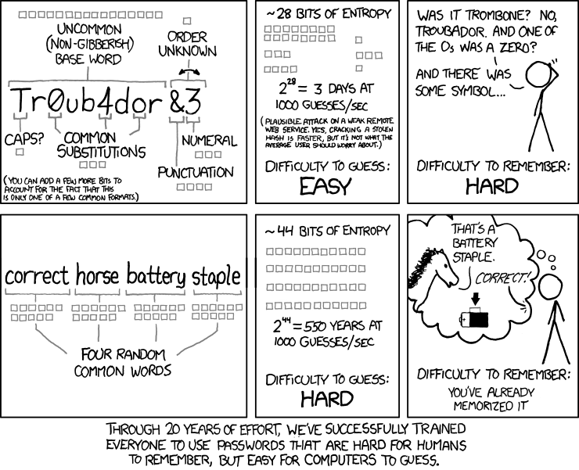
Password Strength
http://xkcd.com/936/

Slide 20
Authentication Tokens
Generated once the user is authenticated
  Or to grant some specific action – e.g., password reset
Does not have to be private, but only server can create/verify them
Example of a security token
  user_id:salt:hash(user_id:salt:secret)
  Where secret is a string known only to the server
Token may hold additional public data (payload)
  Expiration timestamp
  Creation timestamp
  Scope – restrictions on actions that the user may do

Slide 21
Authentication Tokens
Example
{ "alg": "HS256", "typ": "JWT" }
{
"sub": "1234567890",
"name": "John Doe",
"iat": 1516239022
}
eyJhbGciOiJIUzI1NiIsInR5cCI6IkpXVCJ9.eyJzdWIiOiIxMjM0NTY3ODkwIiwibmFtZSI6IkpvaG4gRG9lIiwiaWF0IjoxNTE2MjM5MDIyfQ.XbPfbIHMI6arZ3Y922BhjWgQzWXcXNrz0ogtVhfEd2o
HMACSHA256 (
base64UrlEncode(header) + "." +
base64UrlEncode(payload),
secret
)
https://jwt.io/

Slide 22
Authorization
Verification of the access permissions of the user
Security Model
  Defines protected objects, authorities, operations
  Simple (state-less) models
  Function (object, authority, operation) -> yes/no
  More complex models exist
  Typically implemented in one class (component)
Roles
  Authorities are typically not individual users, but roles
  Each user have one (or multiple) roles

Slide 23
Authorization
Security Models Examples
Directory (Capability List)
  Authorities have lists of accessible objects
Access List (ACL)
  Protected objects have lists of users (+permissions)
Access Control Matrix
  Rows ~ authorities, cols ~ objects, items ~ access rights
Bell-LaPadula (BLP)
  Each authority has maximal level of access, each object has minimal required level of access
Notes:
Note that mentioned models all employ conservative approach – permissions are explicit, denials are implicit (everything that is not allowed is denied).

Slide 24
Example
Access Control List (ACL)
authorizator:
setup:
- addRole('user')
- addRole('editor', 'user')
- addRole('admin', 'editor')
- addResource('Homepage')
- addResource('Archive')
- addResource('Users')
- allow('user', 'Homepage', 'default’)
- allow('user', 'Users', 'default')
- allow('user', 'Users', 'show')
- allow('editor', 'Users', 'show-private’)
- allow('editor', 'Archive', 'edit')
- allow('editor', 'Archive', 'delete')
- allow('admin')
Authorities (roles)
Protected objects (resources) corresponds to controllers here
List of all access privileges (what is not explicitly allowed, is denied)
Admin is allowed everything
Notes:
The example is in Neon syntax (similar to Yaml), which is often used for configurations.

Slide 25
Authorization
Frontend (UI) vs Backend (REST API/CLI)
Permissions are primarily tested in backend
User interface appearance should be in sync with operations the
user is authorized to do
Example – editing an e-shop item
  Users who do not have the permission to edit should not see the link leading to the page with editing form
  What if the user gets to the page another way?
  What if the user switches the role in the middle of editing?
  How to reveal these permissions to the UI without compromising security?
  What if the permissions change in the middle of editing?
Notes:
These questions cannot be easily answered in general, but you have to ask them again when designing security (authorization model) for your application.

Slide 26
MONITORING
Logging Important Events
  Errors
  Security breaches
    Difficult how to detect them and what to log
  All user actions
    May be impossible for large systems, so at least “important” actions
    Logging at request level
    Logging at database level (DB triggers)
Notes:
Delayed Operations : Soft-deletes , Queued operations

Slide 27
takeaway
HTTPS
X.509 Certificates

