Slide 1
NSWI142
Web Applications Fundamentals and Server-side Technologies
special thanks to Martin Kruliš

Slide 2
Model Example
HTML document validation
User submits document(s), application reports errors
Details to consider number of documents, editing, real-time feedback, …
Batch Application
Graphical User Interface Desktop Application
Web Application (CGI/MPA, SPA, ..)

Slide 3
Applications
There are many type of applications…
Batch applications (command-line interface)
Traditional desktop applications (GUI interface)
Web applications (client-server architecture)
Mobile applications, cloud applications, services, scripts, …

Slide 4


Applications
Batch Applications with Command-line Interface
input
(HTML)
processing (validation)
output
(errors)
file
main memory
file
?
Notes:
Since HTTP is text-based protocol we could employ batch application to run our websites.

Slide 5
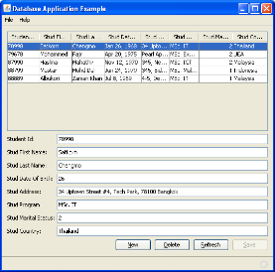
Applications
Graphical User Interface Desktop Applications
Input data are kept in memory – so additional features may be implemented (editing, revalidation better visualization, …)
continuous interaction
event loop
main memory
file
input
(HTML)
processing (validation)
output
(errors)
file

Slide 6
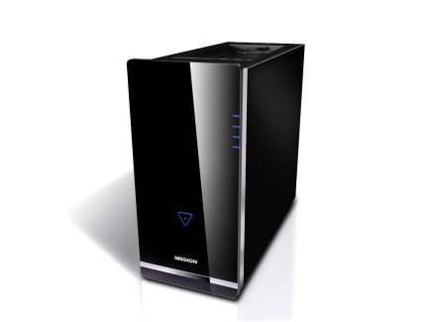
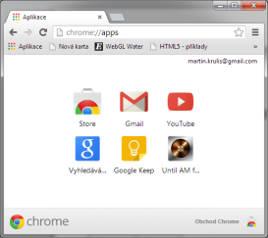


Web Applications
Two interconnected applications - client (GUI) and server (batch CLI).
event loop
Client
Browser
Potential source of many errors
Server App
Web Server
file
file
input
main
memory
(HTML, DOM)
input
main
memory
Internet
processing
processing
output
output
cookies, local storage
Each request is separate batch process
Database
Module
Notes:
This is general view; we can specify this based on the implementation.

Slide 7
Web Applications
Traditional (CGI-like) / Multi-Page Web Applications
HTML visualization,
handling standard controls (e.g., forms)
event loop
Clicking on a hyperlink, submitting a form
Client
Browser
Server App
Web Server
file
main
memory
(HTML, DOM)
input
main
memory
Internet
processing
output
Generated HTML document representing a new state
Database
Module
Notes:
Our example with validation of HTML document will go as follows: user submits a form (which contains the input file), the server validates the file and format the outputs (errors) in a HTML document which is subsequently sent back. I.e., it is very similar to CLI batch applications, but the role of the command line is taken by browser and standard HTML controls.
The idea is to simplify the client side and keep our login at the server side. This is the older approach, now known also as multi-page applications. Think back where we have only HTML.
CGI - Common Gateway Interface

Slide 8
Web Applications
Single Page Web Applications
event loop
JS implementing most of business logic
Client
Browser
Fetching/updating data
Server App
(REST API)
Web Server
file
input
main
memory
(HTML, DOM)
AJAX
requests
input
main
memory
Internet
processing
processing
output
output
cookies, local storage
Data requested by client (e.g. in JSON)
Slightly smarter database interface
Database
Module
Notes:
Our example with validation of HTML document will go as follows: user passes a file into the browser interface; JS loads the file in browser’s memory. JS initiates AJAX (background) HTTP request sending data for validation and receives JSON structure with all reported errors. JS takes the results and updates the DOM to visualize the results.
Actually, there are many other ways how to do this. E.g., file is uploaded to the server first and client gets unique file ID. After that a separate AJAX request starts async validation on previously uploaded file. After that, the client starts polling periodically the server until the results are available (and when they are, the server sends them back).
Here we move some logic to the client side, to improve user experience.

Slide 9
Web Applications
Hybrid Web Applications
Many shades of gray in between MPA (traditional) and SPA web applications
E.g., traditional web application may perform AJAX requests for some selected simple operations
Often the case of legacy applications maintained for a long time
Overlapping with Other Applications (see NSWI153)
Mobile Applications
Cloud services may replace some server functions
Databases, file storages, computing complex tasks asynchronously
Native applications (Electron, ..)

Slide 10
Application State

Slide 11
Application State
What state do we have ?
Where is the state stored ?
Who is responsible for state management?
Should the state be persistent? If so for how long?
Browser
file
input
main
memory
(HTML, DOM)
input
main
memory
Internet
processing
processing
output
output
Database
Module
Notes:
The state is the main core of application; besides states we have only actions or some UI rendering. That is mostly one directional. The way to modify state is using actions. This pattern is optional, yet we may see it later in out applications as it make dealing with state much easier.
Since we have effectively two applications, there is a lot of issues when it comes to state.

Slide 12
Application State
Logical and UI State
Focus, mouse cursor location
Component Micro-States
Open-selection of a control box, …
Scroll location
Values filled in form controls
Which application screen is visible
Work in progress in an open transaction
Handled in HTML/CSS (i.e., by browser) or with little help from JavaScript.
Notes:
Scroll location can be issue when moving back and forth.

Slide 13
Application State
User Interface State
Selected screen
User transaction progress
User login
…
Handled using URL, Cookies, Sessions, IndexedDB, LocalStorage, …
Notes:
Not all on the client side, for example sessions are on a server side.

Slide 14
Application State
Business Logic State, Complex UI States
Modifications in an opened data file
Content of a shopping card
Handled per-user using application files or database

Slide 15


Web Application State
Database, Files,
Session storage
Traditional (CGI-like) Web Applications
URL
Cookies
(POST Data)
Application
State
Browser
Application
State
Check integrity
Event
Batch-like processing
Browsing,
submitting form
Processing
Script
Memory
New
State
Serialization/deserialization, encoding, …

Slide 16
Demo
Application state

Slide 17
Web Server

Slide 18
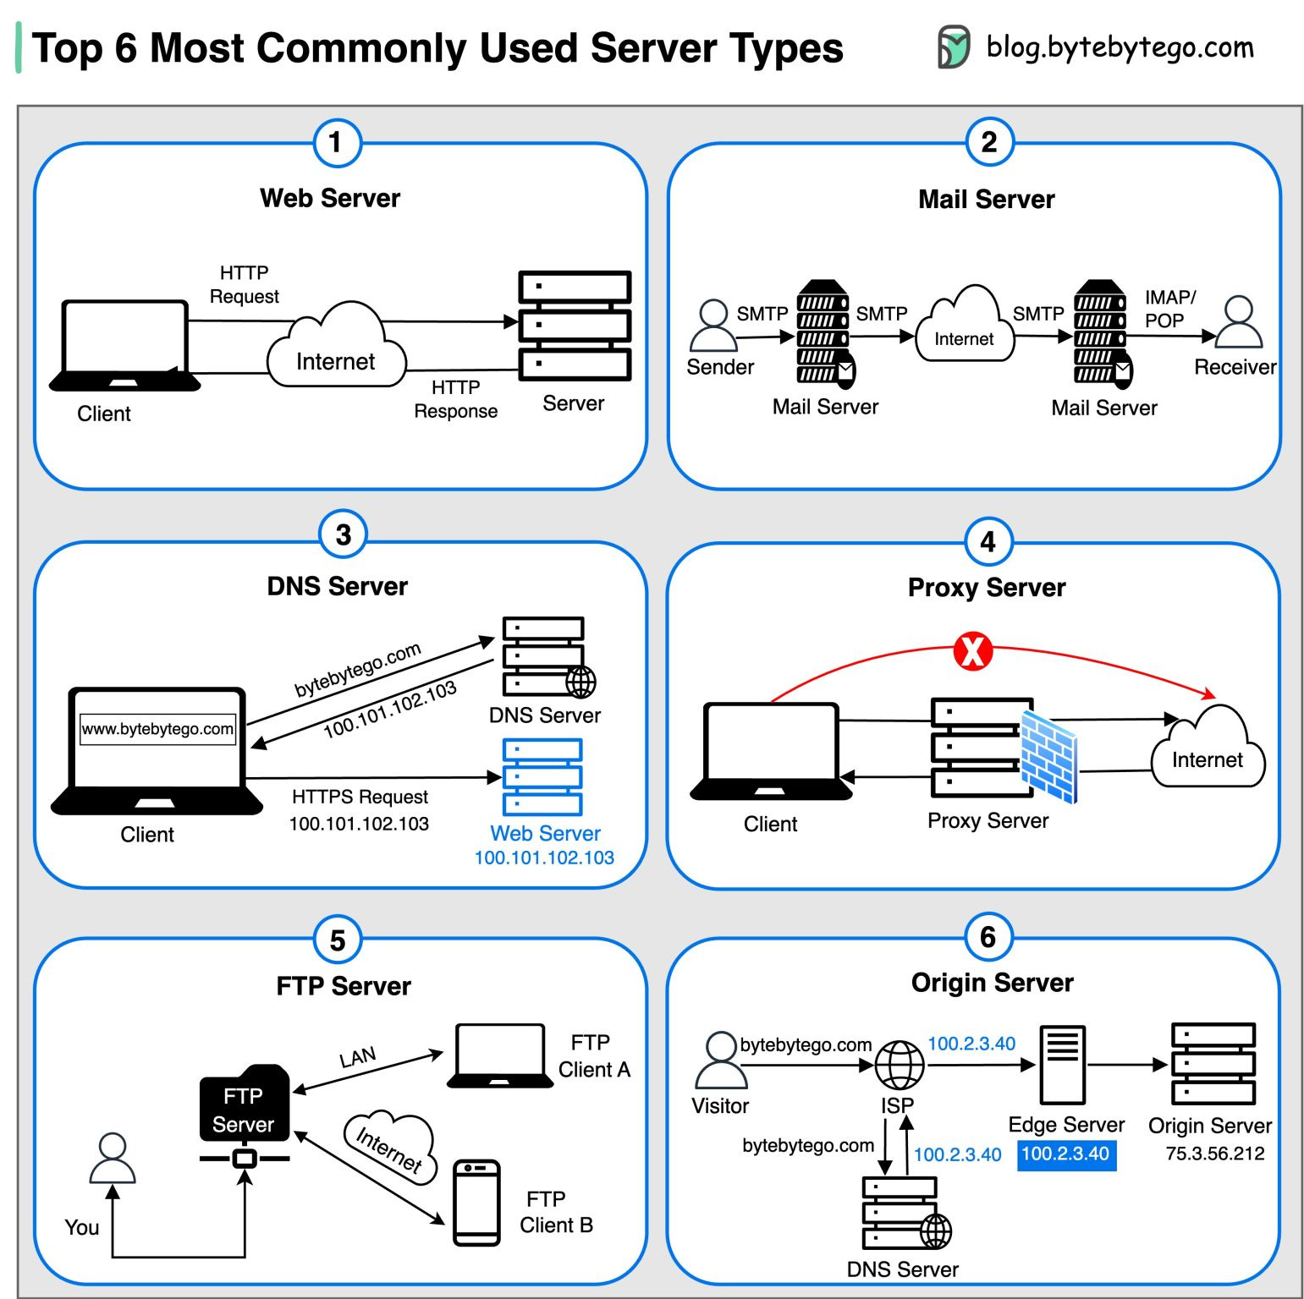
What is a Server?
Mail Server
Handles sending, receiving, and routing of emails across networks.
DNS Server
Translates domain names into IP addresses.
Web Server
Hosts websites and deliver web content over a network.
Examples: Apache, NginX, …
See NSWI153 for more …
From 2023-07-24
Notes:
Proxy Server: An intermediary server that acts as a gateway between clients and other servers, providing additional security, performance optimization, and anonymity.
FTP Server: Facilitates the transfer of files between clients and servers over a network
Origin Server: Hosts central source of content that is cached and distributed to edge servers for faster delivery to end users.

Slide 19



Web Server
Serving Static Pages
Apache configuration
HTTP Request
GET /myweb/index.html
...
/var/www/myweb/
`
Internet
Client
Web Server
HTTP Response
HTTP/1.1 200 OK
Content-Length: 1019
Content-Type: text/html;
...
<contents of index.html>
index.html

Slide 20
Common Gateway Interface (CGI)
One of the first standards for generating dynamic web content
NSCA specification from 1993 how to invoke command line applications
  Current version CGI 1.1 (RFC 3875) from 2004
Specifies only the interface
  Application may be written in any language
  Important information and headers are set as environment variables,
  request body is directed to standard input
  Response is taken from the standard output
Notes:
Note that the server must be configured to recognize, when to execute CGI application and when to simply send back a requested file.

Slide 21

Web Server
Serving Dynamic Content
Apache configuration
HTTP Request
GET /myweb/app.cgi
...
/var/www/myweb/
`
Internet
stdin
Client
Web Server
stdout
app.cgi
HTTP Response
HTTP/1.1 200 OK
Content-Length: 1019
Content-Type: text/html;
...
<contents of index.html>
index.html
Notes:
Please note the security issues of such solution. If the web server is public, anyone in the world can make your server start a process. As a result, your CGI application has to be very secure, especially when dealing with inputs.

Slide 22
Scripting Languages
Scripting Languages for Web Applications
Benefits
  No compilation required
  Much faster deployment of applications
  Necessity at client-side
  Fashion trend in 90’
Drawbacks
  “Speed”
  Main concern of web applications was the speed of the network
  Second concern is the speed of the database
  PHP, Python, JavaScript, Ruby, Perl, …
Notes:
How do we code the dynamic websites?

Slide 23
Demo
BASH
Apache configuration:
<Directory /home/*/public_html/cgi-bin>
Options ExecCGI
SetHandler cgi-script
</Directory>
Removed: 2023/2024
Notes:
For Apache see https://httpd.apache.org/docs/2.4/howto/cgi.html

Slide 24
FastCGI
CGI Issues
Starting a process takes some system time
Each process handles exactly one request
Unable to keep session/shared data in memory
Fast CGI Improvement
Fast CGI server runs independently from web server
Keeps the process pool, resources, …
Communicates with web server via socket/TCP
Multi-request processing may be achieved by multiplexing or multiple connections (or both)
Notes:
The objective is to decrease the resources used to communicate between the web server and the CGI application. CGI applications may be created at startup or on demand. The application remain running after handling the connection.
Resources:
https://fastcgi-archives.github.io/FastCGI_A_High-Performance_Web_Server_Interface_FastCGI.html

Slide 25


Web Server
FastCGI
NginX configuration:
fastcgi_pass unix:/var/run/php/php7.4-fpm.sock;
HTTP Request
GET /myweb/app.cgi
...
`
Internet
Client
Web Server
FastCGI Server
HTTP Response
HTTP/1.1 200 OK
Content-Length: 1019
Content-Type: text/html;
...
<contents of index.html>
index.html
Notes:
Notice there is no change in the interface from the client perspective.
For Apache we have mod_fcgid module.
Example is PHP in NginX. The server would be PHP FPM.
Resources:
https://httpd.apache.org/mod_fcgid/
https://www.nginx.com/resources/wiki/start/topics/examples/phpfcgi/
https://www.php.net/manual/en/install.fpm.php
https://www.digitalocean.com/community/tutorials/understanding-and-implementing-fastcgi-proxying-in-nginx

Slide 26
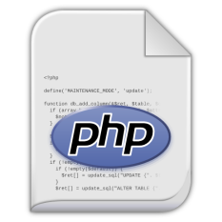
Web Server
Integrating Scripting Modules
Apache configuration
HTTP Request
GET /myweb/index.php
...
/var/www/myweb/
`
Internet
mod_php
Client
Web Server
HTTP Response
HTTP/1.1 200 OK
Content-Length: 1019
Content-Type: text/html;
...
<contents of index.html>
index.php
index.html
Notes:
The PHP interpreter is not an external process, and they can thus communicate better.
This one is no longer recommended, we have php-fpm that can also run multiple PHP versions at the same time.
At the end we have two options, we use it another server (external) or try to embedded into the web server. The first option is forced by NginX and is gaining more traction.
Resources:
https://cwiki.apache.org/confluence/display/HTTPD/PHP
https://www.geeksforgeeks.org/how-to-install-apache-with-php-fpm-on-ubuntu

Slide 27
DEMO
python-wsgi
source code
Apache configuration:
WSGISCriptAlias /python /home/…/python-script.wsgi
Removed: 2023/2024
Notes:
There are other alternatives to using Apache.
Resources:
https://modwsgi.readthedocs.io/en/master/
https://www.fullstackpython.com/wsgi-servers.html

Slide 28

Web Server
Integrated Web Server
Dedicated Web Server for an Application
HTTP Request
GET /myweb/index
...
`
Web Server
Module
Proxy Server
Client
HTTP Response
HTTP/1.1 200 OK
Content-Length: 1984
Content-Type: text/html;
...
<contents generated by app>
Database
Module
Handles static pages, proxies requests for web app(s)

Slide 29
Can I use My language?

Slide 30
PYTHON
WSGI
Web Server Gateway Interface
Universal interface between web servers and web applications designed for the Python language
Interface is called WSGI middleware, and it is implemented by both sides
(server and application)
Other languages have they're with similar API:
Rack (Ruby), PSGI (Perl), JSGI (JavaScript), SAPI (PHP)
Selected features:
  Routing requests to application objects (by URL)
  Multiple applications may run in one process
  Load balancing (remote processing, forwarding, …)

Slide 31
Python
Flask
  WSGI micro framework
  Web server included (for development)
  Suitable for small REST APIs
Django
  Complex web framework
  MTV (Model-Template-View) pattern
  Can be deployed via WSGI or using integrated server
….
Notes:
Using the WSGI interface may not be a pleasant experience we have frameworks; they may make our live easier.

Slide 32
ASP.NET
Microsoft solution built on .NET platform
Supports all .NET languages (C#, VB, …)
Successor to Microsoft’s Active Server Pages
Now with .NET Core available on multiple platforms
Keywrods:
  ASP.NET WebForms
  ASP.NET MVC
  ASP.NET Web Pages (Razor Pages)
  ASP.NET Single Page Applications
Razor syntax for interleaving HTML with executive code
  Block starts with @ and does not require explicit closing

Slide 33
ASP.NET
ASP.NET WebForms
  Event-based model, events may be processed at server
  The forms automatically serializes the whole state
  The idea is to design web pages in the same manner as desktop applications
  Visual designer with set of server components
ASP.NET MVC
  Default view engine is either Razor (.cshtml, .vbhtml), or Web Forms (.aspx).
  More control over HTML.
  Controllers are .NET classes, methods are actions
  Routers select controller class and invoke an action
…

Slide 34
JSP
Java Server Pages
Java-based solution for dynamic web pages
Requires web server with servlet container
  Apache Tomcat, Jetty, …
Supports both “simple” HTML interleaving approach and MVC
  Uses <%, %> marks for scriptlets inside HTML
  MVC usually uses JavaBeans as the model and Java servlets as the controller
Java compilation
  Compiler is integrated in the web server and compiles the page when first needed (or when changed)
JSP is (almost) dead…
Notes:
There are also other efforts to employ Java for web pages. For instance, the Google Web Toolkit (http://www.gwtproject.org/) is a framework that allows you to design the whole web application as a Java application. It compiles the client-side parts of the code into JavaScript and automatically handlers the client-server communication.

Slide 35
JAVA
Spring MVC
Spring boot
JSF
Vaadin
Play 1, Play 2
Struts 1, Struts 2
GWT
Grails
Wicket
…
Notes:
Resources:
http://zeroturnaround.com/rebellabs/java-tools-and-technologies-landscape-2016/
http://zeroturnaround.com/rebellabs/the-curious-coders-java-web-frameworks-comparison-spring-mvc-grails-vaadin-gwt-wicket-play-struts-and-jsf/

Slide 36
Ruby on Rails
Ruby scripting language + Rails web framework
Basic philosophy
  DRY (Don’t Repeat Yourself) – avoid code duplication
  Convention Over Configuration – our way is the “best”
Very strict style of application development
Improves efficiency, but ties your hands
Specific structure of the application
  Reflects the MVC pattern
  $> rails new myapp
  Generates new application structure in ./myapp

Slide 37
Node.js
JavaScript Server-side Platform
Basically, a Google V8 JavaScript engine compiled as CLI script interpreter
V8 is used in Chrome, and it is the fastest JS interpreter
Contains many pre-built packages for server-side application development (sockets, HTTP, …)
HTTP server is embedded in the application, so the programmer may tune it for specific needs
Aims for fast developed single-language solutions
Using JavaScript on client and server allows some level of code sharing

Slide 38
Demo
Node.js Server

Slide 39
PHP
Coming soon …

Slide 40
Web Programming Languages Usage
Removed: 2022/2023
Notes:
https://w3techs.com/technologies/overview/programming_language/all

Slide 41
takeaway
CGI-like Web Applications & Multi-Page Applications
Single-Page Applications
Application State
CGI / WSGI / … interface
Integrated Web Server

