Slide 1
NSWI142
API & Design Patterns
special thanks to Martin Kruliš

Slide 2
Application Development Software Engineering Approach
Analysis
Gathering/anticipating user requirements
Pay extra attention to scaling problems
Development
Use appropriate scope
Trivial custom PHP for trivial applications, robust frameworks and design patterns for complex applications
Testing
User/Application Testing (e.g., Selenium)
Unit testing (e.g., PHPUnit)
Continuous Integration (e.g., Travis CI, GitHub Actions)

Slide 3
Application Development Software Engineering Approach
Introduction to Software Engineering (NSWI041)
Software Engineering in Practice (NSWI149)
Software System Architectures (NSWI130)
Advanced aspects of software engineering (NSWI026)
Software Testing (NTIN070)
Design Patterns (NPRG024)
Software Development Tools (NSWI154)
Advanced Tools for Software Development and Monitoring (NSWI126)
Recommended Programming Practices (NPRG043)
…

Slide 4
Design Patterns
Impact of design patterns on software quality: a systematic literature review
Published: 01 February 2020
Design patterns represent solutions to frequently occurring software problems for designing good quality software.
…
23 design patterns called gang of four (GoF) patterns. GoF design patterns are classified into three categories: structural, creational, and behavioral patterns.
Notes:
creational - factory, builder, singleton, …
structural - adapter, proxy, façade, …
behavioral - command, visitor, observer, memento, …
Resource:
https://memegenerator.net/instance/51707203/dog-scientist-science-in-progress-do-not-disturb
https://martinfowler.com/eaaCatalog/
https://sourcemaking.com/design_patterns
https://www.geeksforgeeks.org/software-design-patterns/

Slide 5
Model-View-Controller

Slide 6
Model-View-Controller
A guideline how to divide code and responsibility
Basis for many frameworks
Model
Uniform data API
View
User interface
Controller
Process requests
Business logic
Notes:
We will discuss each of them in more detail later.

Slide 7
Model-view-controller
Presentation Tier
Business Logic
Data Tier
Controller
Prepares
Manipulates
View
Load data from
Model
Notes:
Data flow from view to controller because of user action, view can load data from model.
Controller issues commands to view and model.
Controller – entry point, invoked by dispatcher.
Model – data manipulation
View – presenting HTML, JSON, XML, …

Slide 8
Model-View-Controller
Presentation Tier
Business Logic
Data Tier
Controller
Database
View
Model
Invoking actions
Dataflow
Removed: 2022/2023

Slide 9
Model-View-Controller VIEW
User interface, data presentation
Typically, responsible for generating HTML
Automatic sanitization of presented data (<,> chars)
Translations for multilingual applications
Templates
Mechanisms that separate HTML coding from application programming
Allow implementing View features (mentioned above) in declarative (instead of imperative) manner

Slide 10
Model-View-Controller Controller
Integrates business (application) logic
Issues commands to view and model
Process user requests
Requests for displaying content (typically GET request)
Requests for modifying app. status (typically POST req.)
Combine well with other design patterns
Front controller, command, …
Alternatives
Model-View-Presenter (separate Model and View)
Model-View-ViewModel
…
Notes:
Model implementation.

Slide 11
Controller/Presenter Example
class EditPresenter extends BasePresenter
{
public function actionShowEditForm(string $id)
{
// Get data
$object = $this->model->getItem($id);
// Prepare view, no direct communication between view and model.
if ($object !== null) {
$this->view->setArg('id', $id);
$this->view->setArg('editedObject', $object);
}
// Render view
$this->view->render();
}
}
Notes:
The separation of view and model is not clearly defined. Some claim that view can read data from model, some that it can read data from controller, some that the controller/presenter is responsible for providing the data.

Slide 12
Model-View-Controller MODEL
Direct SQL writing is “inconvenient” Better to use some data abstraction layer
Object-relational Mapping (ORM)
….
Notes:
Model implementation, there are alternatives. The objective is to provide access to data.
We talk about ORM later.

Slide 13
Database
Notes:
You may not need database!

Slide 14
database
MySQLi
Database Abstraction Layers ….
Advanced Programming of Web Applications - NSWI153
Notes:
Source:
https://www.php.net/manual/en/book.pdo.php
https://github.com/dg/dibi

Slide 15
Data model
Allows you express data entities naturally
Customer, Product, Order, …
Offers benefits like inheritance
Customer, Seller, Admin ~ User
Promotes encapsulation
Well defined interface
Hides the details of actual data representation/storage
Much more readable
Self documented code
Decorated with doc comments
Object persistence
Explicit way to flush objects to persistent storage
Object relations
Like database relations (1:1, 1:N, …)
Notes:
Object oriented approach, we are getting away from SQL.

Slide 16
Object-relational Mapping
Technique which creates object-oriented API over (relational) database
Much simpler for the programmer (no need for SQL) and less error prone (no SQL).
Object-relational impedance mismatch
How to save objects into database?
Mapping IS-A hierarchy, private members, references, …
Advanced Programming of Web Applications - NSWI153
Notes:
Source of truth – most in code.
Doctrine has been downloaded a total of 2,840,976,957 times as of early 2022.
With Doctrine you can still use your own query and just load result into objects, it has query builder, or limited query language.
Source: https://www.doctrine-project.org/

Slide 17
Doctrine Example
/** @Entity @Table(name="subjects") **/
class Lecture
{
/** @Id @Column(type="integer") @GeneratedValue **/
protected $id;
/** @Column(type="string") **/
protected $fullname;
/** @ManyToOne(targetEntity="User", inversedBy="teach_lectures") **/
protected $teacher;
...
public function getDescriptionString() { ... }
public function getStudents() { ... }
}
Advanced Programming of Web Applications - NSWI153
Notes:
Just for reference – lazy and eager loading.
Resource:
http://www.doctrine-project.org/

Slide 18
Doctrine Example
$entityManager = EntityManager::create($conn, $config);
$subj = $entityManager->find('Lecture', (int)$id); // Get record
$subj->setName('Web Applications’); // Modify record
$entityManager->flush(); // Save changes to database
// PHP Magic incoming ..
$subjs = $entityManager->getRepository('Lecture’)->findBy([ 'programme' => 'I2' ]);
foreach ($subjs as $subj) {
print($subj->getDescriptionString());
foreach ($subj->getStudents() as $student) {
...
}
}
Advanced Programming of Web Applications - NSWI153

Slide 19
Components
Notes:
Where do we get the $entityManager ? Question: What are components?

Slide 20
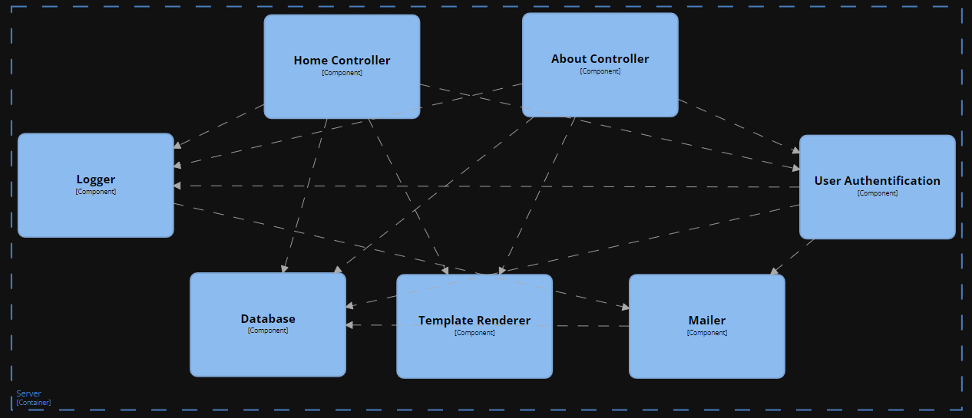
Components Example

Slide 21
Components Component-based Development
Modern applications use components to promote encapsulation and separation of concerns
Component - a software module that provides some functionality through a well-defined interface
Typically, a class that implements an interface (in the code terminology)
Possibly a façade for a small set of classes
Component may depend on other components
Typically declares a list of (code) interfaces
Dependencies must be satisfied by providing components that implement given interfaces (allows some level of modularity)

Slide 22
Components Component Management
Creation and interlinking may be tedious
Who creates components?
When are the components created?
Where is the component configuration?
How do one component find other components it needs to use?
What about different implementations of the same component “types”?
…

Slide 23
Components Container Dependency
class Controller {
public function action() { $log = …? }
}
Controller Requires a Log
Create on demand
Log is a singleton
Log is looked up/created by a registry
$log = new Log();
Multiple instances of log are created!
$log = Log::getInstance();
Implementation bound
$log = Registry::get('Log');
Better, but tedious ..

Slide 24
Dependency Injection
Design pattern that implements inversion of control
Component is not responsible for seeking its own dependencies
Dependencies are injected externally (by the component manager)
Declaring required dependencies
In configuration, by annotations, using reflection, …
The problem of cyclic dependencies
DB component requires Log component to log errors
Log component requires DB component to save messages
Central Component Manager
Responsible for creating and initializing components

Slide 25
Dependency Injection EXAMPLE
/**
* @component WelcomePage
*/
class WelcomePageController implements IController
{
/** @inject IDatabase */
public $db;
/** @inject name="NewsService" */
public $news;
function __construct(ILog $log) { ... }
}
Component naming convention
Annotations (inject by interface)
Annotations (inject by name)
Constructor injection (by type hinting)
Advanced Programming of Web Applications - NSWI153
Notes:
Note that injectable properties are public.
Both injectable properties and constructor parameters are legitimate ways how to implement DI not only in PHP.
The properties are slightly less error prone as they violate OOP encapsulation; however, unlike constructor parameters, the properties can be used even in cases where cyclic dependencies are detected.
FYI: This is just an example, how the injection can work. The example was influenced by Nette framework.

Slide 26
Representational State Transfer (REST)

Slide 27
REST API
Server API which offers retrieval and manipulation with application resources in a HTTP-compliant way
Resources are identified by URIs
Operations are performed by HTTP requests
REST formal constraints are
Client-server model
Stateless interface (no client context is cached at server)
Cacheable (response defines whether it can be cached)
Uniform interface
Layered system (proxies, servers may be replicated)
Roy T. Fielding , Dissertation, Doctor of Philosophy 2000 : Architectural Styles and the Design of Network-based Software Architectures
Notes:
Applications that conform to REST constraints, are typically called “RESTful”.

Slide 28
REST API
HTTP request methods reflect desired operations
GET – retrieve the resource (nullipotent)
POST – append new sub-entity in the resource
PUT – insert/replace the resource (idempotent)
DELETE – remove the resource (idempotent)

Slide 29
REST API EXAMPLE
 | /gallery (collection of galleries) | /gallery/kittens (photos in gallery) | /gallery/kittens/kitten01 (single photo)
GET | Get the list of all galleries (JSON) | Get the list of photos in the gallery (JSON) | Get the image (jpeg)
POST | Create a new gallery | Create a new photo in a gallery | Atypical. Add image metadata…
PUT | Atypical. Replace list of galleries. | Replace entire list of photos in gallery | Replace/insert an image (of given ID)
DELETE | Empty the whole application | Remove all photos of a gallery | Remove the given image

Slide 30
REST API
Advanced Programming of Web Applications - NSWI153
Notes:
Resource:
https://martinfowler.com/articles/richardsonMaturityModel.html

Slide 31
Trends

Slide 32
Trends Single Page Applications
The application logic runs in the browser
Provides more desktop-like user experience
HTTP requests are handled asynchronously (and covertly)
Traditional browsing is typically discouraged
Handled internally by changing DOM dynamically
Thin server architecture
Data storage, security verifications, HTTP API
Disadvantages
Application boot - loading and initialization time
Less stable execution environment (many browser types)
SEO, scraping, size, ..
Advanced Programming of Web Applications - NSWI153

Slide 33
Trends Micro Frontends
Website or web applications as a composition of features
Independent teams
Distinct area of business
A team is cross functional and develops its features end-to-end
Advanced Programming of Web Applications - NSWI153
Notes:
Single Pace Application vs Frontend Monolith
https://micro-frontends.org/

Slide 34
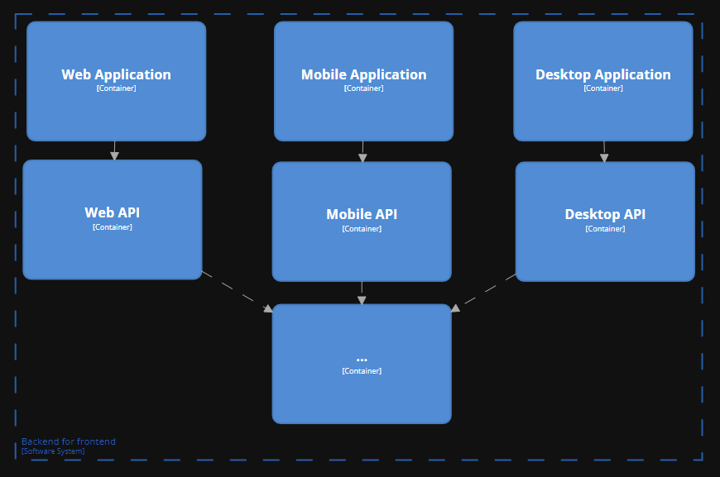
Trends backend for frontend
Removed: 2022/2023

Slide 35
takeaway
Model-View-Controller pattern
Object-Relation Mapping
Component-Based Development
REST API
Advanced Programming of Web Applications
NSWI153

