Slide 1
NSWI142
Security in Web Applications
special thanks to Martin Kruliš

Slide 2
Mathematics for Security
Notes:
We need this especially for web applications.
Resources:
https://www.youtube.com/watch?v=NuyzuNBFWxQ

Slide 3



Crash Course in Cryptography
Make communication (data storage, …) secure
Secure = not readable by 3rd parties, guaranteed to be correct, …
Alice
Bob
Eve (eavesdropper)
Notes:
eavesdropper - a person who listens to someone's private conversation without them knowing.

Slide 4
Symmetric Ciphers
Both sides need to share the same key
There must be another (secret channel) how they pass on the key
The key is used both for encryption and decryption
Algorithm highlight: Advanced Encryption Standard (AES)
Alice
Bob
Eve (eavesdropper)
Notes:
Small key (~256bits), fast.
AES: Probably the most popular cipher of the day. Can use any sequence of bytes as key. Keys are expanded into 128, 192, or 256bit blocks.

Slide 5
Advanced Encryption Standard (AES)
Probably the most popular cipher of the day
Can use any sequence of bytes as key
Keys are expanded into 128, 192, or 256bit blocks
Works with 4x4 blocks of bytes
Requires only basic operations (shift, add, xor, …)
…
Removed: 2022/2023
Notes:
Resources:
https://en.wikipedia.org/wiki/Advanced_Encryption_Standard

Slide 6
Asymmetric (Public-key) Ciphers
Separate encryption (public) and decryption (private) key
Does not require secure channel for transmitting the key
Algorithms highlight: Rivest–Shamir–Adleman (RSA)
Alice
Bob
Eve (eavesdropper)
Notes:
Public/private key (~2048 bits), slow.
Work only in one way.
RSA: Based on factorization principle.
Preparing the keys – public (𝑛,𝑒) and private (𝑛,𝑑)
…
Encryption 𝑐= $m^{e}$ mod 𝑛 (where 𝑚 is the message)
Decryption 𝑚= $c^{d}$ mod 𝑛

Slide 7

Rivest–Shamir–Adleman (RSA)
Based on factorization principle
  Which is believed to be extremely computationally demanding
  Relies on the absence of sufficiently powerful computing machine
Preparing the keys – public (𝑛,𝑒) and private (𝑛,𝑑)
…
Encryption 𝑐= $m^{e}$ mod 𝑛 (where 𝑚 is the message)
Decryption 𝑚= $c^{d}$ mod 𝑛
…
Concept of proof
$c^{d}≡{\left(m^{e}\right)}^{d}≡m^{ed} (mod n)$
Removed: 2022/2023

Slide 8
Hashing
One-way transformation of data into a fingerprint of fixed size
Similar (but different) inputs have completely different hashes
Various applications
  Integrity verification
  Passwords
  Security tokens,
  …
6a d9 06 82 71 cc 73 75 11 63 85 ed c0 f1 b8 10 1f 5d 2f 4f 02 b4 97 6b be 13 36 cc 81 77 c7 f9 28 e8 93 5d 8b 79 dc 6e 8a f0 13 28 27 21 8a b2
84 bd 31 5b 82 05 ...
D0F297FE42

Slide 9
Hash Functions
MD4, MD5, SHA1
  Obsolete algorithms, still applicable for some cases (e.g., deduplication)
SHA-256, SHA-512, … (SHA2)
  Quite old, but probably the most widely used hashing algorithm
SHA3-256, SHA3-512, …
  New revision of SHA family, better than SHA2, but not widely used yet
bcrypt, scrypt
  Specifically designed to be computationally demanding (especially scrypt)
  More resistant to brute-force attacks (guessing the input)
Argon2
  Winner of Password Hashing Competition in 2015
Notes:
Argon2 won in 2015, it has not been widely adopted, yet … here represent a new approach.
Resources:
https://github.com/p-h-c/phc-winner-argon2

Slide 10
Digital Signature
Reversed application of public-key cipher
Assumes the decryption/encryption procedures may be swapped
Sender transforms the message using decryption algorithm
(and private key)
Anyone can transform it back to original using encryption (and public key)
And everyone will know that only the person with the corresponding private key could have created the message

Slide 11
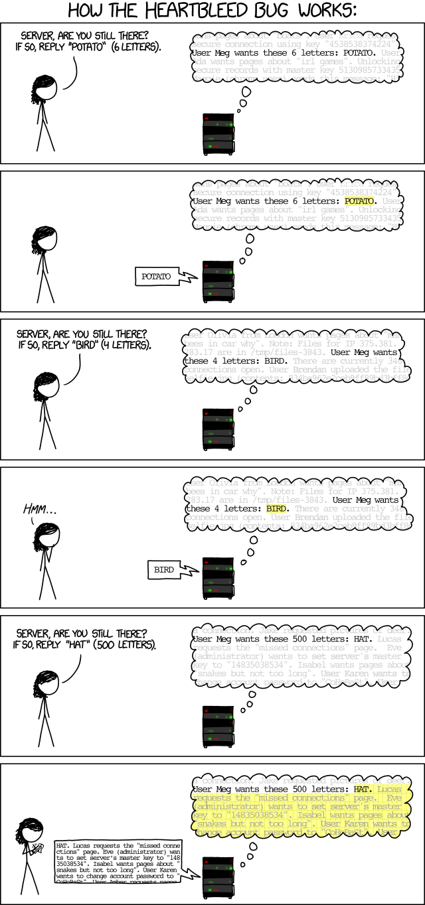
Implementation …
Even the best theoretical algorithms are vulnerable to implementation issues.
Notes:
Resources:
http://xkcd.com/1354/

Slide 12
HTTPS

Slide 13
HTTP Secure
Insert SSL/TLS layer between TCP and HTTP
SSL/TLS provides transparent asymmetric encryption
X.509 Certificates are used
  Certificate carries the public and private key
  Certificate has additional info (e.g., a domain name)
  Certificate is verified, before its keys are used
  Usually only the server has a certificate
Notes:
The process is described on following slides.
Resources:
https://www.ssllabs.com/ssltest/

Slide 14
DEMO
CERTIFICATE

Slide 15



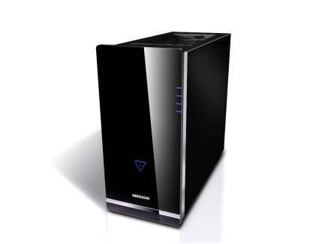
HTTP Secure
The SSL/TLS Handshake
Client verifies the certificate
TCP channel established
Certificate (without private key) is sent to the client
If the certificate is accepted, client finishes SSL/TLS handshake using public key to safely send data to the server
Client
(Browser)
Web Server

Slide 16
X.509 Certificates
Subject name (structured, Common Name = domain)
Issuer (also structured) – who created (and signed) the certificate
Validity (not before, not after)
Optional extensions (e.g., list of alternate domain names)
Certificate must be digitally signed by the issuer
  Self-signed certificate (issuer = subject)
  Certificate chain
Well-known certificate
(root CA)
webik
Let's Encrypt
Internet Security Research Group`

Slide 17
DEMO
Does my site need HTTPS?
Notes:
List of reasons why you should use HTTPS.
Including requests for unimportant things like styles or images.
Susceptible to common mistakes (especially when dealing with absolute URLs)
https://doesmysiteneedhttps.com/

Slide 18
HSTS
HTTP Strict Transport Security (HSTS)
Strict-Transport-Security HTTP header instructs the client that given server must be accessed only by encrypted connections (for given period).

Slide 19
Security

Slide 20
Demo
Bonus Points
Notes:
As a quick break, how could you get to the list?
Session hijacking – SID can be stored in URL, Hidden form or Cookie. Attack: Brute Force, XSS, Session fixation (login using fake website), read from communication for missing HTTPS,
https://webik.ms.mff.cuni.cz/~skoda/bonus-points.php

Slide 21
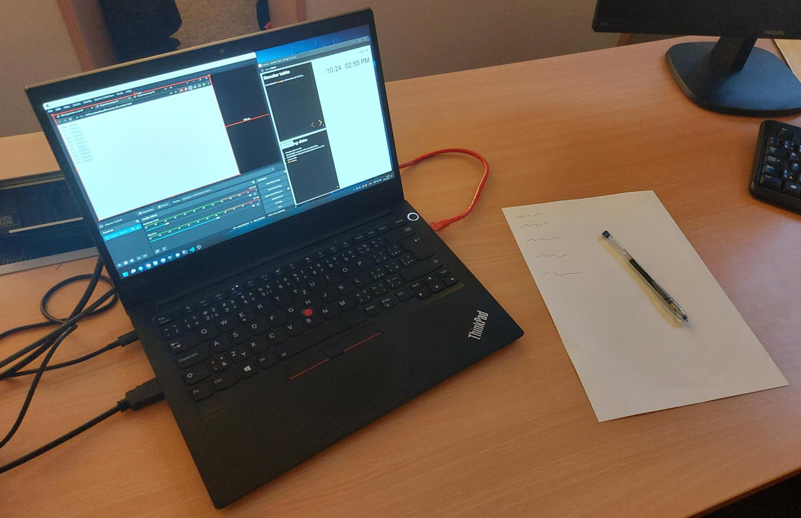
Common Security Vulnerabilities
Dedicated to our fellow colleagues ...
Notes:
Risks:
Documents
Un-locked computer
Any external devices
Network
Security is not only about your application!!!

Slide 22
Security in Web Application
…
…
Server
User
Client
DNS
XSS
Developer
Network
Trust
…
Hijack a user’s session
Infrastructure
Libraries
Hardware
Notes:
This is not a complete list by any means, just to start a discussion.
Trust - Do we trust the request coming from …. ?

Slide 23
Výkladový slovník
Kybernetické bezpečnosti (CS)
By AFCEA Czech, AFCEA International
Cyber security: Legal, organizational, technical and educational means aimed at ensuring the protection of cyber space.
Basic principles (interpretation, see link for definition):
  Confidentiality ~
  Only authorized persons can access information and systems.
  Integrity ~
  Information is complete and cannot be changed by unauthorized persons.
  Availability ~
  Authorized persons can access information and systems whenever needed.
Notes:
Principles are defined in the document, information here is an interpretation and does not match the definitions.

Slide 24
computer security threats
STRIDE Model
Spoofing
“pretend to be someone else”
Website spoofing
Mostly connected to phishing.
Domain name spoofing
DNS cache poisoning
…
Tampering
“harmful change in the data/system”
Repudiation
“associating actions with an individual”
Information disclosure
Privacy breach
GDPR, …
Data leak
Denial of Service
DoS attack
Yo-yo attack
…
Elevation of Privilege
Vertical privilege escalation
Horizontal privilege escalation
Notes:
How do we think about security? STRIDE is a model design to guide us when thinking about various security threads.
Overall security is complex and should enterprise-wide concern to address. Common issue is that security is hard to quantify and measure.
- Spoofing is also using another user’s credentials (username, password).
- DNS cache poisoning
A corrupt Domain Name System data is introduced into the DNS resolver's cache, causing the name server to return an incorrect result record. This allow to redirect traffic to attacker’s computer.
- Tempering aim at integrity. For example, change in database or data traveling over network. It can also include webpages.
- Repudiation – user may perform illegal operation that system fails to prevent, like developer delete data in database table. Better example is interaction with third party, to make sure that they perform certain action, or received certain data.
- Data leak includes any unauthorized activity with the data. May not be personal or structured data (documents, sensitive information}.
- DoS may include internal network, like flooding database server with TCP/IP packets.
- [NOT VERIFIED] With Yo-yo we force the host to scale-up resources to handle the demand, then scale down and up … draining financial resources. Requires less resources compare to DoS attack.
- Elevation of Privilege
- Vertical is user to admin.
- Horizontal is accessing resources/functionality of another user. Nice example is banking application.
Resource:
https://learn.microsoft.com/en-us/previous-versions/commerce-server/ee823878(v=cs.20)
https://en.wikipedia.org/wiki/STRIDE_(security)
https://en.wikipedia.org/wiki/DNS_spoofing
en.wikipedia.org/wiki/Information_privacy
https://www.tripwire.com/state-of-security/key-ot-cybersecurity-challenges-availability-integrity-confidentiality

Slide 25
Hardware / Infrastructure
Hardware
Secured
  Server (physically)
  Data storage
  Network
  …
May be difficult to ensure (e.g., in Cloud)
Software
Up-to date software (system, libs)
Notes:
Hardware may also include USB and other devices. Like replacing keyboard with key logger.
Meltdown and Specter
Resources:
https://meltdownattack.com/

Slide 26
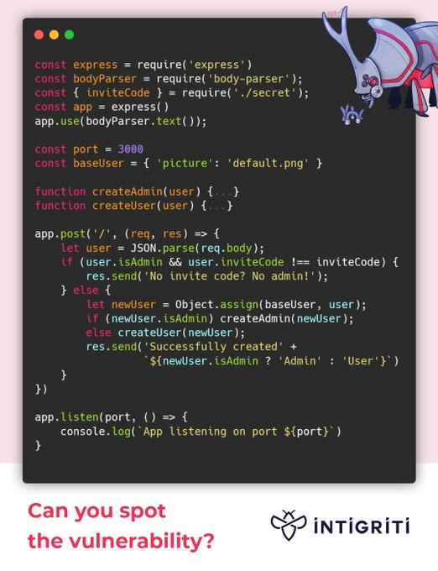
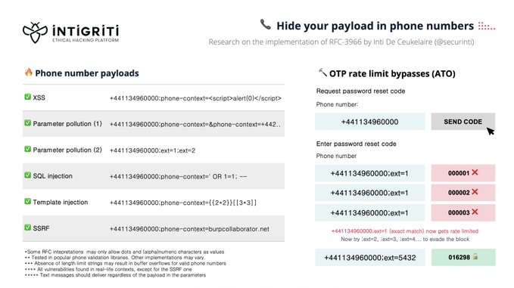
validation
Validation ~ data are consistent with expectations.
Do not sanitize invalid input data.
mysql_real_escape_string, vulnerable character sets
Client-side validation/sanitization provides zero value from security perspective.
COVID vaccination reservation system
Notes:
Any feedback on invalid data can be used by a malicious user. Special care must be exercised when error message contain user provided values. With attempt to sanitize input we get more room to attacker. Validation is a form of enforcing a contract with the user.
The reservation system use client only validation. As a result, the imposed age-based restriction could be easily bypassed.
All valid phone numbers based on RFC-3966.
In the right example we have Prototype Poisoning - req.body can contain __proto__ : { isAdmin: true }. In combination with JSON.parse and Object.assign, the if is evaluated to false and in else an admin is created.
This is like Mass assignment, more prevalent with PHP where we take user input from form and just put pairs of key/value into database using a framework. For both the solution is to manually enumerate and validate the values.
Resources:
https://shiflett.org/blog/2006/addslashes-versus-mysql-real-escape-string
https://stackoverflow.com/questions/5741187/sql-injection-that-gets-around-mysql-real-escape-string/12118602#12118602
https://www.linkedin.com/pulse/zaj%C3%ADm%C3%A1-v%C3%A1s-jak-ud%C4%9Blat-rezerva%C4%8Dn%C3%AD-syst%C3%A9m-kter%C3%BD-v-prvn%C3%AD-tom%C3%A1%C5%A1-herceg/?originalSubdomain=cz
https://twitter.com/intigriti
https://twitter.com/intigriti/status/1579799435772858369?s=20&t=yW3pdNtk3dBzNmIs6YC50g

Slide 27
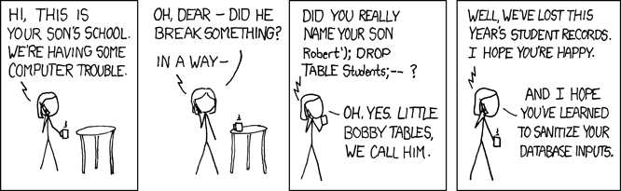
ATACK
SQL Injections
Notes:
This is true for every database not just SQL, even for NoSQL. In general, we should not build any query using string concatenation.
We also have GPT-3 injections.
Resources:
https://www.troyhunt.com/stored-procedures-and-orms-wont-save/
https://simonwillison.net/2022/Sep/12/prompt-injection/

Slide 28
sanitization
HTML is very permissive format.
Encoding contexts: HTML, JavaScript, JSON, CSV, …
Nested contexts : URL in JavaScript in HTML
Do NOT encode raw user input before storing it.
<p>The Honorable Justice Sandra Day O'Connor</p>
document.getElementById('name').innerText = 'Sandra Day O'Connor'
Notes:
Due to nature of HTML, it is easy to inject code into it. Browsers do their best to render the page even if it is not valid.
We can even end the command in the string and execute JS code. Similar to SQL injection.
Resources:
https://martinfowler.com/articles/web-security-basics.html

Slide 29
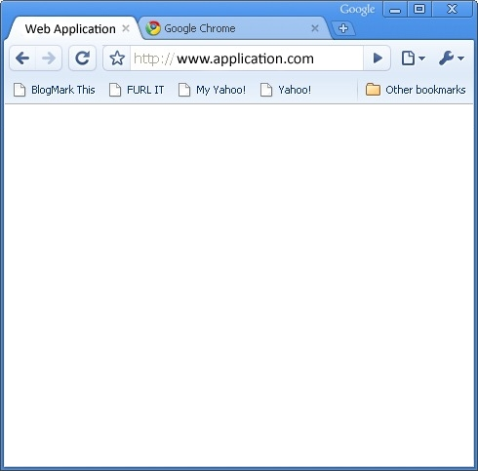

ATACK
Cross-site scripting (XSS)
User injects malicious JavaScript into regular data fields
(registration form, e-mail body, …)
The field is displayed to another user -> the script is executed
Prevention
  Browser blocks HTTP requests to other domains
  Browser hides secured cookies from the script
  Programmer’s discipline (sanitization)
Kapslík
<script>...</>
Fufník
Database
Notes:
On the example the scrip may get executed in other user view, like admin.
Stealing session identifier: Modern websites store data on LocalStorage and sSssionStorage, that is easy to read from JavaScript. Unlike HttpOnly cookies.
We can also use this on client site, for example by injecting code into search query argument and sending link to another user. Similar can be executed using server rendering, like PHP.
Resources:
https://cheatsheetseries.owasp.org/cheatsheets/XSS_Filter_Evasion_Cheat_Sheet.html
https://portswigger.net/web-security/cross-site-scripting/cheat-sheet

Slide 30
Content security policy (CSP)
Can limit loading JavaScript from other domains
Can limit use of eval or inline JavaScript – require only external sources
We can remove that limitation by using nonce attribute with value from CSP header
Most CSP can be avoided (study from 2015)
Proposal: 2022/2023
Notes:
Resources:
https://dl.acm.org/doi/10.1145/2976749.2978363

Slide 31
ATACK
JSONP
We can request JSON from other domain
The domain may request execution of local JavaScript method
Proposal: 2022/2023
Notes:
Resource:
https://en.wikipedia.org/wiki/JSONP

Slide 32
ATACK
Same Origin Method Execution
Proposal: 2022/2023
Notes:
Resources:
http://www.benhayak.com/2015/06/same-origin-method-execution-some.html

Slide 33
MONITORING & Logging
Logging Important Events
Errors
Security breaches
  Difficult how to detect them and what to log
All user actions
  May be impossible for large systems, so at least “important” actions
  Logging at request level
  Logging at database level (DB triggers)
Notes:
Security breaches may include invalid login attempts (not passwords). Also security incidents as required by law for the audit.
Delayed Operations : Soft-deletes , Queued operations
Enable fast response to current threads. We need to know that is happening. It is too late when we go the bill from the Cloud, and somebody was mining crypto for a month on our infrastructure.
Attack detection, blacklisting (users, IPs), …

Slide 34
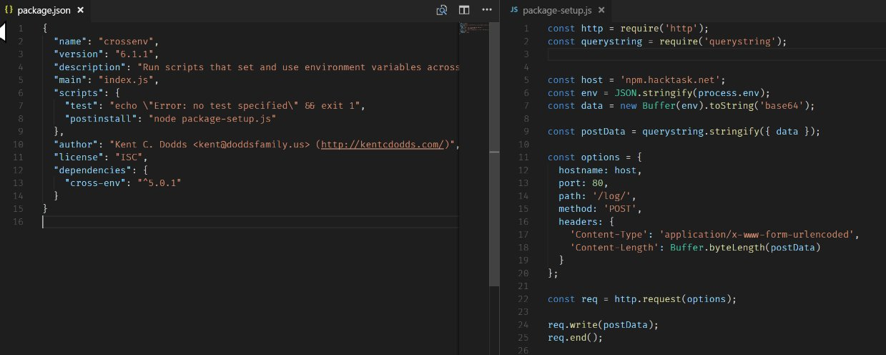
Libraries
Account Takeover
NPM / Docker / …
left-pad unpublished
Part of automated pipeline
Notes:
Library: execution of a third-party code on your computer.
Library left-pad was unpublished after forced remove of another NPM package (Kik) for brand infringement. Leaving thousands of projects (Node, Babel) broken.
Resources:
theregister.com/2018/07/12/npm_eslint/
https://twitter.com/o_cee/status/892306836199800836
https://www.mend.io/resources/blog/npm-package-javascript-library-compromised-via-account-takeover/
https://www.theregister.com/2016/03/23/npm_left_pad_chaos/
https://snyk.io/

Slide 35
Authentication & Authorization

Slide 36
Authentication
Authentication confirms that a user is who they claim to be
Based on user credentials, a certificate, …
  Something you know (password)
  Something you have (cell phone, token)
  Something you are (fingerprint)
Protect credentials using HTTPS
User identity must be held despite statelessness (session management)
In a (secured) session, in a cookie, …
External identity providers : Single Sign-On
Multi-Factor Authentication
Reauthenticate for important actions
Notes:
In addition, storing passwords as plain text allow insiders to impersonate users.
Session identifiers must be unique and random. Not just counter and current time. There are recommendations from OWASP. When using cookies, we should use their options to make them secure (HttpOnly, Domain, secure, path). Set them as strict as possible. Sessions are not limited to PHP.
With Two-Factor Authentication (2FA) we may require something you know and something you have. This may include external applications like Google Authenticator. This is replacement of SMS due to presenting various risks.
For example, in back application user may be required to provide PIN to authorize an operation. PIN can be different to password for logging into the application.
When communicating invalid username and password, we can make live easier for attacker by “The user ID is unknown” message for user and another for wrong password. There are other ways to enumerate users, like resetting passwords. That is why your email is very valuable.
Resources:
https://cheatsheetseries.owasp.org/cheatsheets/Session_Management_Cheat_Sheet.html

Slide 37
Password
Password should not be stored in plain text nor in decryptable form in the database, but rather hashed:
<salt>,hashfnc(<salt>,<password>)
The hashfnc could be SHA-256, SHA-512, bcrypt, scrypt, …
Salt is necessary to prevent rainbow-table attacks
Also, to assign different hashes to same passwords used by different users
Notes:
We may limit password length to 100-160 to prevent DoS attack resulting from extremely long passwords.
What about initial passwords - like admin? We can see this mostly for IoT devices, routers and other devices. Do NOT hardcore credentials into an application even for debugging and testing.
There are services that would lookup tables to crack password hashes.
Resources:
http://xkcd.com/936/
https://crackstation.net/
https://www.md5online.org/md5-decrypt.html?

Slide 38
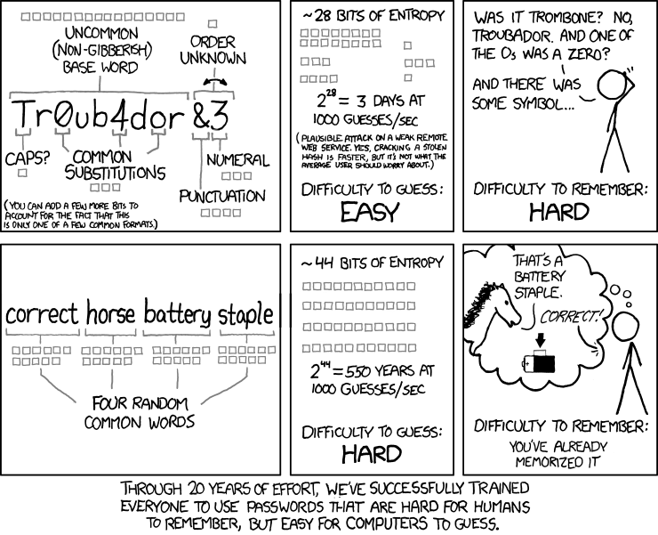
Demo
Passwords and Users
Notes:
Resource:
https://neal.fun/password-game/

Slide 39
Password
Authentication in PHP
class User {
private $passwordHash;
public function setPassword(string $password): void
{
$this->passwordHash = password_hash($password,
PASSWORD_BCRYPT, [ 'cost' => 12 ]);
}
public function verifyPassword(string $password): bool
{
return password_verify($password, $this->passwordHash);
}
}
Notes:
We may need to prevent brute-force attacks. This can be done using show lockouts 10 – 60 seconds, or CAPTCHAs (decreasing effectiveness).
Note that even comparing strings with password hashes must be done in a secure way (it must take a constant time, or a random time delay has to be issued). Otherwise, a timing attack can be conducted.

Slide 40
Authentication Tokens
Generated once the user is authenticated
  Or to grant some specific action – e.g., password reset
Does not have to be private, but only server can create/verify them
Example of a security token
  user_id:salt:hash(user_id:salt:secret)
  Where secret is a string known only to the server
Token may hold additional public data (payload)
  Expiration timestamp
  Creation timestamp
  Scope – restrictions on actions that the user may do

Slide 41
JSON WEB TOKENs
Example
{ "alg": "HS256", "typ": "JWT" }
{
"sub": "1234567890",
"name": "John Doe",
"iat": 1516239022
}
eyJhbGciOiJIUzI1NiIsInR5cCI6IkpXVCJ9.eyJzdWIiOiIxMjM0NTY3ODkwIiwibmFtZSI6IkpvaG4gRG9lIiwiaWF0IjoxNTE2MjM5MDIyfQ.XbPfbIHMI6arZ3Y922BhjWgQzWXcXNrz0ogtVhfEd2o
HMACSHA256 (
base64UrlEncode(header) + "." +
base64UrlEncode(payload),
secret
)
Notes:
With tokens we may need to hold database of invalidated tokens.
Resources:
https://jwt.io/

Slide 42
ATACK
JSON Web Tokens
Do not use JWT to store sensitive information (passwords, …)
Check for "alg": "none"
Proposal: 2022/2023
Notes:
Resources:
https://www.youtube.com/watch?v=RFKbHrqMiv8

Slide 43
Authorization
Authorization defines whether a user is allowed to do something.
Roles
  Authorities are typically not individual users, but roles
  Each user have one (or multiple) roles
Security Model
  Defines protected objects, authorities, operations
  (state-less) function (object, authority, operation, …) -> yes/no
  Typically implemented in one class (component)
Notes:
The security model function can consume different data, for example RBAC vs ABAC.
Role-based access control (RBAC) - Decide based on user role. Spring Security, CanCanCan. Better for static permissions.
Attribute-based access control (ABAC) - Any user attribute not only role, but it can also use global attributes. E.g., We can restrict access based on time. Can be expressed using XACML, an XML-based format from Oasis. Alternatively, DSL can be employed. Consider in dynamic environment.
Resources:
https://spring.io/projects/spring-security/
https://github.com/CanCanCommunity/cancancan
https://github.com/danielsomerfield/authorization-js
https://martinfowler.com/articles/web-security-basics.html

Slide 44
Authorization
Security Models Examples
Directory (Capability List)
  Authorities have lists of accessible objects
Access List (ACL)
  Protected objects have lists of users (+permissions)
Access Control Matrix
  Rows ~ authorities, cols ~ objects, items ~ access rights
Bell-LaPadula (BLP)
  Each authority has maximal level of access, each object has minimal required level of access
Notes:
Note that mentioned models all employ conservative approach – permissions are explicit, denials are implicit (everything that is not allowed is denied).

Slide 45
Authorization
Access Control List (ACL) Example
authorizator:
setup:
- addRole('user')
- addRole('editor', 'user')
- addRole('admin', 'editor')
- addResource('Homepage')
- addResource('Archive')
- addResource('Users')
- allow('user', 'Homepage', 'default’)
- allow('user', 'Users', 'default')
- allow('user', 'Users', 'show')
- allow('editor', 'Users', 'show-private’)
- allow('editor', 'Archive', 'edit')
- allow('editor', 'Archive', 'delete')
- allow('admin')
Authorities (roles)
Protected objects (resources) corresponds to controllers here
List of all access privileges (role, resource, action)
What is not explicitly allowed, is denied.
Admin is allowed everything
Notes:
The example is in Neon syntax (similar to YAML), which is often used for configurations.

Slide 46
Authorization
Frontend (UI) vs Backend (REST API/CLI)
Permissions are primarily tested in backend
User interface appearance should be in sync with operations the
user is authorized to do
Example – editing an e-shop item
  Users who do not have the permission to edit should not see the link leading to the page with editing form
  What if the user gets to the page another way?
  What if the user switches the role in the middle of editing?
  How to reveal these permissions to the UI without compromising security?
  What if the permissions change in the middle of editing?
Notes:
These questions cannot be easily answered in general, but you have to ask them again when designing security (authorization model) for your application.
The last one can be interesting when we remove user from system or remove some permissions. As the person no longer work for organization, account was compromised, etc …

Slide 47
takeaway
HTTPS
Validation & Sanitization
Authentication & Authorization
X.509 Certificates

