Slide 1
Organization
NSWI153 - Advanced Programming of Web Applications
2023/2024
Petr Škoda
https://github.com/skodapetr
https://www.ksi.mff.cuni.cz

Slide 2
Annotation
The lecture aims to extend students' knowledge of web technologies and it focuses on open languages. The first part addresses the details of server-side scripting and advanced features of PHP language. The second part presents current trends in web development, especially client-side scripting (JavaScript), specific properties of HTML 5, and script-controlled communication with server (AJAX, WebSockets). Students are supposed to implement a seminar project that uses some of the technologies presented in the lecture.
Last update 2013
Notes:
Source SIS

Slide 3
Alternatives
NPRG021 : Advanced Programming for Java Platform
Home project program
Practical programming test
Home-works, submit at least half
NPRG038 : Advanced C# Programming
Home project program
Home-works
NPRG051 : Advanced Programming in C++
Home-works (3)
NSWI153 : Advanced Programming of Web Applications
?
Notes:
Students: (2019/20, 2020/21, 2021/22, 2022/23, 2023/24) respectively (50, 10, 37, 45) 68, (98, 50, 90, 140) 153, (65, 46, 75, 95) 111, (21, 24, 60, 66) 66.
All success rates around 50%. All are about single language, what about web applications?
What are you doing here?

Slide 4
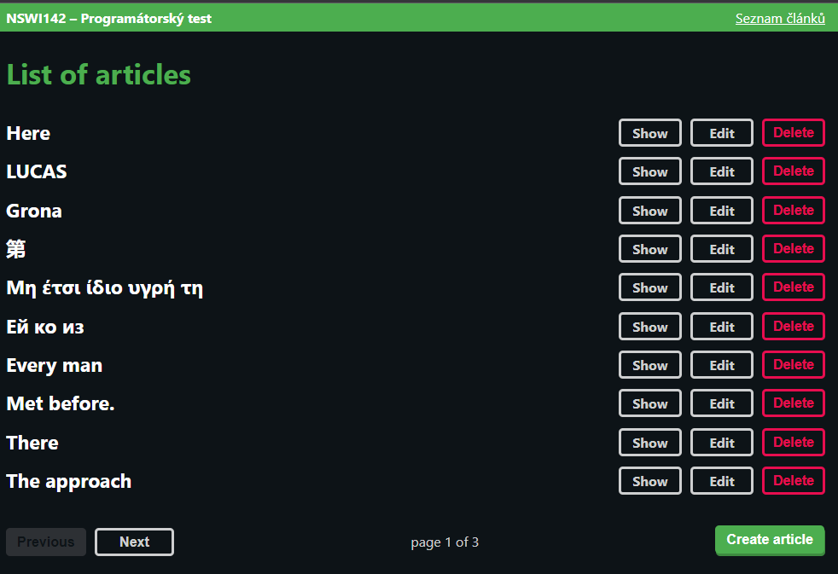
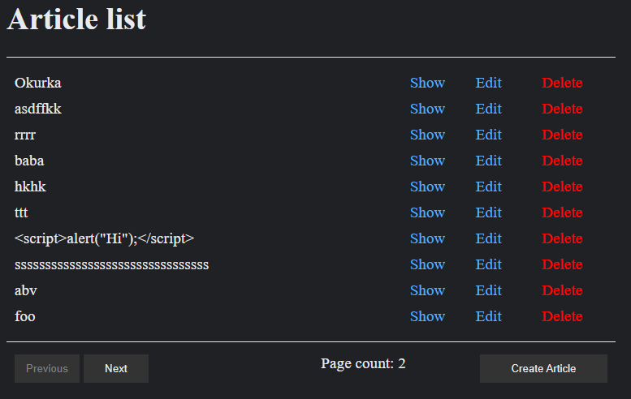
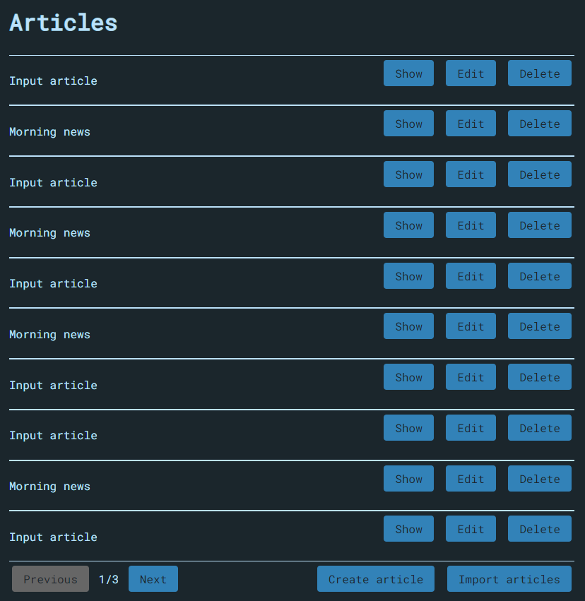
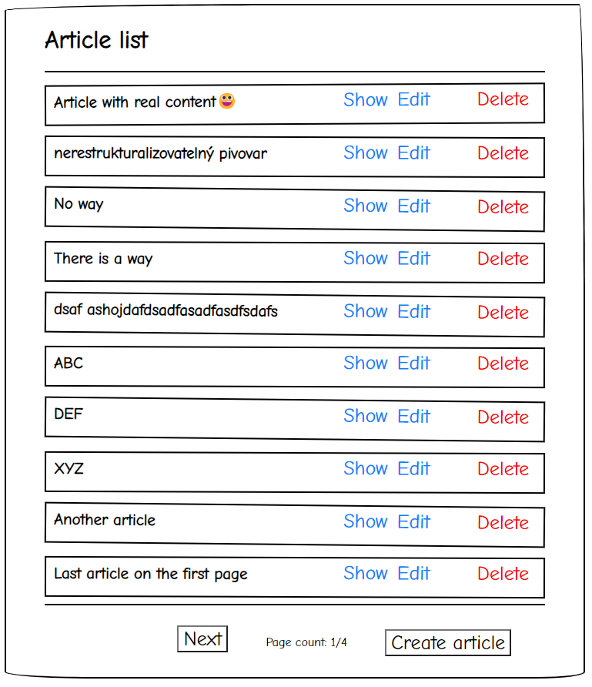
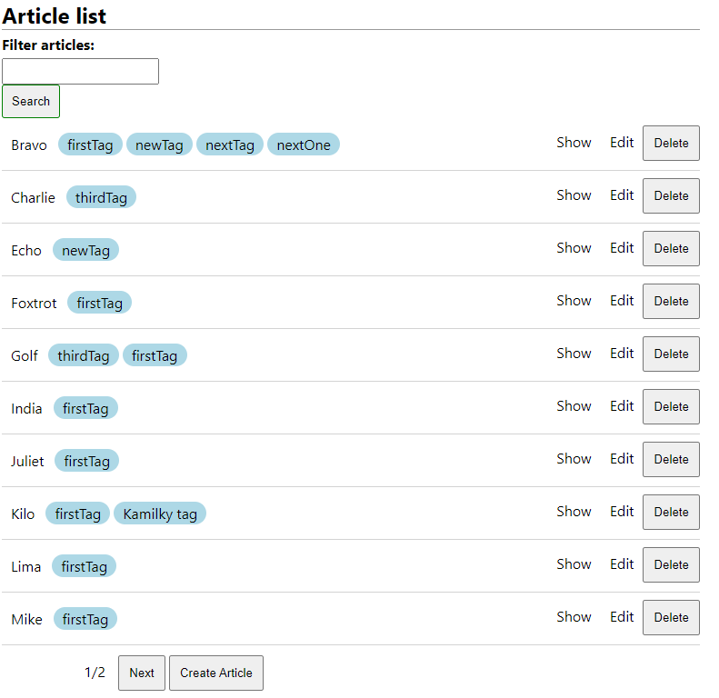
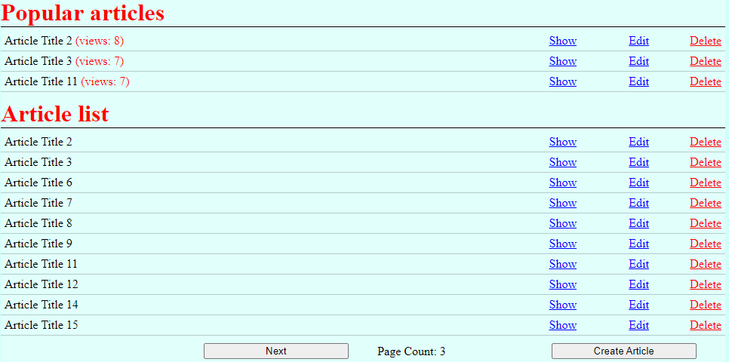
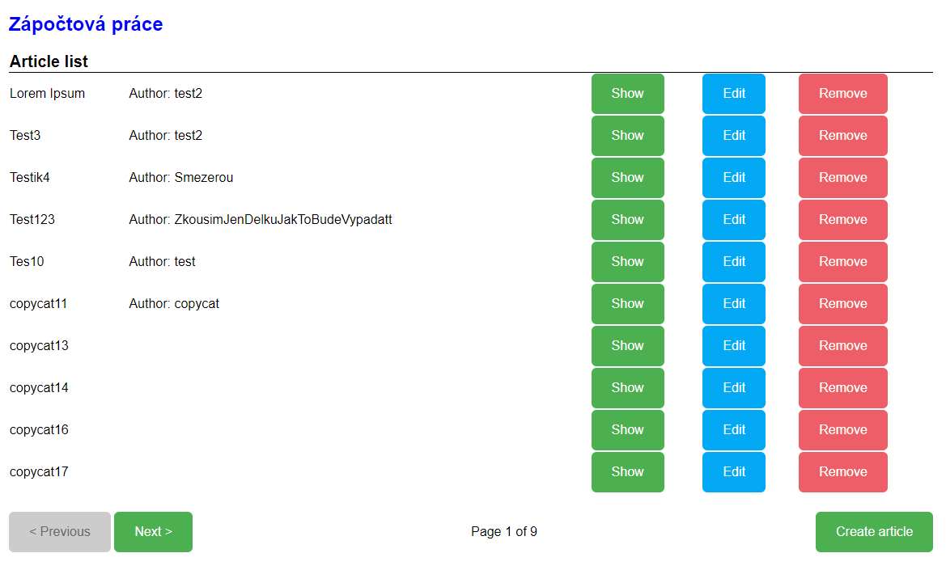
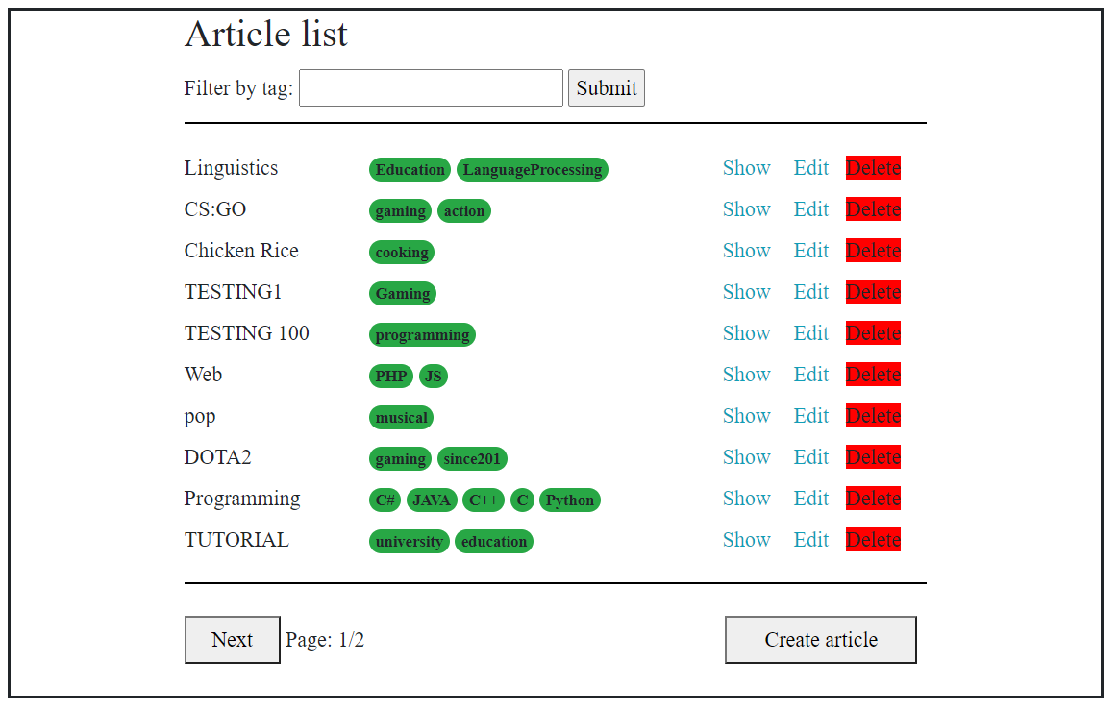
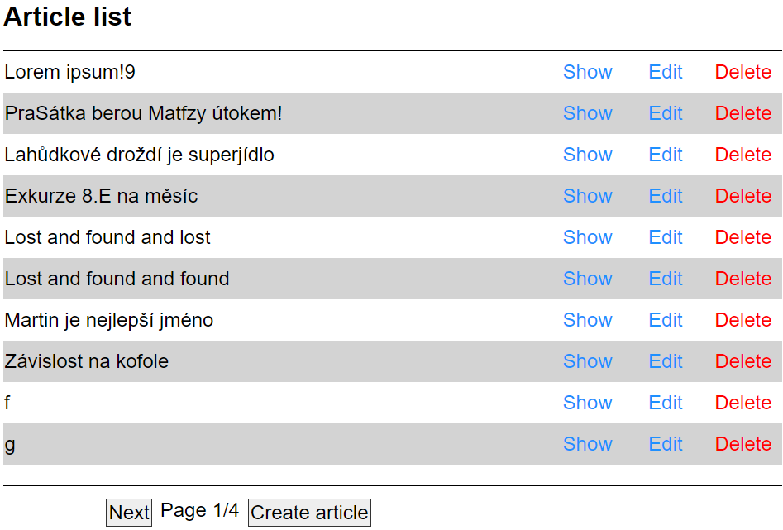
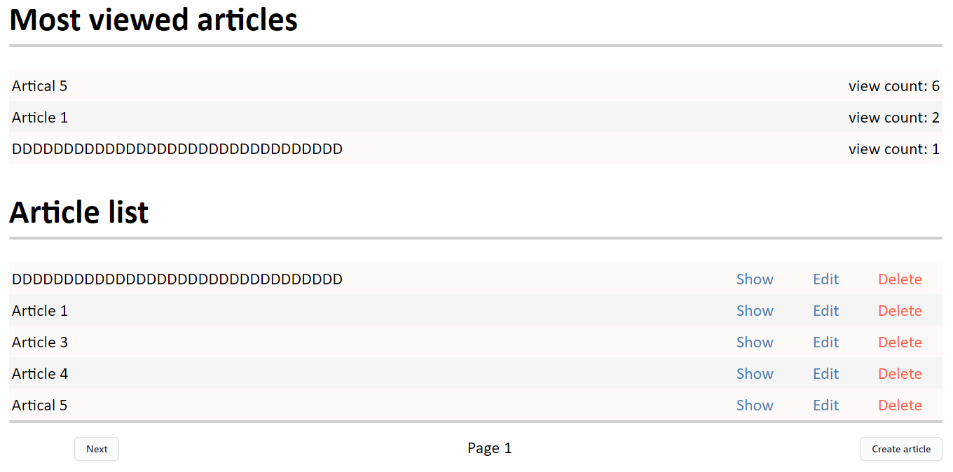
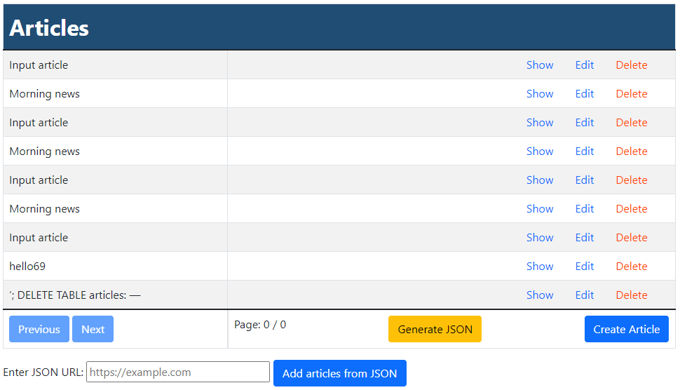
Starting point
Notes:
Screenshots from 2021/2023.
Tags, Authors, Number or reads, JSON API, …
Overall good work.

Slide 5
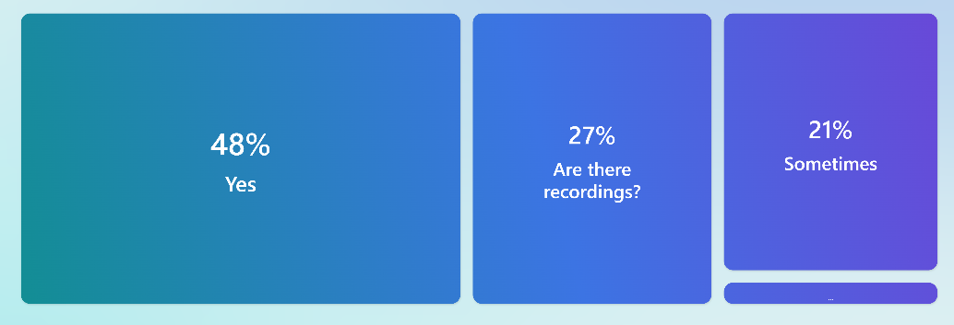
Expectations
For there to be recordings, in case of missed lectures because of sickness/travelling
I really do not know
Random Student 2023/2024
Random Student 2023/2024
Hoping to learn the correct approach to setting up a large project and understand the ways to evolve and maintain it
Bol by som rád, ak by bol obsah zaujímavo a pútavo prenesený
Random Student 2023/2024
Random Student 2023/2024
Are you going to attend the lecture?
Notes:
In total 37 people voted, thank you!

Slide 6
Objective
Na pokročilém programovacím předmětu se naučíme dokonale programovat v daném jazyce a budeme nejlepší programátoři na světě a nikdy se ne už nebudeme muset nic učit.
Random Student 2021/2022
Trial by Fire: Develop a Web Application
Notes:
Quote is from a student 2021/2022, what asked about the expectations.
This was mostly focus last year. Knowledge of advanced features does not make you a good developer.
What is the right metric? What are web applications about?
Roadmaps: https://github.com/kamranahmedse/developer-roadmap#view-all-roadmaps (Frontend, DevOps)
In addition, web apps are in a constant motion. New frameworks are nice, yet enterprise may not keep up-to date. You need to know the basic and expand your knowledge.
Objective: we go back to a starting point ~ development is not only coding, but design and deployment. Web Application is not only JS or PHP.
Sources:
https://cs.m.wikipedia.org/wiki/Soubor:PHP-logo.svg
https://commons.wikimedia.org/wiki/File:Unofficial_JavaScript_logo_2.svg

Slide 7
Credit
Seminars
Not every week - https://webik.ms.mff.cuni.cz/nswi153
Mandatory attendance
Any absence must be notified at least 24 hours in advance. Excuses must be submitted via email and must include a justification.
You may have a maximum of one unexcused absence.
Home assignments
Default one week deadline
GitLab
Seminar project
Notes:
More about seminar project other slide.

Slide 8
Organization
Topics
More PHP
JavaScript project
JavaScript today
Deploy
Server technologies
API
Server architecture
Write once …
There is no escape …

Slide 9
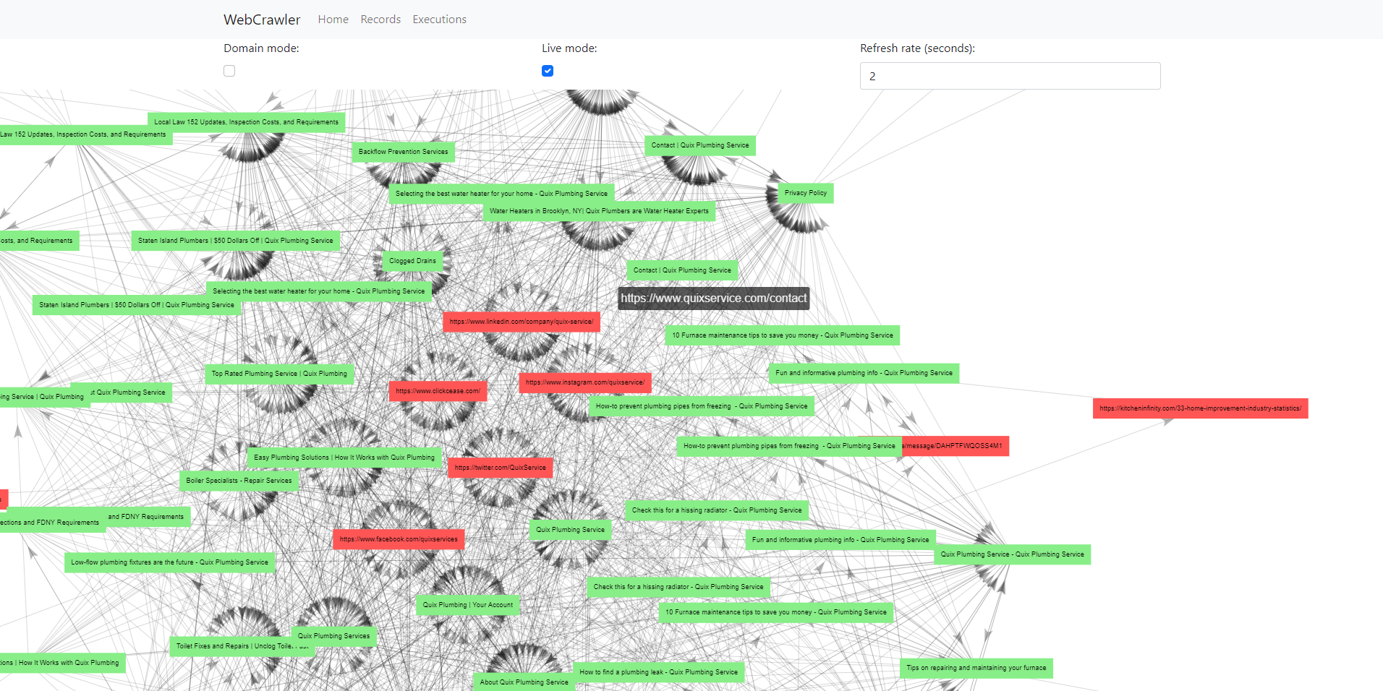
Destination
Team project
Team 1-3 people
Team leader
Use GIT (Gitlab / GitHub)
(TBD) Status meetings
Presentation
Notes:
Image: The one with black background is moving 3D visualization.
The end game.
Teamwork brings lot of positives and challenges. Alone you can not experience development of a web-application to it’s full potential.
Team leader is not a boss, they are responsible for communication.
Presentation: a few questions, preparation time, you need the project, discussion

Slide 10
Feedback
Přišlo mi zbytečné prezenci na povinných cvičeních odměňovat bodem za docházku. Když jsme na tato cvičení nepřišli, tak jsme museli ke splnění zápočtu dohnat bod za docházku úkolem v Recodexu,který byl časově průměrně 2x náročnější, než být na cvičení. Na těchto cvičeních jsme stejně jen "osahávali" základy s danou technologií, což jsme mohli zkusit v klidu doma.
Random Student 2021/2022
Nic moc mi to nedalo. Učit se technologii dle její dokumentace bych zvládl doma sám, bez nutnosti prezence na povinných cvičeních.
Random Student 2021/2022
Random Student 2021/2022
Notes:
Here I focus on the negative one.

Slide 11
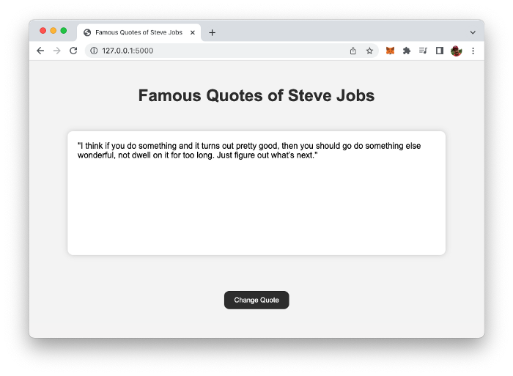
Change is the Only Constant in Life
Build a Complete Website Using ChatGPT in 1 Minute
Added: 2022/2023
Notes:
“Change is the Only Constant in Life” – Heraclitus
Not sure how to handle this, you feedback is welcomed.
Resource:
https://medium.com/codingthesmartway-com-blog/build-a-complete-website-using-chatgpt-in-1-minute-16edef87bc30

Slide 12
Summary
https://webik.ms.mff.cuni.cz/nswi153
Project
Feedback
Communicate
Rules are subject to change

