Slide 1
Sharing is caring
NSWI153 - Advanced Programming of Web Applications
2023/2024
Petr Škoda
https://github.com/skodapetr
https://www.ksi.mff.cuni.cz
Notes:
We employ PHP for context, yet many of the concepts are not limited to PHP.

Slide 2
This lecture in context
Original title “Higher Level Concepts”
Libraries banned for NSWI142
Resources:
Books
Libraries / Frameworks
Lectures / Seminars
…
Notes:
Anti-patterns are the opposite of best practice, which is a solution that has been proven to be effective.
Code Smells are the traces in the code that indicates a deeper problem in the application or codebase.
Design patterns will be introduced later.

Slide 3
Gang of Four Design Patterns
.. a reusable and flexible design is difficult if not impossible to get "right" the first time ... Yet experienced object-oriented designers do make good designs. Meanwhile new designers are overwhelmed by the options … Each design pattern systematically names, explains, and evaluates an important and recurring design in object-oriented systems. … Design patterns make it easier to reuse successful designs and architectures. A pattern has: pattern name, problem, solution, consequences.
Categories:
Creational Patterns for the creation of objects : Builder, Singleton,…
Structural Patterns to provide relationship between objects : Adapter, Façade, Proxy, …
Behavioral Patterns to help define how objects interact : Command, Observer, Strategy, …
Notes:
Gang of Fours are the authors of the book: Erich Gamma, Richard Helm, Ralph Johnson, and John Vlissides. Originally written for C++, for Object oriented language. From 1995.
- Naming patterns increase our design vocabulary, make it easier to communicate and design.
- Problem describes when to apply the pattern.
- Solution what elements make up the design, their responsibilities and collaboration.
- Consequences results and trade-offs of applying the pattern
Resource:
https://springframework.guru/gang-of-four-design-patterns/
Design Patterns Elements of Reusable Object-Oriented Software [1995]

Slide 4
Front Controller
Initialization
Load configuration
Initialize libraries (autoloading)
Initialize application (component manager, components)
Routing
Get router component and perform routing
Get instance of target presenter/controller
Verify/sanitize input data
Dispatch
Invoke target action on the presenter/controller
Collect outputs and complete the request
Remove: 2024/2025
Notes:
The idea is to have a single controller that handles all requests.
Components may include data access, logging, messaging, monitoring.
Alternative is page controller where a shared base class is employed to reduce redundancy. This approach allow for higher degree of specialization.

Slide 5
Dependency Injection
Inversion of control
Component is not responsible for seeking its own dependencies
Dependencies are injected externally
Declaring dependencies In configuration, by annotations, using reflection, …
/**
* @component WelcomePage
*/
class WelcomePageController implements IController
{
/** @inject IDatabase */
public $database;
...
}
Notes:
You may already know inversion of control from frameworks.
Configuration may be tedious to maintain, reflection can be slow (we can optimize).
Problem with cyclic dependencies (pass as constructor).
In this example we are using annotations, just to be backwards compatible.

Slide 6
Dependency Injection example
Example implementation in PHP.
function processDocComment($comment) {
if (preg_match_all('/@[-a-zA-Z()_]+/', $comment, $matches)) ...
}
$refClass = new ReflectionClass('WelcomePageController‘);
processDocComment($refClass->getDocComment());
foreach ($refClass->getProperties() as $property) {
processDocComment($property-> getDocComment()); ...
}
foreach ($refClass->getMethods() as $method) {
processDocComment($method->getDocComment()); ...
}

Slide 7
Dependency Injection example
Example in Java using Spring.
@Service
public class Configuration { … }
@Service
class WebServer {
@Autowired
public WebServer( Configuration configuration { … }
@PostConstruct
public void onInit() { … }
}
<?xml version="1.0" encoding="UTF-8"?>
<beans:beans … >
<mvc:annotation-driven/>
<context:component-scan
base-package="com.linkedpipes…"/>
<beans:bean
id="jsonMessageConverter“
class="org.…"/>
</beans:beans>
Notes:
Example using Spring, we can reduce the complexity using Spring Boot. Left side is code-based annotations, right side is XML-based.
What is wrong with this approach? There should be an interface and there should be implementation somewhere else.
Resources:
https://github.com/linkedpipes/etl/blob/develop/executor-monitor/src/main/java/com/linkedpipes/etl/executor/monitor/web/WebServer.java
https://github.com/linkedpipes/etl/blob/develop/executor-monitor/src/main/resources/web/spring/context-web.xml

Slide 8
Demo
Design Patterns
Notes:
Mention design patterns as a general groups and other groups as patterns for specific situations.
Show Singleton, section (Dis)advantages.
Pattern can have different implementations based on a language at hand, consider Factory in PHP.
It is important to know benefits and when to employ the pattern.

Slide 9
Model-view-controller (MVC)
Controller
updates
notifies
View
reads
Model
User Interface Display information to the user
Data manipulation
Notes:
There are no clear definitions of the MV* patterns. In addition, they live inside an application written in a given language and even using framework. That do have impact of the implementation.
While View can be created by Controller. Controller register binding (callbacks) to be notified about actions by View.
Design for Small Talk by Trygve Mikkjel Heyerdahl Reenskaug in 1979. Separation of concerns.
Not designed from Web applications but it gets quickly adopted. The idea was to allow user to see data from multiple perspectives (view). For example, we can, when creating the View, bind handling methods in the controller. There Controller can delete data and request View to update from Model. The connection between view and model is subject of criticsm.
Over time MVC was not good enough as technology got more complicated. All follow-up patterns share:
V for view, that is the user interaction point. Presents content and capture user inputs.
M for model, where business logic happens, working with data.
What remains is the place of difference, the controller/translator that mediate between V and M.
Resources:
https://medium.com/@duncandevs/origins-of-model-view-controller-d685528857ce
Applications programming in smalltalk-80: how to use model-view-controller (mvc) https://www.researchgate.net/publication/238719652_Applications_programming_in_smalltalk-80_how_to_use_model-view-controller_mvc
https://www.youtube.com/watch?v=I5c7fBgvkNY

Slide 10
Model-view-presenter (MVP)
Presenter
updates
notifies
notifies
updates
View
Model
User Interface Display information to the user
Data manipulation
Notes:
Presenter strictly separates model and view; it is sort of a layer. Now we can change view or model and we do not need to change the other.
Presenter is now responsible for retrieving data from model and providing them to the view. We can also be notified by model to show a change (push notification). View is given reference to Presented where it get access to callbacks.
As there are less connection it has better testability.
Considerations:
Introduce interface for View and Presenter.
Bind actions from View to allow for easier change of views.

Slide 11
Model-view-ViewModel (MVVM)
ViewModel
updates
data & command binding
notifies
notifies
View
Model
User Interface Display information to the user
Data manipulation
Notes:
One problem of MVC/MVP is a lot of boiler plate in Controller.
View pass handling of action to ViewModel using data-binding. View directly binds to properties of the ViewModel, making it easy to propagate to model. We shift some code into “common” area shared by all.
Presenter does not need a reference to the View like in MVP. Using two-way data binding we do not need specific refresh call like in MVP.
Great of reactive programming and data-binding scenarios (mostly client-side web).
Model can be domain model or data access module representing content.
View can be defined using a declarative language XAML in C#, XML for Python QT, or HTML-like templates for Java Script. We aim for as little code as possible.
Resource:
https://learn.microsoft.com/en-us/dotnet/architecture/maui/mvvm
https://addyosmani.com/blog/understanding-mvvm-a-guide-for-javascript-developers/
https://www.oreilly.com/library/view/learning-javascript-design/9781449334840/ch10s06.html

Slide 12
Model-View-Template
Which data you see, not how!
View
Controller
Template
Model
How user see the data
Data manipulation
Remove: 2024/2025
Notes:
More like a toy example .. to demonstrate that the objective is not to know all design patterns and their variants. You need to remember the context, like libraries and programming language.
View is implemented as a callback function in Python, that returns all necessary data. View describes what data are preserved for the user. Besides View act sort of as a controller.
Controller is Django as a framework, that gets the URL and handles the processing. Like initializing, moving the data etc.. thus, the view can focus only on business logic.
Resources:
https://docs.djangoproject.com/en/4.1/faq/general/

Slide 13
Model View View-Model Coordinator
Add Coordinator to View-Model.
The Coordinator coordinates transitions between screens.
Add: 2023/2024
Notes:
Resources:
https://www.youtube.com/watch?v=I5c7fBgvkNY

Slide 14
View, Interactor, Presenter, Entity, Router
Most modular pattern.
Replace Model with Interactor.
The Interactor interacts with Business Logic upon request from a presenter.
The Interactor is using Entity to communicate with database.
Add: 2023/2024
Notes:
Resources:
https://www.youtube.com/watch?v=I5c7fBgvkNY

Slide 15
Demo
Conferences
Notes:
Resources:
https://www.php.net/conferences/index.php
https://reactsummit.com/
https://pycon.org/
https://gotopia.tech/
https://vuejsnation.com/
https://frontendisti.cz/ (show archive)

Slide 16
IDE / Generated Code
IDE code generation snippets
Browser based IDE
Copilot
AI integrated tools
GitHub Copilot falls inside the tech shortcut bucket. This platform is the next evolution of pre-packaged coding elements that started in the 1950’s with software libraries, which morphed into APIs (1970’s) and then became crowd sourced code snippets housed on StackOverflow (2000’s).
Medium, Brandeis Marshall, 14.3.2023
Notes:
Resources:
https://chat.openai.com/chat
https://github.com/features/copilot#pricing
https://zed.dev/
https://medium.com/@brandeismarshall/github-copilot-is-code-cloning-2-0-93726e40afbe
https://zed.dev/docs/getting-started 27.02.2024 (Video)

Slide 17
Database
Database transactions - maintaining data integrity
Database View
Stored Procedures/Functions
Triggers
Migration
Do you need one?
Notes:
In database we share information with out future self or other services and users.
Transactions are probably the best solution (begin, commit, rollback). They may be restarted – there is another lecture about them. It start being interesting with complex setup and parallel execution, alternatives:
File locking
Synchronization primitives (e.g., mutexes)
We can optimize performance
We can move some logic into database, we need to decide who is responsible for what. Runs in a database / transaction.
Can help us to update data, example keep track of likes. We can recompute automatically the number of likes for item when a new like is added to a like table.
Data update can be tricky, it is not only schema.

Slide 18
Database example
MySQLi (mysqli_) / (pg_) / …
Database Abstraction Layers
PHP Data Objects (PDO)
DiBi
$sql = 'SELECT name FROM fruit’;
foreach ($conn->query($sql) as $row)
echo($row['name’]);
}
$result = dibi::query(
'SELECT name FROM [users] WHERE [login] = %s’,
$login);
$username = $result->fetchSingle();
Notes:
You already know, there are other databases PostrgreSQL (API similar, pg_connect, pg_query), SQLite (running on top of file system), and commercial.
Database Abstraction Layers – solving problem of portability, not DMBS specific functionality (vendor lock).
PHP extension php_pdo + database specific e.g., php_pdo_mysql. Minimalistic, object-oriented API.
DiBi is one of the first, still have releases on GitHub. Automated sanitization.
Source:
https://www.php.net/manual/en/book.pdo.php
https://github.com/dg/dibi

Slide 19
Data model
Allows you express data entities naturally
Customer, Product, Order, …
Offers benefits like inheritance
Customer, Seller, Admin ~ User
Promotes encapsulation
Well defined interface
Hides the details of actual data representation/storage
Much more readable
Self documented code
Decorated with doc comments
Object persistence
Explicit way to flush objects to persistent storage
Object relations
Like database relations (1:1, 1:N, …)
Collections
Implicit
All customers
Defined by object relations (orders of a customer)
Explicit
Orders that are due today

Slide 20
Object-relational Mapping (ORM)
Technique which creates object-oriented API over (relational) database
Much simpler for the programmer (no need for SQL) and less error prone (no SQL).
Object-relational impedance mismatch
How to save objects into database?
Mapping IS-A hierarchy, private members, references, …
PHP Framework: Doctrine
Contains both DB abstraction layer and ORM
Provides transparent persistence of PHP objects
Requires mapping (XML, YAML, PHP annotations/attributes)
A DB schema is generated from the PHP classes
Migration management
Notes:
Source of truth – most in code.
Doctrine has been downloaded a total of 2,840,976,957 times as of early 2022.
With Doctrine you can still use your own query and just load result into objects, it has query builder, or limited query language.
Source: https://www.doctrine-project.org/

Slide 21
Doctrine example
/** @Entity @Table(name="subjects") **/
class Lecture
{
/** @Id @Column(type="integer") @GeneratedValue **/
protected $id;
/** @Column(type="string") **/
protected $fullname;
/** @ManyToOne(targetEntity="User", inversedBy="teach_lectures") **/
protected $teacher;
...
public function getDescriptionString() { ... }
public function getStudents() { ... }
}

Slide 22
Standup
ORM and Lazy Loading

Slide 23
Object-relational Mapping alternatives
NotORM
Between Doctrine and DIBi
SQL queries are not written in strings, but semi-automatically procedurally composed (similar to query builder)
Unlike ORM, the API does not have to know complete DB schema
Original API was proposed and implemented by Jakub Vrána
$db = new NotORM(...);
$subj = $db->lectures[42];
$subj->fullname = 'Web Applications';
$subj->update();
foreach ($db->lectures()->where('programme', 'I2')->order('teacher.name’) as $subj)
{
echo $subj->teacher['name'], ' ', $subj['fullname'];
}
Notes:
Original NotORM is still working (not checked) but there are alternatives.
Gives you more control.
You should not depend on the database anyway.

Slide 24
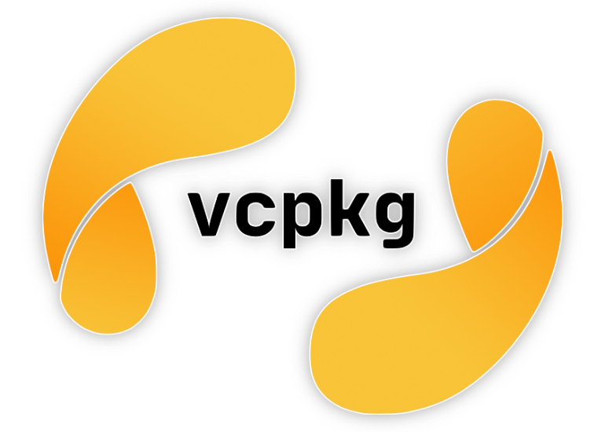
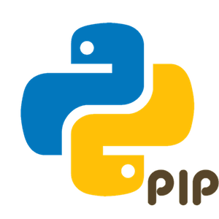
Dependency manager
Dependency manager / Package manager / …
Package ( code + metadata )
Lock file
CLI client
Repository
Sharing components
Notes:
Many package managers support "lock files", which "freeze" the entire dependency tree including transitive dependencies.
Resources:
https://packagist.org/packages/monolog/monolog
https://www.npmjs.com/package/parcel
https://mvnrepository.com/artifact/com.github.jsonld-java/jsonld-java/0.13.6 [DEMO]
https://bit.dev/ - self promo [DEMO]

Slide 25
Dependency monitoring
Monitoring security vulnerabilities.
Dependabot
Strong GitHub integration
Automatic PR for dependency updates
.github/dependabot.yml
Renovate
Self hosting / CI / Cloud
Snyk
Dashboard
Notifications
Notes:
Renovate vs Dependabot: Renovate has a dashboard, support monorepositories,
Snyk aim to be a security platform, dependency monitoring is just one service. They provide security services and consultation.
Resources:
https://github.com/renovatebot/renovate
https://docs.renovatebot.com/bot-comparison/
https://docs.renovatebot.com/modules/manager/
https://docs.github.com/en/code-security/dependabot/dependabot-version-updates/about-dependabot-version-updates#supported-repositories-and-ecosystems
https://app.snyk.io/

Slide 26
Linter
Originally a software developed for static code analysis. Now family of tools performing code analysis.
Rules
IF code meets a certain expectations, THEN … ELSE …
IDE Integration
SonarQube
Java, C++, JavaScript, Python, PHP, …
ESLint
JavaScript
Notes:
Tools can be rune offline or online.
ESLint as a dependency.
Resources:
https://eslint.org/
https://www.sonarsource.com/products/sonarqube/ there is free community edition

Slide 27
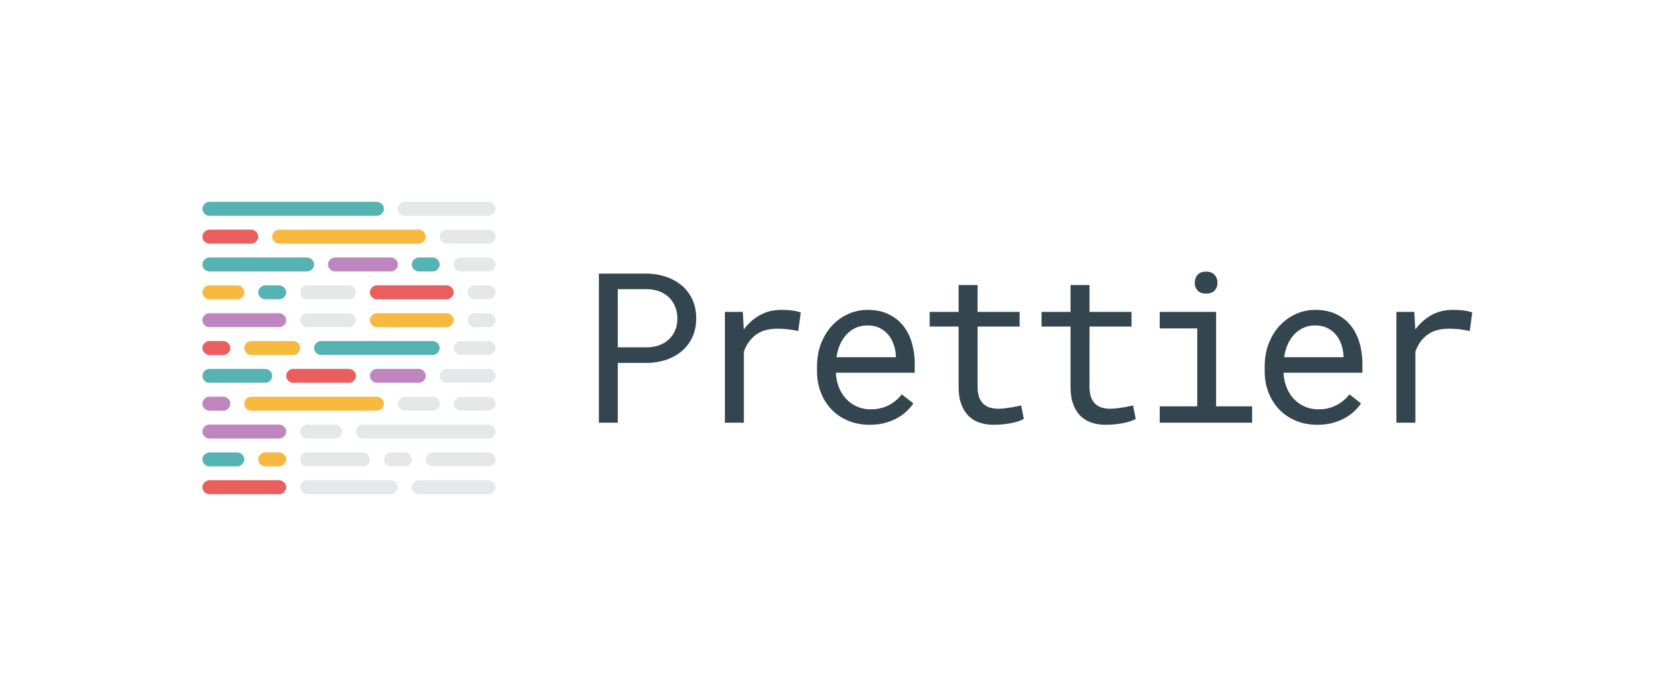
Prettier / code formatter
“Prettier is an opinionated code formatter. It enforces a consistent style by parsing your code and re-printing it with its own rules that take the maximum line length into account, wrapping code when necessary.”
Notes:
Modified on write or using a custom command.
Resources:
https://prettier.io/
https://black.readthedocs.io/en/stable/

Slide 28
Maintenance
Co se týká HTTP/2 – tam je trošku problém, že by se musel web server Apache běžet na verzi 2.4 (nyní běží na verzi 2.2), současně HTTP/2 nepodporuje PHP ve formě modulu Apache, ale muselo by se přejít na řešení pomocí PHP-FPM.
A v neposlední řadě mám informaci od jednoho z autorů redakčního systému webu, že změna verze PHP, která by při tom všem nastala, by mohla způsobit nefunkčnost redakčního systému, protože novější verze PHP není vždy úplně zpětně kompatibilní se starší verzí PHP (starší funkce se mění nebo je i ruší).
Tedy tady zatím změny určitě nebudu J .
2020/2021

Slide 29
Takeaway
Design patterns
ORM
MVC / MVP / MVVM / …
Dependency managers
Linters
Code formatters
NSWI154 - Software Development Tools

