Slide 1
JavaScript eco-system
NSWI153 - Advanced Programming of Web Applications
2023/2024
Petr Škoda
https://github.com/skodapetr
https://www.ksi.mff.cuni.cz

Slide 2
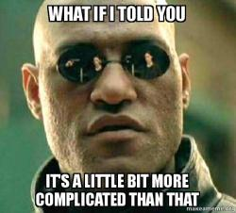
Demo
Starting point
Notes:
ACTIVITY: Starting project, just an input text and a button. On click the content of a page change. This should be nothing new for you. What do we need and how we can do this?
The question is, how to make this more complicated?

Slide 3
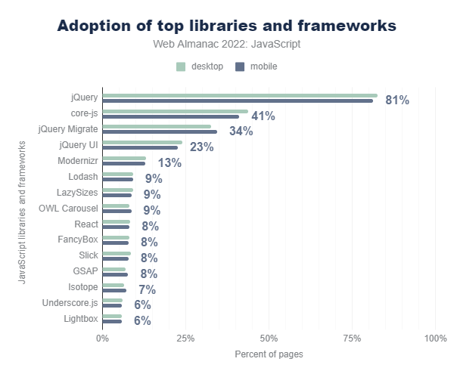
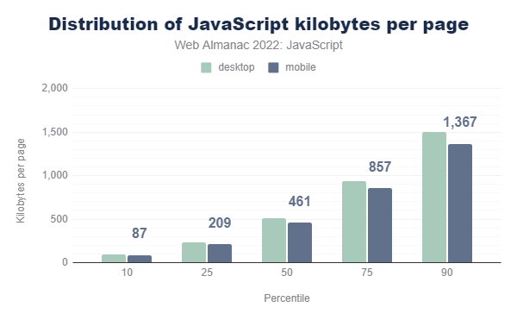
State of JavaScript 2022
Notes:
We are using more JavaScript, yet in global the adoption of libraries is not as wide-spread as we could expect (see jQuery 81% and React 8% ).
On the other hand, JavaScript features like Web Components (2.0%) and Shadow DOM (0.37%) are still waiting.
This is the last report they did to March 2024. They visited websites and look for content (8.36M websites with 43TB of data).
Resources:
https://almanac.httparchive.org/en/2022/javascript

Slide 4
CSS Libraries and Frameworks
Bootstrap
Grid system, components, JavaScript plugins
SASS
Material Design
Design system, Web library of components,
Tailwind
Use CSS classes instead of CSS styles, style directly from HTML
Component libraries, CDN, optional build step, custom CLI
<div class=“modal”>
<div class=“modal-dialog”>
<div class=“modal-content”>
<div class=“modal-header”>
<h5 class=“modal-title”>Title</h5>
</div>
<div class=“modal-body”> … </div>
<div class=“modal-footer”>
<button type=“button”
class=“btn btn-primary”>
Save changes
</button>
</div> </div> </div> </div>
<md-dialog>
<div slot=“headline”>Title</div>
…
</md-dialog>
<div class="pt-6 md:p-8 text-center md:text-left space-y-4"> … </div>
Notes:
Material Design is Google design system. It provide components and guidance on how to design an application. We have government design systems as well (gov.uk, gov.cz). Material is not limited only to a web, but contain web library of web-components.
Resources:
https://getbootstrap.com/docs/5.3/getting-started/introduction/
https://m3.material.io/
https://tailwindcss.com/
https://code.gov.cz/gov-cz/gov-design-system/

Slide 5
.header__right { display: none }
@media(min-width: 1024px) {
.header__right {display:flex; gap: .5rem }
}
Quiz
.header__right
Notes:
What is header__right for?
Source:
https://edoklady.gov.cz/

Slide 6
CSS preprocessors
Syntactically Awesome Stylesheets (SASS)
Leaner CSS (LESS)
.gov-container{
display:block;
width:100%;
max-width:calc(
var(--gov-container-width, 73.75rem) +
2*var(--gov-container-padding, 2.5rem));
margin-right:auto;
margin-left:auto;
padding-right:var(
--gov-container-padding-mobile, 1.25rem);
padding-left:var(
--gov-container-padding-mobile, 1.25rem)}
*.SASS
MAGIC BOX
*.CSS
@mixin container() {
display: block;
width: 100%;
max-width: calc($container-width + (2 * $container-padding));
margin-right: auto;
margin-left: auto;
padding-right: $container-padding-mobile;
padding-left: $container-padding-mobile;
…
}
$class: ".gov-container";
#{$class} {
@include container();
}
Notes:
SASS: Variables, Nesting, Partials (_partial.scss and @use …), Modules (@use), Mixins, Inheritance, Operators (math)
LESS: Use to be supported by Bootstrap, but there was a switch to SASS in version 4.
The objective is not to compare them here!
Both can be included directly and preprocessed on the client side, but that is not optimal for production. But where we can get the preprocessor [NEXT]?
Sources:
https://css-tricks.com/sass-vs-less/ from 2012
https://www.npmjs.com/package/sass-browser
https://lesscss.org/usage/

Slide 7
Package managers
npm
NodeJS default.
yarn
Introduced 2016 to address issues with npm.
pnpm
Improve package sharing among projects.
bit
Not really an alternative, focus on components.
Notes:
How can we employ CSS preprocessors, where we can find them?
npm is part of NodeJS, it is the default. It is not only a package manager but also the registry that hosts the packages. Packages can be libraries or tools to execute.
yarn introduced in 2016 as npm was not effective/fast, with lock file (now with npm as well), security (now npm as well). Since Node.js 16.10 also distributed by default (must be enabled). yarn focus more on workspaces (use Lerna with npm), support parallel installation.
New feature in Yarn2 (Berry) is removing node_modules in favor of pnp.js file and Plug'n'Play functionality.
pnpm shares packages among projects by using symlink.
bit is not really an alternative for whole libraries, but for components (purpose is to split the application), focus on easy management, component marketplace.
Sources:
https://www.section.io/engineering-education/npm-vs-yarn-which-one-to-choose/
https://dev.to/arcanis/introducing-yarn-2-4eh1

Slide 8
JavaScript runtime
Node.js 0.0.1 (2009), 21.6.2 (2024-02-14)
Asynchronous event-driven JavaScript runtime
Deno 0.1.0 (2018), 1.41.1 (2024-02-29)
Native TypeScript support
Build-in linter, prettier, test runner
Secure by default with no access to file system, network, environment variables, …
Custom dependencies management using deno.json
Bun 0.0.0-8 (2021), 1.0.30 (2024-03-04)
Bun is a fast all-in-one toolkit
Experimental native build for Windows
Notes:
Many JavaScript related tools have been written using JavaScript. That is why we need a runtime to run them.
NodeJS gain traction around 2017, NodeJS rated as 4-th most important open-source project (Linux, Git, MySql, Node.js, Docker, Hadoop, …)
Resources:
https://blog.risingstack.com/history-of-node-js/
https://github.com/nodejs/node-v0.x-archive/tree/v0.0.1
https://techcrunch.com/2017/04/07/tracking-the-explosive-growth-of-open-source-software

Slide 9
Demo
SASS

Slide 10
Demo
The Page With No Code
Removed: 2023/2024
Notes:
Use with Firefox : https://danq.me/wp-content/no-code-webpage/
Idea is to employ CSS style set in header to create a content for an empty page.
Source:
https://danq.me/2023/01/11/nocode/
https://css-tricks.com/adding-css-to-a-page-via-http-headers/

Slide 11
Introducing HTML to JavaScript
JavaScript XML (JSX)
Transpilation
Hyperscript Tagged Markup (HTM)
Tagged templates html`x` ~ html(x, …variables)
function WelcomePage(name) {
return <p className=“high">Hi {name}!</p>;
}
function WelcomePage(name) {
return html`<p class=“high">Hi ${name}!</p>`
}
Babel
"use strict";
function WelcomePage(name) {
return /*#__PURE__*/ React.createElement( "p",
{ className: “high“ },
“Hi ", name, "!");
}
Notes:
Working with DOM as HTML …
We can use similar idea as for the CSS, some sort of preprocessing / compilation / transcompilation (source-to-source). Nesting elements would be put into the list of children. This is also a reason why there must be only one root, unless fragment is used.
Source:
https://reactjs.org/docs/introducing-jsx.html
https://babeljs.io/repl
https://github.com/developit/htm
https://developer.mozilla.org/en-US/docs/Web/JavaScript/Reference/Template_literals#tagged_templates

Slide 12
Demo
Babel & JSX
Notes:
Babel is a transpiler. It is often used to transform new JavaScript or syntax so it can run in older browsers.
https://babeljs.io/repl

Slide 13
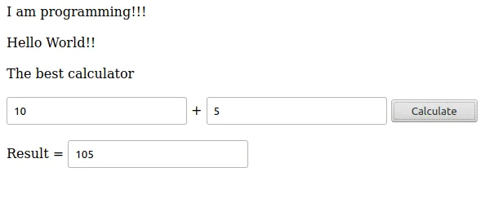
JavaScript
JavaScript suffers …
being too weakly typed …
Solutions:
Comments
JS proposal type annotations
Specialized solutions
JavaScript dialects
function equals(x: number, y: number): boolean {
return x === y;
}
Notes:
We can:
Employ comments and IDE, static code analyzer, linters. We get to them later.
Proposal is Stage 1 since 2022 (see example code).
Libraries may provide way how to specify types (Vue, React, …).
We can use other language and transform it into JavaScript.

Slide 14
Static type checker
Flow
Static type checker for JavaScript
Works with explicit types of variables, members, and function args
Inferred from assignments
Extended syntax for type annotations (like type hinting in PHP)
Checker scans the code for possible type violations
Plugins exist for various IDEs, also may enhance intellisense
// @flow
function square(n) { return n * n; }
function mulStr(str: string, times: number): string { … }
Notes:
We have @babel/preset-flow, we can run analyzer from NPM flow-bin package or use flow-remove-types to remove the types.
Source: https://flow.org/

Slide 15
Typescript
Superset of JavaScript that introduces strict typing
Compiled (transpilled) to JavaScript whilst type constraints are checked
Designed and maintained by Microsoft
Probably the most widely-spread dialect of JavaScript
Key Features
Type annotations (variables, members, arguments) and type inference
Both class annotations and standalone interfaces (for non-class objects)
Generics (re-usable parametrized type declarations)
…
“TypeScript is a popular choice for programmers accustomed to other languages with static typing, such as C# and Java.”
Notes:
standalone interfaces – we can define object without a class/interface
Sources:
https://www.typescriptlang.org/
https://www.typescriptlang.org/docs/handbook/typescript-in-5-minutes-oop.html

Slide 16
Typescript: Types
Basic: string, number, boolean, symbol, bigint, null, undefined
Arrays
Object types, Interfaces, Classes
Union types number | string | null
Enums enum State { Queued, Failed = "failed" }
Tuples [ string, number ]
Special: any, unknown
….
Notes:
Object types (aliases) are named composed types. Interfaces are similar but can be used in inheritance and definition is open.
Enum is compiled into numeric constants of provided strings.
Source:
https://www.typescriptlang.org/docs/handbook/2/everyday-types.html#differences-between-type-aliases-and-interfaces

Slide 17
Typescript: Basic syntax
type Pipeline = {
url: string,
name: string;
components: {
x: Number,
y: Number
} [],
};
interface PipelineService {
listPipelines(): string[];
pipeline(): Promise<Pipeline | null>;
}
class Local implements PipelineService {
private readonly directory: string;
constructor(directory: string) {
this.directory = directory;
}
…
}
const rootPath = '/data/storage';
const service = new Local(rootPath);
Notes:
Syntax to cover:
Type definition – different syntax, can be named on in place. Like interface but can not be extended.
Same as type not part of the output. Can be declared on multiple places.
Class – as you know it, but with JS specifics. Highlight read only, visibility only on a compile time.
Types can be inferred from assignment (sometimes preferred).

Slide 18
Demo
TypeScript
Notes:
What benefits we get here?

Slide 19
Typescript: Narrowing
Using type guards (if conditions) to handle specialized situations
Typescript understand important type-restricting operators: typeof, in, instanceof, equality, casting to bool, …

Slide 20
Demo
TypeScript: Narrowing
Notes:
Resources:
https://www.typescriptlang.org/play

Slide 21
ELM
Functional language
Advantages:
Focuses more on form, not on implementation details
Shorter code (in many cases)
Static typing (less error prone)
Naturally immutable data structures
Specifically designed to declaratively create GUIs in web browsers
Compiled to JavaScript
Simple interoperability with HTML and CSS using virtual DOM approach
Pure JavaScript interoperability via ports
Ports are abstractions that allow message exchange (similar to workers)
Notes:
Since we started compiling into JavaScript already.
Sources:
https://guide.elm-lang.org/

Slide 22
ELM: Example
import Browser
import Html exposing (Html, button, div, text)
import Html.Events exposing (onClick)
main = Browser.sandbox { init = 0, update = update, view = view }
type Msg = Increment | Decrement
update msg model = case msg of
Increment -> model + 1
Decrement -> model - 1
view model = div [] [
button [ onClick Decrement ] [ text "-" ]
, div [] [ text (String.fromInt model) ]
, button [ onClick Increment ] [ text "+" ] ]

Slide 23
Purescript
Support: 2023/2024
Notes:
Alternative, compiled to JavaScript, Haskell-like syntax but with strict evaluation strategy.
https://www.purescript.org/

Slide 24
Code style and beyond
ESLint
A tool that analyses source code Marks errors, suspicious constructs, stylistic errors, …
Logic error related rules: getter-return, no-unused-vars, no-unreachable, …
Essential for interpreted languages as there is no compilation
Customization
Prettier
An opinionated code formatter
Supports many languages
Notes:
Sources:
https://eslint.org/
https://eslint.org/docs/rules/
https://prettier.io/

Slide 25
Demo
ESLint & Prettier
Notes:
Resources:
https://eslint.org/play/
https://prettier.io/playground/

Slide 26
Documentation
Docosaurus
Hugo (static site generator)
JSDocs
Consider: 2023/2024
Notes:
Resources:
https://docusaurus.io/
https://gohugo.io/

Slide 27
Takeaway
CSS preprocessors
CSS libraries and frameworks
Package managers
Working with HTML in JavaScript
There are alternatives to JavaScript
TypeScript overview (class, type, interface, generic, guards, … )
Linter & Prettier

