Slide 1
JavaScript eco-system II.
NSWI153 - Advanced Programming of Web Applications
2023/2024
Petr Škoda
https://github.com/skodapetr
https://www.ksi.mff.cuni.cz

Slide 2
ADVANCED Programming of Web Applications NSWI153
JavaScript Project

Slide 3
JavaScript project in 2016
Hooks
Redux
Hooks
Material UI
Flux
Tailwind
stage-3
React
Babel
Typescript
JSX
React DOM
HTTP/2
Fetch
jQuery
Webpack
npm registry
On production you need to perform a series of pre-tasks to get your project ready that make the ritual to summon Satan look like a boiled eggs recipe.
Notes:
We need to get data from REST API and show them in a list. But we want to use JavaScript in 2016.
React DOM is for manipulating the DOM.
jQuery has wrap for AJAX.
We used to have CDN to include resources from.
With HTTP2 it make sense to split source code into multiple files, as it can handle multiple requests.
stage-3 is a reference to a Babel, which support JS features in Babel. It used to be that you need to use Typescript and then Babel to get back to ES5 compatibility.
And all of that is only 2016 …
Source:
https://hackernoon.com/how-it-feels-to-learn-javascript-in-2016-d3a717dd577f

Slide 4
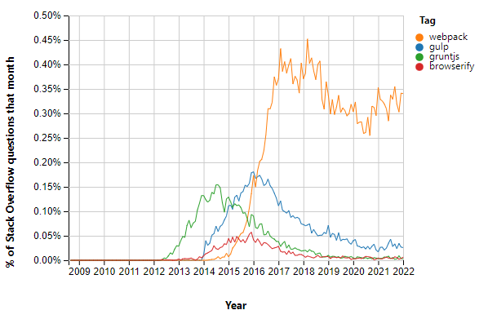
Can I speak to your manager?
CSS / HTML / JavaScript / media files
Task runner / Bundler / Bundler native ESM
Coding vs Configuration
Convention over configuration
Notes:
We need to manage assets for a web page (HTML/ …). We can use bash to automate, but that is not good. Later task runners are getting less popular. A module bundler is a tool that bundle, initially, all JavaScript resources into a single file.
Left image is about supported features in predefined tests, right represents questions on stackoverflow.
Bundlers focus on combining static assets.
Sources:
https://www.ionos.com/digitalguide/websites/web-development/gulp-vs-grunt-differentiating-between-the-task-runners/
https://blog.logrocket.com/node-js-task-runners-vs-module-bundlers/
https://insights.stackoverflow.com/trends?tags=gulp%2Cwebpack%2Cgruntjs%2Cbrowserify
https://bundlers.tooling.report/

Slide 5
Expectations
Copy files
Apply tools (tsc, sass, babel)
Run tests
Dev server
Hot reloading
HTTPS (self signed certificate)
API proxy
Code splitting
Dynamic imports
Tree shaking
Shared bundles
Minification
Compression
…

Slide 6
Browserify
Consider: 2023/2024
Notes:
https://browserify.org/ [2011] Bundler Pure bundler, as such it must be used with task runner like Gulp or Grunt. Focus on using Node.js packages in frontend ~ used to be a close competitor to webpack.

Slide 7
Grunt: The JavaScript Task Runner
Consider: 2023/2024
Notes:
https://gruntjs.com/ [2011-2012] Task Runner Employ temporary files. Focus on plugin configuration (tasks), there is a huge number of plugins ~6K. Configuration is huge nested object.

Slide 8
Gulp.js
Task runner, 2013
Programming over configuration.
Build pipelines using tasks Over 2.7K plugins
Task composition: series(), parallel()
Configuration file – JavaScript/…
Employ (memory) streams and pipelines
Watching files: watch()
const { src, dest } = require('gulp');
exports.default = function() {
return src('src/*.js') .pipe(dest('output/'));
}
exports.build = series(
clean,
parallel(
cssTranspile,
series(jsTranspile, jsBundle)
),
parallel(cssMinify, jsMinify),
publish
);
Notes:
Gulp is design to automate a build pipelines consisting of tasks. Pipelines are specified in JavaScript/Typescript/… file.
Example load all files and move them to other location. We can apply transformations along the way. Other example is a composition of tasks into a pipeline.
“watch” allow to execute task when a file change.
Compare to Grunt:
Use memory streams
Sources:
https://gulpjs.com/

Slide 9
Broccoli
Consider: 2023/2024
Notes:
https://github.com/broccolijs/broccoli [2013 - 2021] Task Runner Build resources using pipelines.

Slide 10
Turbopack
Consider: 2023/2024
Notes:
https://vercel.com/blog/turbopack
Rust-based successor to Webpack, use since Next.js 13

Slide 11
Webpack
Bundler, 2012
Complex configuration Zero-configuration with Webpack 4
Handles non-code assets (images, css, … ) with require ES6 module syntax
Loaders
Plugins
Consider: 2023/2024
Notes:
Configuration similar to Grunt or Gulp. Primary focus is on combining JavaScript files with require statements. Before we may need Browserify + Gulp, Webpack can handle all.
Webpack can load JavaScript and JSON, for other formats it needs loaders. For example, reading raw text, css or TypeScript. Overall loader transform a single module.
On the other hand, Plugin can do much more like optimization, injection of environment variables.
Sources:
https://webpack.js.org/
https://webpack.js.org/concepts/hot-module-replacement/

Slide 12
Demo
Webpack & LinkedPipes: ETL
Notes:
Start with common.js next is production.js then develop.js. I hope this shows the complexity. Also, we are missing hot-reloading!
Do not try this at home, the code is old – initial commits 2018-07-30
https://github.com/linkedpipes/etl/commit/34ce8224d6f442b1fd4120b1716bed5d89926f8f

Slide 13
Rollup
Consider: 2023/2024
Notes:
https://rollupjs.org/ [2015] Task Runner Easier configuration compared to Webpack, easier plugin implementation.

Slide 14
Parcel.js
Zero-configuration bundler, 2017 (V2 2020)
JavaScript, HTML, CSS, CSV, TypeScript, CoffeScript, Sass, Stylus, Less, SugarSS, Vue, Elm, JSON, TOML, GraphQL, YAML, GLSL, Prug, MDX, XML, …
Consider: 2023/2024
Notes:
Webpack is hard to configure, there is an alternative. Parcel can take a file (like HTML) and scan and prepare all what is needed. You need to use the right plugin, but Parceljs can load it for you automatically.
Sources:
https://parceljs.org/

Slide 15
Demo
Parcel.js & datova-kancelaria
Notes:
The configuration is much smaller.
https://github.com/datova-kancelaria/nkod-software/tree/f7ac55b14013be3f5ccd218070120d6495106b57
Showcase: JavaScript, SCSS, …

Slide 16
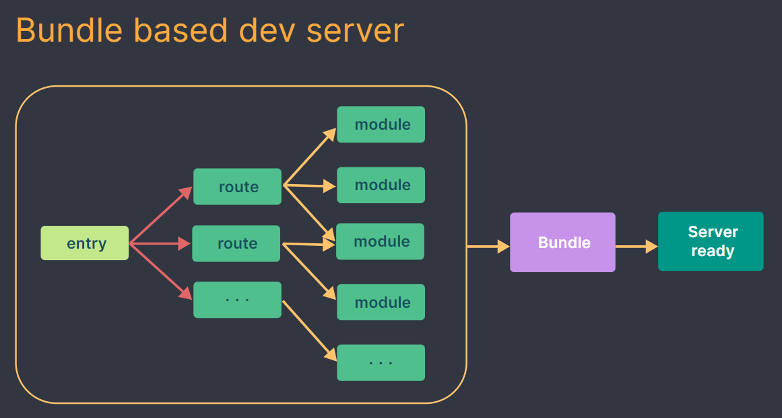
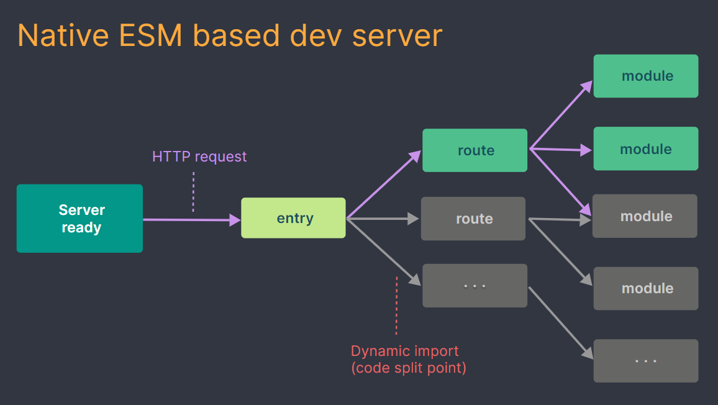
Vite
Bundler
Wrap esbuild, native ESM modules
Unbundled deployment
Notes:
The idea is to employ native Javascript modules (ESM).
Resource:
Images are from Vite documentation.
https://vitejs.dev/guide/why.html#how-is-vite-different-from-x
https://blog.konnor.site/misc/bundlers-and-beyond/

Slide 17
Demo
Vite & hot deployment

Slide 18
Create React Application
Set up a modern web app by running one command.
React specific libraries and functionality.
You can “eject” from the CRA to webpack, Babel, ESLint, ...
React's documentation, released on 2023-03-16, no longer recommends CRA as the go-to solution for creating React applications.
npx create-react-app my-app
cd my-app
npm start
Notes:
This is sort of a library specific tools wrapping what we need to develop our application.
Issues with used tools, dependencies, warnings, … removed from official documentation in 2023.
For example, starting dev server may take up to 80s on CRA and under a second with Vite (depends on a project).
Resources:
https://create-react-app.dev/
https://dev.to/ag2byte/create-react-app-is-officially-dead-h7o
https://luketheweb.dev/blog/what-is-vite-and-why-should-you-use-it-instead-of-create-react-app

Slide 19
Testing
Units Tests / Integration Tests / Regression Tests
Test-Driven Development
UI Tests / End-to-End testing (e2e)
Asynchronous Testing
Browser Specific
Notes:
Asynchronous testing ~ imagine sending a HTTP request where you need to wait. Now consider JS is a single thread application with promises. As such the test function ends before it can be evaluated.

Slide 20
Testing
Test Framework
Assertions
Stubs / Mocks
Code Coverage
Browser
describe(GitHub', function () {
describe(‘LandingPage', function () {
it(‘should not contain kitten', function () {
driver.get('http://github.com’);
chai.expect('#site-container h1.heading').dom.to.not.contain.text("I'm a kitty!");
} } }
Notes:
What we need:
Framework are about running tests, run them and show the result.
Assertions allow us to express the test.
Stubs / Mocks (Test Double Library) to answer what was called and how many times.
Code Coverage to know what was tested, important for introducing tests into legacy code.
Browser to run test in a specific environment.
Example: Mocha, Selenium, Chain.
References:
https://mochajs.org/ - [Test Framework] design to run and report test results. In the example. Without assertion library or stub library.
https://jasmine.github.io/ - [Test Framework] with assertions and test doubles (stubs / mocks)
https://karma-runner.github.io/latest/index.html – [Browser Testing] Using a web server executes test code in a spawned browser (Chrome, Firefox) instances. It can run in multiple browsers and devices. Mocha can do that as well, but the focus is different.
https://www.chaijs.com/ - [Assertion Library] (assert, expect, should).
https://istanbul.js.org/ - [Code coverage]
https://sinonjs.org/ [Stub Library] Can also mock whole HTTP server.
https://selenium.dev/ - [Browser] automation (browser specific drivers), not only for testing.
Specialized libraries may offer better functionality and allow for modular test design.

Slide 21
Meta-Frameworks
Did somebody say .. server-side rendering?
Next.js (React)
Nuxt.js (Vue)
Gatsby (React)
Remix (React)
Astro (React, Vue, Lit, Svelte, …)
…
Features:
Build-in Optimizations (Images, fonts, ..)
Data fetching / Server Actions
Route handlers
SSR
…
Notes:
The objective is to address the deployment and provide you with the environment.
- - - - - - - - - - - - - - - - - - - - - - - - - - - - - - - - - - - -
Dan Abramov - author of Redux,
https://twitter.com/dan_abramov/status/1259614150386425858
React was released 2013, ~2016 the Framework of choice
Resources:
https://nextjs.org/
https://astro.build/
https://www.gatsbyjs.com/
https://remix.run/
https://nuxt.com/

Slide 22
Demo
Server-side rendering (SSR)
Notes:
Resources:
https://github.com/bluwy/create-vite-extra/tree/master/template-ssr-vanilla

Slide 23
Small to medium React projects
You might not need a toolchain
<script src=“…/react.production.min.js" crossorigin></script>
<script src=“…/react-dom.production.min.js" crossorigin></script>
<script src=“…/babel.min.js"></script>
<script type="text/babel“> …. </script>
You might need a toolchain, but like in 2023+
npm create vite@latest my-application -- --template react
You might need a ….
npx create-next-app@latest
Notes:
Sources:
https://reactjs.org/docs/create-a-new-react-app.html

Slide 24
(Mono)repository
Git Submodules
A single repository for your code
NPM / YARN Workspaces
Lerna, Turborepo, Nx
Notes:
Dependency detection and code linking.
Build process can also be optimized.
While this increase coupling, it actually allows to better decouple UI and Service/Business layer into multiple projects.
Turborepo
CI/CD shared caches
Compatible with Lerna / NPM, YARN V1 workspaces
Nx – more powerful, can replace workspaces / Lerna, code Generators, extensible by plugins.
Source:
https://nx.dev/
https://turbo.build/
https://lerna.js.org/

Slide 25
Lerna
Consider: 2023/2024
Notes:
Resource:
https://lerna.js.org/

Slide 26
Turborepo
Consider: 2023/2024
Notes:
Resource:
https://turbo.build/

Slide 27
Nx
Consider: 2023/2024
Notes:
Resource:
https://nx.dev/

Slide 28
Demo
Monorepository
Dataspecer
Notes:
Resource:
https://github.com/mff-uk/dataspecer/

Slide 29
JavaScript age
Notes:
The First Age was about building out a language
The Second Age was about users exploring and expanding the language
The Third Age is about clearing away legacy assumptions and collapsing layers of tooling. Also, the tools may not be implemented in JavaScript.
Source:
https://www.swyx.io/js-third-age/

