Slide 1
User Interface JavaScript
NSWI153 - Advanced Programming of Web Applications
2023/2024
Petr Škoda
https://github.com/skodapetr
https://www.ksi.mff.cuni.cz

Slide 2
Disclaimer
I am biased …

Slide 3
Demo
úřední desky
GitHub
Demo
Notes:
Examples using Vanilla JavaScript. Show only code, read-only UI, imperative style of programming, we say how should the UI be modified.

Slide 4
Objectives
Create user interface We need to render or create HTML page. Can be client or server side.
Listen to events We need to be able to listen for events and changes as user interaction with the page.
Update data model Once user perform action, we need to update our data model. This may be a complex change recomputing multiple values.
Update user interface Once our data model is ready, we need to synchronize changes with the HTML page (DOM).

Slide 5
jQuery
“It makes things like HTML document traversal and manipulation, event handling, animation, and Ajax much simpler with an easy-to-use API that works across a multitude of browsers. ”
We know how to do things; it was just about doing more.
DOM Traversal and Manipulation
Event Handling
Better DOM API
Open sourced in January 2006.
// Execute when page is ready.
$( document ).ready( () => { … } );
// Register for an event.
$( "p" ).on( "click", (event) => { … });
// Set button content.
$( "button.continue" ).html( "Next Step..." );
// Get a value from an input, pass a value to set it.
$( "#myselect" ).val();
Notes:
jQuery also wrap AJAX, now we have Fetch API – much better. jQuery is still active (57K star as of 2023), but most plugins are deprecated. There is also a library with UI elements. The focus was to make common task easier.
Sources:
https://jquery.com/
https://github.com/jquery/jquery
https://api.jqueryui.com/

Slide 6
Objectives in the Age of jQuery
Create user interface Render HTML at server (static / PHP), wait for page to load to initialize jQuery.
Listen to events Using jQuery register for events.
Update data model
Update user interface Using jQuery set value based on the change.
Notes:
Now that we solve DOM, we need to take care of the business logic.

Slide 7
D3.js
Visualization library (bring data to life)
Selection
Computed properties / Transitions
Enter / Exit
Event handling
// We can use d3 like jQuery.
d3.selectAll("p").style("color", "blue");
// Create new paragraphs with given text.
const p = d3.select("body")
.selectAll("p")
.data([4, 8, 15, 16, 23, 42])
.text( value => value );
// New object enters data.
p.enter().append(“p")
.text(value => value ) .attr(“class", “bar");
// Object leaves data.
p.exit().remove();
Notes:
Designed to work well with SVG as a way to draw.
We can compute properties in functions from data.
D3 lets you transform documents based on data; this includes both creating and destroying elements.
Event handlers are added using .on({event name}, {callback})
Sources:
https://d3js.org/
https://github.com/d3/d3
http://using-d3js.com/08_01_events.html
https://medium.com/@mbostock/a-better-way-to-code-2b1d2876a3a0

Slide 8
Demo
prankweb
GitHub
Demo
Notes:
Like previous example, yet the state management is complicated. Is there a way to tackle this?

Slide 9
Angular.js
“AngularJS support has officially ended as of January 2022.” (since 2010)
Custom HTML directives.
View, Controller separation.
Custom HTTP wrapper ($http.get(…), …).
angular.module("app", [])
// Register a controller.
// We can request injection of services like
// $html.
. controller("counter", function($scope, $http) {
// This is executed on binding.
$scope.value = "initial";
// All in $scope is usable from HTML.
$scope.onClick = () => $scope.count = "";
});
<!doctype html>
<html ng-app="app"> <body>
<div ng-controller="counter">
<input type="text" ng-model="value">
<button ng-click=“onClick“>
{{value}}
</button>
</div>
</body> </html>
Notes:
The fetch API standard since 2015.
CodePen with Angular.js https://codepen.io/NickCelaya/pen/qXjPbB .

Slide 10
Angular.js
Scope, digests , …
https://docs.angularjs.org/guide/scope
https://ponyfoo.com/articles/angle-brackets-rifle-scopes
https://www.newline.co/ng-book/p/The-Digest-Loop-and-apply/
Optional: 2023/2024

Slide 11
Angular.js
Two-way data binding ~ synchronize two data sources.
<section ng-app="clickApp">
<div ng-controller="clickCtrl">
<button ng-click="addNum()">
<p>Add Num</p>
</button>
<p>{{count}} : {{value}}</p>
</div>
</section>
angular.module("clickApp", []) .controller("clickCtrl“, function($scope){
$scope.count = 0;
$scope. value = 0;
$scope.addNum = () => $scope.count++;
$scope.$watch('count’, (next) => $scope. value = next + 1 );
$scope.$watch(value', () => {
$scope.count += $scope.count % 2 === 0;
});
// …
});
Notes:
Automatic synchronization of data between JavaScript and HTML. We have live view of the data. We need something that will update the values in Model. Propagation is handled by the framework. Two-way databinding allows for quick prototyping, there was saying Angular Jaguar …
Angular.js CDN https://cdnjs.cloudflare.com/ajax/libs/angular.js/1.6.5/angular.min.js .
We can use $watch to register for changes on a $scope, watchers are saved in $$watchers.
Assignment of a variable to $scope or using in HTML creates a $watch.
Angular can detect change, see next slide for more information on when are changes detected. Once detected all relevant watchers are invoked. Changes are detected by comparing old values with new values.

Slide 12
Angular.js
Two-way data binding ~ synchronize two data sources.
One-time data binding.
Change detection: dirty checking
Angular.js is a framework!
setInterval(() => { // NOT WORKING !
$scope.count += 1;
}, 1000);
setInterval(() => {
$scope.$apply(() => $scope.count += 1);
}, 1000);
// Internal method invoked to start the digesting, // i.e. calling all watchers.
$scope.$digest();
Notes:
Sometimes we need to bind only once, like title or static data. There is no need to register watcher for such binding. It is an optimization called one-time data binding.
The framework needs to know when something has changed, how does the framework know?
Angular.js utilize $digest and $apply. $apply takes a function and executes it in Angular scope. We need to use this when computing something outside $scope (like event handler).
This would be common for async operations, luckily Angular provides custom $http. From this perspective Angular.js was a framework providing all user needs.

Slide 13
Backbone.js
2010 - …
Optional: 2023/2024
Notes:
https://en.wikipedia.org/wiki/Backbone.js
https://github.com/jashkenas/backbone

Slide 14
Knockout
2010 - 2019 (feature complete
Optional: 2023/2024
Notes:
https://en.wikipedia.org/wiki/Knockout_(web_framework)
https://github.com/knockout/knockout
https://github.com/justlep/knockout-esnext

Slide 15
Ember.js
2011 -
Optional: 2023/2024
Notes:
https://en.wikipedia.org/wiki/Ember.js
https://github.com/emberjs/ember.js

Slide 16
Objectives in the Age of Angular.js
Create user interface Client side rendered code with JavaScript. HTML template files with custom attributes and elements.
Listen to events Two-way data binding and event handling.
Update data model Two-way data binding. Custom code and watchers for propagations, notify about change using specialized methods.
Update user interface Two-way data binding.
Notes:
Angular.js is not the only library, there were others (see hidden slides: Backbone.js, Knockout, Ember.js, …).
The main problem is the business logic, watchers can get quite complicated, inconsistencies may be created.

Slide 17
Preliminaries
User interface as a function of an application state.
Two-way data binding is not easy to manage for large projects as there are hidden dependencies. Watcher-Watcher
One-way data flow / one-way data binding / unidirectional data flow. Watcher-Event
Change detection (manual / automatic / publish-subscribe ).
State
User Interface
Event
Change Request
Notes:
Unidirectional data flow is used in scope of React.
Change detection:
Manual – user need to detect (React : setState, AngularJS : $digest, $apply). Control is handled back to user code, and later the framework is called to perform change detection.
Automatic - user must follow specifics of the library (Vue, Immutability, Redux)
Publisher / Subscriber (Knockout)
Sources:
https://stackoverflow.com/questions/34519889/can-anyone-explain-the-difference-between-reacts-one-way-data-binding-and-angular
https://reactjs.org/docs/two-way-binding-helpers.html
https://www.accelebrate.com/blog/two-way-data-binding-angular-2-and-react

Slide 18
Preliminaries
Virtual DOM
Specification of a desired state
Browse’s DOM tree is updated to match to the Virtual DOM tree
Declarative approach
When should we re-render?
<p>Hello all!</p>
<p class="big">Hello World!</p>
const virtualDom = {
type: "p",
props: {},
children: [ " Hello all!!" ],
};
const virtualDom = {
type: "p",
props: { "class" : "big" },
children: [ "Hello World!" ],
};
18
Notes:
We may need to access the real DOM, for example to set focus. Frameworks often provide some sort of a reference (createRef in React).
HTML like syntax is also used by Angular and AngularJS.
The examples at the bottom are two Virtual DOMs as HTML and JavaScript.
Original objective was to allow developer to re-render entire app on every single state change without worrying about performance. This works nice with the UI as a function approach.
Sources:
https://preactjs.com/tutorial/01-vdom
https://github.com/developit/htm
https://blog.angular.io/how-the-angular-compiler-works-42111f9d2549

Slide 19
Virtual DOM example
Current state (source)
Desired state (target)
<div id=“content”>
<ul class=“list”>
<li>First</li>
</ul>
Loading items …
</div>
<div id=“content”>
<ul>
<li>Second</li>
<li>First</li>
<li>Third</li>
</ul>
<div>
Total items loaded 2.
<button>Load next</button>
</div>
Loading items …
</div>
Patch / Diffing / Reconciliation / …
Notes:
Array modification with filtering. Mention change detection, i.e., how to know when to re-render. We know this, DOM is just a tree but that is inefficient.
Rendering Virtual DOM is called mount. Updating from one to another is called patch/diffing/reconciliation.
The reconciliation algorithm cannot make any assumptions about the incoming virtual DOM tree, so it must fully traverse the tree and diff the props of every vnode in order to ensure correctness. Even nodes that do not change needs to be created. This is one of the most criticized aspect of virtual DOM: the somewhat brute-force reconciliation process sacrifices efficiency in return for declarativeness and correctness.
For example, Vue has Compiler-Informed Virtual DOM – with hints from compiler about the content.
The mounting function can be just calling document API to create DOM elements.

Slide 20
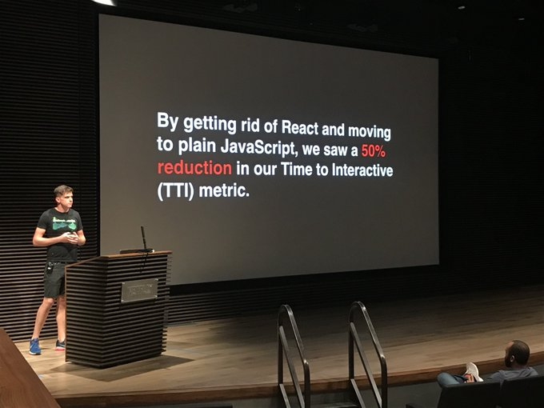
React.js
<?php
$post =
<div class="post">
<h2>{$post}</h2>
<p>Hey there.</p>
<a href={$like_link}>Like</a>
</div>;
“The library for web and native user interfaces” (since 2013)
Rendering library with a huge ecosystem. Rendering library only!
Introduced JSX.
User interface as a function.
Virtual DOM.
Component state (unidirectional data flow)
props
state ( this.state, this.setState, useState, … )
…
React 2017 !== React 2021 !== React 2023 !== compiled React …
Notes:
History:
First signs are from 2010 where Facebook introduced xhp (similar to JSX syntax, anything inside {} is interpreted as a PHP script - see the code fragment) into PHP.
In 2012 Facebook acquired Instagram so they need their internal technology to be decoupled from Facebook. They saw it as an alternative to HTML5.
2013 open-source targeted at innovators does not receive warm welcome in general.
2015 First version of React native (iOS, Android), Redux (state management). React is considered stable and mature, next year it gets mainstream.
2017 Netflix removed React (https://twitter.com/NetflixUIE/status/923374215041912833)
184K GitHub Start as of 2022.03
React 2017 using Class Components and mixins, React 16.8.0 (2019) introduced hooks (we use this one), React 2024 (focused server side first, Next.sj).
Sources:
https://beta.reactjs.org/learn Nice tutorial from JS to React
https://blog.risingstack.com/the-history-of-react-js-on-a-timeline/
https://github.com/phplang/xhp

Slide 21
React.js: JSX
React utilize JSX to let user define the desired state as a sequence of function calls. It is possible to utilize React without JSX.
<button onClick = { () => this.like() }>
Like {times} !
</button>
React.createElement("button", {
onClick: function onClick() {
return _this.like();
}
}, "Like ", times, “!");
function MediaPlayer(props) {
return ( <div> { props.playing ? ( <Button text="Stop" /> ) : ( <Button text="Play" /> ) } </div> );
}
Notes:
The JSX is transformed into a JavaScript. The curly braces allow us to use JavaScript in the template.
By default, React DOM escapes any values embedded in JSX before rendering them.

Slide 22
React.js: Component API
class Example extends React.Component {
constructor(props) { super(props); this.state = { count: 0, name: props.name };
this.onClick = this.onClick.bind(this); }
onClick() { this.setState({count: this.state.count + 1}) }
render() { const {name, count} = this.state;
return
<div>
<p>{name} clicked {count} times</p>
<button onClick={this.onClick}>Click me</button>
</div> } }
Using ES2015 (ES6) classes. Simple inheritance, no mixins.
React.Component vs React.PureComponent.
Smart components vs. dump components.
Prefer Hooks to HOCs and Render Props.
Notes:
HOC – example of connecting Redux (state management) to a components. We wrap a component (function) into another component (function). Another example is data loader, where the HOC waits for data to be loaded.
Render Props – pass function as a property to allow sharing of code, example can be component to render.
HOC and Render Props were designed to share code between components. They are patterns invented by the community.
Resources:
https://stackoverflow.com/questions/42556083/what-does-bindthis-in-constructor-do-in-reactjs

Slide 23
React.js: Component lifecycle
Mounting
constructor
static getDerivedStateFromProps()
render()
componentDidMount()
Unmounting
componentWillUnmount()
Updating
static getDerivedStateFromProps()
shouldComponentUpdate()
render()
getSnapshotBeforeUpdate()
componentDidUpdate()
Notes:
Legacy and unsafe methods are not included here. There is also support for catching exception.
componentDidMount - You may call setState() immediately in componentDidMount(), it will cause rerender but before updating the DOM.
componentDidUpdate – setState() will cause another update, use only with condition.
getDerivedStateFromProps – when state depends on props and state. This can be mostly avoided.
getSnapshotBeforeUpdate – we can store DOM data before update here, like a scroll position.
How can we map those when it comes to hooks?
Sources:
https://reactjs.org/docs/react-component.html
https://legacy.reactjs.org/docs/state-and-lifecycle.html

Slide 24
Demo
React application with Components
jsComplete.com
playcode.io/react
Notes:
Component API
HOC + render props.
Resources:
https://react.dev/reference/react/Component

Slide 25
Recompose
Recompose is a React utility belt for function components and higher-order components. 2015 - 2018, with announcement: “Hi! I created Recompose about three years ago. About a year after that, I joined the React team. Today, we announced a proposal for Hooks (Oct 25, 2018). Hooks solves all the problems I attempted to address with Recompose three years ago, and more on top of that. ….”
Hooks was just one more attempt to tackle issues of sharing common logic between components.
const enhance = withState('counter', 'setCounter', 0)
const Counter = enhance(({ counter, setCounter }) =>
<div>
Count: {counter}
<button onClick={() => setCounter(n => n + 1)}>Increment</button>
<button onClick={() => setCounter(n => n - 1)}>Decrement</button>
</div>
)
Optional: 2023/2024
Notes:
Resources:
https://github.com/acdlite/recompose
https://reacttraining.com/blog/where-did-hooks-come-from

Slide 26
React.js: Functional components
Definition of Example component using Hooks. The component takes props (state from parent) and use useState (hook) for internal state.
React Conf 2018: React Today and Tomorrow and 90% Cleaner React With Hooks
import React, { useState } from 'react';
function Example(props) {
const [count, setCount] = useState(0);
return (
<div>
<p>{props.name} clicked {count} times</p>
<button onClick={() => setCount(count + 1)}>
Click me
</button>
</div>
);
}
Notes:
20.03.2024
Resource:
https://www.youtube.com/watch?v=dpw9EHDh2bM

Slide 27
React.js: Hooks NOT explained …
Pure rendering function.
Designed to share logic.
Selected hooks:
useState
useEffect
useMemo
useReducer
The main drawback is (besides code quality) the fact that we need memoize.
import React, { useState } from 'react';
function Example(props) {
const [count, setCount] = useState(0);
return (
<div>
<p>{props.name} clicked {count} times</p>
<button onClick={() => setCount(count + 1)}>
Click me
</button>
</div>
);
}
0
Notes:
Hook based example; how may a React Code look like. Steps in a navigation:
useState is call to React the entry point, we get back array with two variables. The value (getter) and the setter.
We can reference the value in the render function just like any other variable.
We also get the set function. By calling this function React knows about the change. We must call it whenever the value changes! The function can be re-rendered multiple times and there are no names to variables. How does React know?
React use ordering of the calls. It simple set up a counter and increase it with every useState call, this is why ordering matter.
Rendering functions must be pure (not side effects) as react can call them multiple times. In development React may call the method twice by design, just to check.
On re-render only components with changed props are rendered. Render must be pure function without side effects.
React Hooks are invoked repeatedly every time a component updates. Restriction compared to Vue:
Hooks are call-order sensitive and cannot be conditional. Calling a hook function uses up one slot and increments an internal "slot number" counter so the next call uses the next slot.
Variables declared in a React component can be captured by a hook closure and become "stale" if the developer fails to pass in the correct dependencies array.
Expensive computations require the use of useMemo
Event handlers passed to child components cause unnecessary child updates by default and require explicit useCallback as an optimization.
Source:
https://alexkondov.com/tao-of-react/
https://reactjs.org/docs/render-props.html
https://vuejs.org/guide/extras/composition-api-faq.html#comparison-with-react-hooks
https://reactjs.org/docs/hooks-intro.html

Slide 28
Demo
React application
jsComplete.com
playcode.io/react
Why react re-renders?
There is more …
Notes:
Application with a button
useState, useEffect, …
Extraction of a service function
Re-rendering, immutability. Set object of different type and try to modify the object directly.
Mixing MVC into a single file.

Slide 29
React.js: Rendering NOT explained …
React internals (subject of change … )
Calls the root render function.
Serves hooks (useState, useEffect, … ).
Waits for something to happen (synthetic event).
Execute user code in reaction to an event.
Notification (hook called).
Calls the root render function.
Reconciliation.
Commit (write changes to DOM).
Notes:
Reconciliation (async) then Commit (synch). When React gets to Commit phase, it has 2 trees and the effects list.
Update: recursively traverses the tree
If corresponding nodes have different types, the whole subtree is rebuilt. All components in the subtree are unmounted (and possibly mounted again)
Else it is updated:
Changed attributes are re-set (CSS style also modifies only changed properties)
Children are processed recursively
Key attribute may be used for matching children. If no key is present, they are matched by position.
There are hints like shouldComponentUpdate, there is also React.PureComponent with default implementation that test using shallow equal on props and state.
Sources:
https://reactjs.org/docs/reconciliation.html
https://geekflare.com/react-rendering/
https://dev.to/spukas/react-work-phases-4eaj
https://indepth.dev/posts/1008/inside-fiber-in-depth-overview-of-the-new-reconciliation-algorithm-in-react
https://www.velotio.com/engineering-blog/react-fiber-algorithm
https://andela.com/insights/building-your-own-version-of-react-from-scratch-part-1/
https://beta.reactjs.org/learn/render-and-commit

Slide 30
State management
Where do we store a state of our application? (useState /setState )
How do we share the state with other components? Props
Prop-drilling is bad!
React solution: Context: Provider, Consumer
Original idea: User interface as a function of a state. Distributed state (systems) are complicated …
Root
Header
Main
Footer
Article
Section
Button
Notes:
We need to access same information in various location within our component tree. We do not want to use property drilling.

Slide 31
Single source of truth
User interface as a function
Redux
Action
Action
View
View
State
Store
Reducers
Flux (React)
Vuex (Vue)
Action
Dispatch
Action
Commit
View
Dispatcher
View
Mutation
Store(s)
Render
State
Mutate
Notes:
Arrows show main flow, you may need to read data from store/state in some instances.
Left Up: General patters
State – source of truth
View – mapping to UI
Action – modify State
Works fine inside a small component.
- - - - - - - - - - - - - - -
Left Down: Flux - application architecture
We get deterministic state, easy to reason about (scope of change).
Dispatcher (singleton) send actions to the stores (all stores).
Store is responsible for the modification, it is a combination of a store and a reducer from Redux.
Yet here is still an issue with shared state.
- - - - - - - - - - - - - - -
Right Top: Redux
A solution is to Extract that state into a SINGLE source of true for whole application called Store.
As a result, there is no dispatcher as all goes to a single store.
Reducers are pure functions and employ immutable state.
- - - - - - - - - - - - - - -
Right Down: Vuex
We have mutations are re-usable components.
- - - - - - - - - - - - - - -
The common theme is we have a source of truth and a unidirectional flow.
We can connect our stores to our application using hooks and provided functions. In some situations, this may be beneficial to passing the state using props. The reason is that by passing using props we can cause re-rendering. We can not replace this with React context (it only helps to avoid prop-drilling).
Sources:
https://facebook.github.io/flux/docs/in-depth-overview
https://vuex.vuejs.org/
https://redux.js.org/
https://github.com/reduxjs/react-redux/tree/4.x/src/components
https://punits.dev/jargon-free-intros/why-do-we-need-a-state-management-library-in-react/

Slide 32
Redux
State management library. There are binding for React.
const store = configureStore ({
reducer: reducer
});
const reducer = (state = new State(), action) => {
switch(action.type) {
case ActionAdd.Type:
// Immutability ! return { … state, value: state.value + 1 };
default:
return state;
}
};
// Invoke an action.
store.dispatch({ type: ActionAdd.Type });
// Register change listener.
store.subsribe(() => { … } );
// React hooks binding.
useSelector((state) => state.value ) ;
useDispatch( … );
// React HOC binding.
connect( mapStateToProps, mapDispatchToProps)(Component);
Notes:
Resource:
https://github.com/reduxjs/redux
https://react-redux.js.org/api/connect

Slide 33
The React alternative?
Vue was created by Evan You after working for Google using AngularJS in several projects.
“I figured, what if I could just extract the part that I really liked about Angular and build something really lightweight.”
“In February 2014, that was how I first released it as an actual project. I put it out on Github and sent a link to Hacker News, and it actually got voted to the front page."
Notes:
First code commit in 2013. Image is from JSConf China, 2015.
Resource:
https://en.wikipedia.org/wiki/Vue.js

Slide 34
Vue.js
Since 2014.
Declarative Rendering
Reactivity
Single-File Component (*.vue)
Options API, Composition API (Hooks)
Custom renderer interface
Recommended (Official) libraries
Vue 2 vs Vue 3 💔
Angular.js successor (we have Angular)
<input
:value="text"
@input="event => text = event.target.value">
<div @click="doSomething">
<p v-if="seen"> {{message}}</p>
<p v-else> … </p>
</div>
<input v-model="text">
Notes:
194K GitHub Start as of 2022.03
Using HTML templates.
Vue track changes and propagate them to DOM.
Under the hood, Vue compiles the templates into highly-optimized JavaScript code. Combined with the reactivity system, Vue is able to intelligently figure out the minimal number of components to re-render and apply the minimal amount of DOM manipulations when the app state changes.
There are also references to the DOM.
Sources:
https://sfc.vuejs.org/
https://vuejs.org/api/custom-renderer.html

Slide 35
Reactivity
There is no need to explicitly announce change in the data by manually calling a function! Vue.js utilize runtime dependency-tracking based reactivity system.
Example with Composition API.
import { ref, computed, watch } from 'vue';
// Define reactive state.
const A0 = ref(0);
const A1 = ref(1);
// Define computed value.
const A2 = computed(() => A0.value + A1.value);
// Watch for a change, there are limitations …
watch(A2, (next, previous) => { .. });
// Set value to update all dependencies.
A0.value = 2;
ref(0)
ref(1)
computed(…)
Notes:
There are two ways of intercepting property access in JavaScript: getter/setters and Proxies.
Vue 2 used getter/setters exclusively due to browser support limitations - this created issues with arrays and dynamically added properties.
In Vue 3, Proxies are used for reactive objects and wrapping object with getters and setters for refs.
Vue is able to track changes in JS using get/set or proxy and create a dependency graph. When something change it knows what to update.
By default, the state is deeply reactive, but there is API to create shallow reactive objects.
Vue buffers changes and apply them with next tick.
Vue's reactivity system works by deeply converting plain JavaScript objects into reactive proxies. The deep conversion can be unnecessary or sometimes unwanted when integrating with external state management systems.
Vue is buffering updates and execute DOM update asynchronously later. This we can change a value multiple times without causing a re-render. We can await nextTick() to wait for update to happen.
Sources:
https://vuejs.org/guide/extras/reactivity-in-depth.html
https://vuejs.org/guide/essentials/reactivity-fundamentals
https://vuejs.org/api/reactivity-core.html

Slide 36
Vue.js: Options API / Composition API
Options API example
Composition API example
export default {
data: () => ({ count: 0 }),
methods: {
increment() {
this.count++;
}
},
mounted() {
console.log(`The initial count is ${this.count}.`);
},
}
import { ref, onMounted } from 'vue'
const count = ref(0);
function increment() { count.value++; }
onMounted(() => {
console.log(`The initial count is ${count.value}.`);
});
watch(count, async (next, prev) => { … } );
Some users moving from Options API found their Composition API code less organized, and concluded that Composition API is "worse" in terms of code organization. We recommend users with such opinions to look at that problem from a different perspective.
Notes:
The Options API is implemented on top of the Composition API! The composition API must be wrapped in exported object with setup function, alternatively we can add “setup” argument to the script tag.
Do not use arrow for methods in Options API as that would mess with this.
The watch API is only for Composition API as there is no space for the Options API.
Composition API:
Invokes setup() or <script setup> code only once.
Vue's runtime reactivity system automatically collects reactive dependencies used in computed properties and watchers, so there's no need to manually declare dependencies.
No need to manually cache callback functions to avoid unnecessary child updates. In general, Vue's fine-grained reactivity system ensures child components only update when they need to.
We acknowledge the creativity of React Hooks, and it is a major source of inspiration for Composition API.
Sources:
https://vuejs.org/
https://vuejs.org/guide/extras/composition-api-faq.html#trade-offs

Slide 37
Demo
Vue
play.vuejs.org
playcode.io/react
Notes:
Component API
Composition API

Slide 38
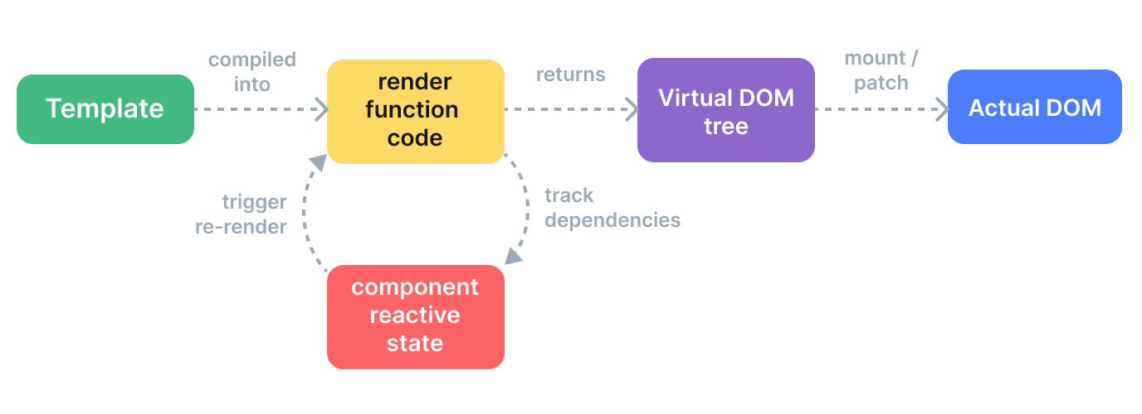
Vue.js: Virtual DOM
<div>
<div v-if="ok">yes</div>
<span v-else>no</span>
</div>
<div>
{ok.value ? <div>yes</div> : <span>no</span>}
</div>
h('div', [ok.value ? h('div', 'yes') : h('span', 'no’)]);
Notes:
Example of “if” statement implementation. There are more: for, slot, teleport. We get those additional construct to be used in HTML part of Vue files.
Sources:
https://vuejs.org/guide/extras/rendering-mechanism.html#render-pipeline
https://vuejs.org/guide/extras/render-function.html

Slide 39
Vue.js: Reactivity & State management
Similar time and place like React (Options API -> Composition API), state management libraries.
import { ref } from 'vue’
// ref is like reactive property in Vue 2, we use it
// to create a reference to a value we can
// directly update.
const globalCount = ref(1)
export function useCount() {
const localCount = ref(1)
return { globalCount, localCount }
}
// store.js
import { reactive } from 'vue’
// creates reactive object which can be observed
// for changes
export const store = reactive({ count: 0 });
<template>
<button @click="store.count++">
From A: {{ store.count }}
</button>
</template>
<script setup>
import { store } from './store.js'
</script>
Notes:
Thanks to reactivity we can just store our data in a module and import it.
We can build custom logic using something that look like a hook (Composable API).
Beware of using global state! But unlike with hooks the implementation is straightforward.
With ref we can bind only to primitive values. With reactive we can detect change of a property.
Using reactive does not change the original object (like it use to in Vue 2).
Resources:
https://enterprisevue.dev/blog/ref-vs-reactive-in-vue-3/

Slide 40
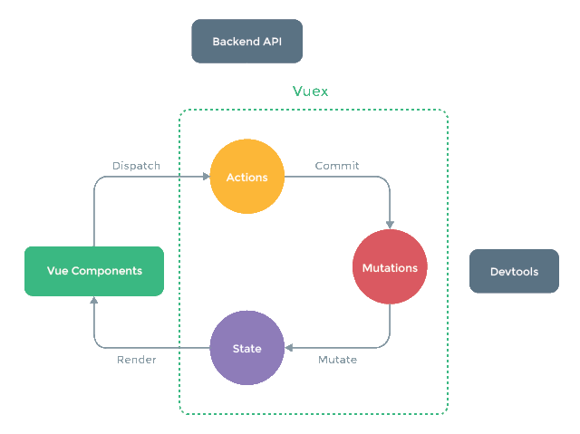
Vue.js: Vuex
“The official state management library for Vue has changed to Pinia. “
“Vuex helps us deal with shared state management with the cost of more concepts and boilerplate. It's a trade-off between short term and long term productivity.”
Concept of one-way data flow.
Concepts:
State - single state tree. Connect to component using mapState helper.
Getter - way to compute derived state.
Mutation - the only way of changing a state.
Action - can be async, commit mutations.
Optional: 2023/2024
Notes:
Resources:
https://vuex.vuejs.org/#what-is-a-state-management-pattern

Slide 41
Vue.js: Pinia
We can share state using Reactivity, but distributed state is complicated.
Remember: “Not all applications need access to a global state”.
Benefits of using a store:
Actions / Mutations and DevTools
Time travel
Hot module replacement
Server-Side Rendering support
…
import { defineStore } from 'pinia’
// There is also Composition API inspired syntax.
export const useCounterStore =
defineStore('counter', {
state: () => ( { count: 0 } ),
actions: {
// We rely on this, so no arrow functions.
increment() { this.count++ },
},
getters: { // Computed values
nextCount: (state) => state.count + 1
}
})
const counter = useCounterStore();
counter.increment();
Notes:
Before we have Vuex, or Redux for React. Since Redux is not popular for small to medium application let us show Piana here.
Do not include local state (visible items, internal state) in the store.
Sources:
https://pinia.vuejs.org/

Slide 42
Objectives with React.js / Vue.js
Create user interface React.js: Client side rendered, use JSX to create Virtual DOM. Vue.js: Client side rendered, use custom HTML-based syntax.
Listen to events Create custom function listening to (synthetic) events and changing state (state management). Vue.js: Use reactivity for simple values, register watchers to watch for a change.
Update data model React.js: Announce changes by calling setter from a hook or setState method, immutable data. Vue.js: Reactivity, optional immutability (for time traveling).
Update user interface React.js: Re-run rendering, React takes care of the update. Vue.js: Reactive updates.

Slide 43
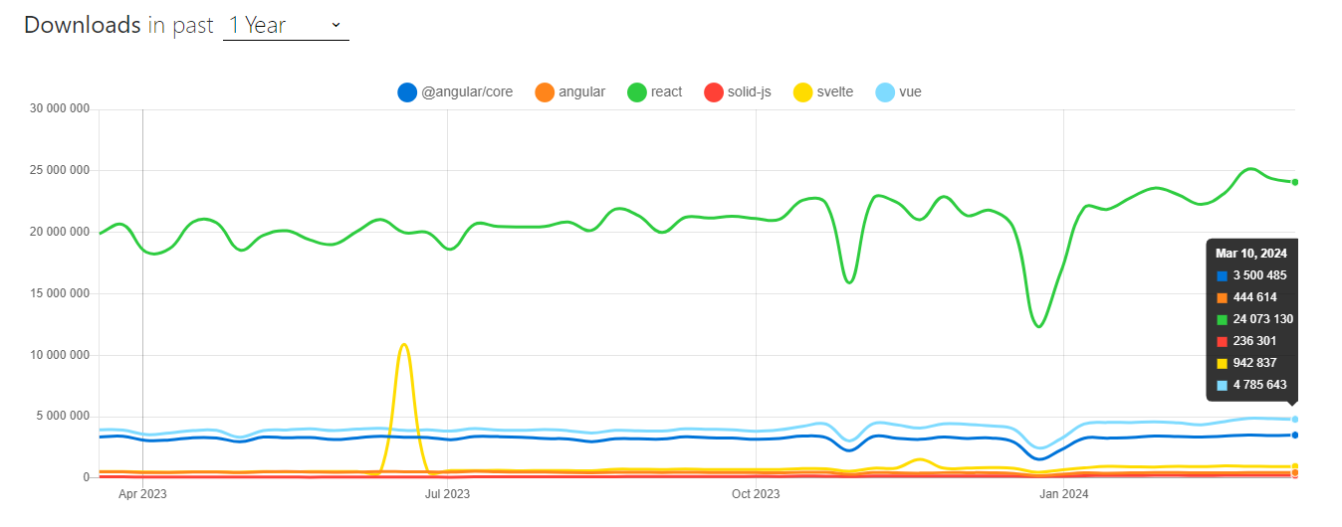
This is just the beginning ...
Notes:
Can you guess the drop?
Sources:
https://www.npmtrends.com/@angular/core-vs-react-vs-solid-js-vs-svelte-vs-vue-vs-angular

Slide 44
Server-side
Server-Side Rendering (SSR)
Why
Faster time-to-content
Unified mental model
Better SEO
Why NOT
Setup
Server load
Browser / Server specific code
Dehydration / Hydration
Static Site Generation (SSG)
User independent rendering
Easier deployment
<p><div>hi</div></p>
Notes:
We can not use client specific functionality on server and vice versa, for example no window or document. In addition, templates (for Vue) are compiled in a different way on server (string) and client (Virtual DOM). For example (Vue) onMounted or onUpdated methods are not called on the server side. Global state is shared among multiple client requests on the server side.
If you've already pre-rendered or server-side-rendered your application to HTML. But then we need JS to take back control ~ hydration.
There can be issues with hydration where browser parse the DOM producing mismatch. Frameworks can handle some of this, yet there is performance penalty.
We also need to manage routing, data fetching, and state management stores in a universal manner. A solution might be to go with higher level tools. Vue (Nuxt, Quasar, Vite SSR) or React (Next, ).
We may need both of them, depending on the page at hand.
Sources:
https://vuejs.org/guide/scaling-up/ssr.html#overview

Slide 45
Server-side
Features
Image optimization
Internationalization
Zero Configuration
Hybrid: SSG and SSR
Incremental Static Regeneration
Routing
API Routes
Built-in CSS Support
Production build
Building Blocks
User Interface
Routing
Data Fetching
Rendering
Integration
Infrastructure
Performance
Scalability
Developer Experience
Notes:
Features:
For example, Next.js pre-renders every page by default. React 18 propose only server-side components, which are not rendered on client side at all. We can choose rendering method on per-page basis.
Static Regeneration is for Static Site Generation (SSG).
Routing – Next.js will employ File-system routing, so there is no need for input index.html and index.js. Frameworks will mostly force a directory structure upon you.
Production – Compilation for given browsers, Minifying, Bundling, Code Splitting, Tree-Shaking.
For each block we can build it our-self or use existing solution.
UI – how user interacts with out application.
Rendering – when and where render the static and dynamic content.
Integration – auth, payments, …
Infrastructure – where to deploy and run code (Serverless, CDN, Edge, ..)
Origin – the server that store and run the original code.
Content Delivery Network – for static sites on multiple locations around the world.
Edge – is a concept, servers close to the user. CND can be part of the Edge, the difference is that Edge can run the code.
Scalability – also include developer team size
Developer Experience – a dev server for example.
Data Fetching – client / server side. We can have unified interface (Gatsby with GraphQL) over data sources like file system, API WordPress ... Remix for example join HTTP API declaration and use in fronted, so you do not need that separately – we can read files in client code from server inside a loader. This also help to reduce the data size making sites load faster.
For example, React only provide user interface, but dos not deal with the rest, not even where the rendering should take place.
Frameworks aim to fill in the missing building blocks. Some frameworks can be added additively into an existing application. For example, Next.js may will in more to a React application compared to Nuxt.js to a regular Vue application.
Some provide even ability to build cross-platform applications, like Quasar for Vue ,(more on write that later). To make this work Quasar provide custom set of components.
Sources:
https://nextjs.org/
https://nuxtjs.org/
https://www.gatsbyjs.com/
https://quasar.dev/
https://remix.run/

Slide 46
Progressive Web Apps
Optional: 2023/2024
Notes:
Sources:
https://developers.google.com/web/tools/lighthouse/

Slide 47
Do we need virtual DOM?
function render() {
return (
<ul>
{items.map(item => (
<li key={item.id}>{item.name}</li>
)}
</ul>
);
}
Notes:
Remind concepts of virtual DOM.
We can be without virtual DOM.

Slide 48
years of experience | % of survey respondents
< 2 | 13.9%
3-5 | 22.1%
6-10 | 20.1%
11-20 | 14.7%
> 20 | 5.5%
Demo
II. The State of JS 2021 (2022)
Changes over time
Front-end Frameworks
Notes:
In total there were 39 471 respondents.
Also show satisfaction vs usage.
There is difference between popular, nice to use and used.

Slide 49
Virtual DOM alternative
Svelte
“Svelte converts your app into ideal JavaScript at build time, rather than interpreting your application code at run time” ~ “Svelte is a compiler” Compile-time reactivity!
HTML, CSS, JavaScript ~ *.svelte
Specific use of features: labeled statement, export
HTML templates / directives: {#if loggedIn}, {#await promise}, … , on:click, …
tick()
Lifecycle methods: onMount, onDestroy, beforeUpdate, afterUpdate
Context API
Store: subscribe, writable, readable, derived, …
Notes:
Svelte compile code to imperative JavaScript that modify the DOM.
Specific:
Label statements are used to mark reactive properties : $
Module export is used to
Conditions and other in HTML {#if loggedIn}, {#await promise}, …
tick() can be waited to run code after DOM has been updated
Custom store implementation: subscribe, writable, readable, derived, … - object to implement, custom implementation for custom store.
Slots (with names) to pass HTML content down the tree.
Sources:
https://svelte.dev/
https://svelte.dev/tutorial/basics
https://svelte.dev/examples/hello-world
https://github.com/DeMoorJasper/parcel-plugin-svelte

Slide 50
Demo
Svelte 3.46.4 != Svelte 5
Online Editor
Routing Library
React Routing Library
Notes:
Basic interactivity, computed property, working with arrays. life cycle method with SSR.
Highlight change detection: this.setState({ count: count + 1 }); -> count += 1; $$invalidate('count', count);
Compare routing Library to React routing.
Sources:
https://github.com/sveltejs/svelte/blob/master/src/runtime/internal/Component.ts
https://github.com/EmilTholin/svelte-routing

Slide 51
Web components
Web standards:
Custom Elements
Shadow DOM
HTML templates : <template> , <slot>
class WordCount extends HTMLParagraphElement {
constructor() {
super();
const shadow = this.attachShadow( {mode: 'open'} );
const value = this.getAttribute('data-value');
….
} }
customElements.define( 'word-count', WordCount, { extends: 'p’ } );
Notes:
Use standards – so it is here to stay. In addition, they are framework agnostic and can be integrated.
Shadow DOM - encapsulation, it does not affect anything outside, for example CSS classes. It can be open or close to access using JavaScript from outside.
HTML templates - parts of HTML that are not rendered unless added to the HTML via JS. We can use this from Shadow DOM.
We have life cycle methods.
Definition call needs to happen after HTML is parsed.
Sources:
https://developer.mozilla.org/en-US/docs/Web/Web_Components
https://developer.mozilla.org/en-US/docs/Web/Web_Components/Using_custom_elements#libraries
https://developers.google.com/web/fundamentals/web-components/customelements
https://reactjs.org/docs/web-components.html
https://custom-elements-everywhere.com/

Slide 52
Demo
Web Components
Lit Playground
Notes:
There is also Stencil, similar API they are life cycle methods (like React).
We can get more benefits; we can build whole website with Stencil including SST.
Sources:
https://lit.dev/
https://lit.dev/tutorial/
https://stenciljs.com/

Slide 53
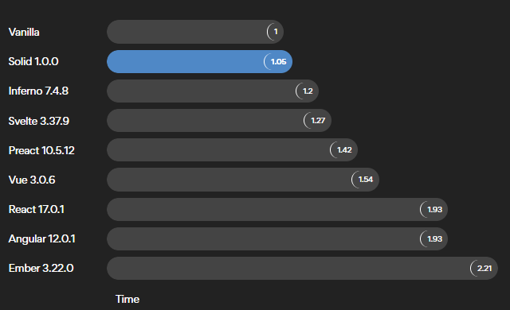
Performance
Values for 2022.
Notes:
Fastest rendering HTML .. even for redundancy in the markup as there is compression.
Solid vs Svelte
Solid has smarter reconciler, especially for lists
.. for more use google
Also, this may change over time
Sources:
https://www.solidjs.com/
https://ryansolid.medium.com/javascript-ui-compilers-comparing-svelte-and-solid-cbcba2120cea

Slide 54
SolidJS
“React without Virtual DOM”
Rendering: JSX, html`` Render ONCE !
Reactivity: Signals, Memos, and Effects
State Management: Store, Context
createEffect(() => {
console.log( count() );
});
<button type="button" onClick={increment}>
{count()}
</button>
Notes:
The API is close to React, perhaps hooks enhanced? In React we re-render the components in Solid we track the effects instead.
We can also employ html`` templates to get rid of JSX – can run in browser without transpilation.
But unlike react rendering happen only once.
Stores are wrapped with Proxy for reading only, modification must be done using a function.
Reactivity is similar to Vue 3 Composition API, where framework keep track of used resources. Unlike Vue it does not user get/set/proxy but leave us with functions.
Source:
https://www.solidjs.com/

Slide 55
Demo
SolidJS
Playground
Notes:
Basic application similarities to React and Vue. onMount and computed property.

Slide 56
HTML strikes back
Alpine.js
“like jQuery for the modern web”
Small API:
15 attributes (x-data, x-on, x-text, x-model, x-for, x-init …)
6 properties
2 methods (Alpine.data, Apine.store, Alpine.bind )
Reactivity: Proxies, with
return new Function(
["__self", "scope"],
`with (scope) {
${expression}
}; `);
<script src="//unpkg.com/alpinejs" defer></script>
<div x-data="{ count: 0 }">
<button x-on:click="count++">Increment</button>
<span x-text="count"></span>
</div>
Notes:
Framework is about inversion of control – we give them all the power and they give us something back. Perhaps we need a little reactivity. Similar to jQuery, a library for manipulating DOM. But it has added reactivity. In addition, Alpine focus more on HTML, jQuery is still more about JavaScript.
The API is little bigger than the intro site states. This is not good to building SPA. We have Stores to manage global state.
Reactivity is built on proxies an all data are saved in the DOM using the _x_ properties (may change over time). The with () from JS is used to enforce proper scope, result is we can just use variables from function calls. The example is only for illustration, based on generateFunctionFromString (https://unpkg.com/alpinejs@3.9.1/dist/cdn.js ).
Sources:
https://alpinejs.dev/
https://daily.dev/blog/alpine-js-the-ultimate-guide
https://codewithhugo.com/alpine-tips/
https://codewithhugo.com/alpinejs-inspect-component-data-from-js/

Slide 57
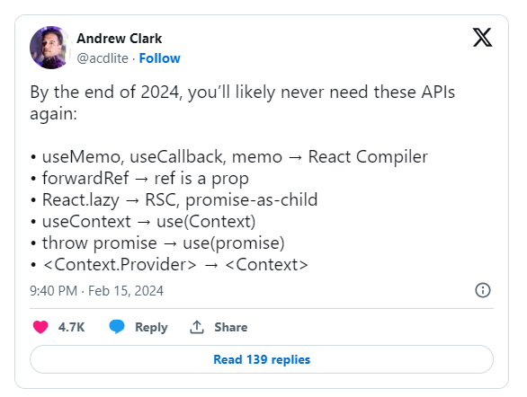
2023 / 2024
React Compiler Solution for hooks related issues.
Vue Vapor Vue without virtual DOM.
Svelte runes
Signals Adopted by many frameworks for state management. Popularized by SolidJS and used by Knockout.
Optional: 2023/2024
Notes:
Sources:
https://x.com/acdlite/status/1758229889595977824

