Slide 1
Server
NSWI153 - Advanced Programming of Web Applications
2023/2024
Petr Škoda
https://github.com/skodapetr
https://www.ksi.mff.cuni.cz

Slide 2
Starting point
PHP
$_GET, $_POST, $_REQUEST, $_SERVER
CGI / FastCGI / PHP-FPM / mod_php / mod_SuPHP / …
$app = AppFactory::create(); $app->setBasePath("/~skoda/lab-02"); $app->get('/name/{name}', function ($request, $response, $args) { $response->getBody()->write("Hello " . $args['name’]); return $response;
});
Notes:
CGI (common gateway interface) Specification/Protocol for transferring information between a Web server and a CGI program, with minimal requirements on the system/applications. A CGI program is any program/script designed to accept and return data that conforms to the CGI specification. Compared to alternative this is very slow. Advantage is strong isolation.
FastCGI (around 1996] Improves CGI, the main idea is to keep the program running the whole time with a pool of workers. It is more than a proxy, there are some metadata to be included, communication using sockets/TCP/...There is still a strong isolation. It can run as a process inside the web-server.
PHP-FPM (FastCGI Process Manager) Primary PHP FastCGI implementation for (Apache, Nginx, ...) with standalone server.
mod_php An Apache module to run PHP, scripts are executed inside the Web Server.
mod_SuPHP Like mod_php but can change the user/group that the process runs under to address permission issues.
Resources:
https://fastcgi-archives.github.io/FastCGI_Specification.html
https://www.nginx.com/resources/wiki/start/topics/examples/fastcgiexample/
https://flask.palletsprojects.com/en/2.1.x/deploying/fastcgi/
https://www.digitalocean.com/community/tutorials/understanding-and-implementing-fastcgi-proxying-in-nginx
https://www.php.net/manual/en/install.fpm.php
https://www.plesk.com/blog/various/why-do-you-need-php-fpm/
https://www.slimframework.com/

Slide 3
Demo
Python & Sockets
Notes:
- Detecting end of a request.
- Generating valid a HTTP response.
- Size of a waiting queue before connections are refused.
- Long running tasks – global interpreter lock (may be removed).

Slide 4
Web server
“A web server is computer software and underlying hardware that accepts requests via HTTP” Wikipedia 2024
Features:
Debug Mode / Error Handling / Logging
Routing
Static Files
Template Rendering
Request Data (POST, …) / Response Data
Sessions
SSL
…
Language:
PHP
Python
NodeJS
Java
…
<<actor>>
user
<<component>>
web server
Notes:
ACTIVITY
Resources:
https://flask.palletsprojects.com/en/2.1.x/

Slide 5
Python

Slide 6
Python & Web framework
Flask is a Micro-Framework (no database, validator, … ).
Slim Framework
…
$app = AppFactory::create(); $app->get('/name/{name}’, ….);
…
app = Flask(__name__)
@app.route("/")
def hello_world():
return "<p>Hello, World!</p>"
Notes:
Like Slim Framework for PHP.
Implements most of the features mentioned before.
Resources:
https://wiki.python.org/moin/WebFrameworks
https://flask.palletsprojects.com/en/2.1.x/

Slide 7
Demo
Python & Sockets Flask
<<actor>>
user
<<component>>
???
<<component>>
our code
Notes:
- Now we are using library – a dependency.
- Still problem with long running tasks.
- Note that we should use guard/check (if __name__ == '__main__’) for app.run()
- Where is the web-server coming from ?

Slide 8
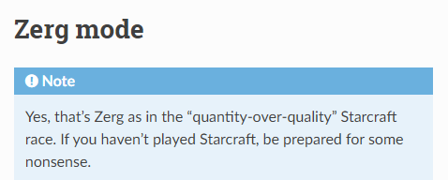
Are we there yet?
Deployment:
uWSGI (Apache, Nginx, …)
mod_wsgi (Apache)
Gunicorn / …
CGI / FastCGI (Apache, Nginx, … )
Cloud
Notes:
Our application is not ready for deployment … or is it?
What are the hosting options we have?
WSGI (Web Server Gateway Interface) servers – replace mod_python (not a standard specification). Server just invoke a callable object, PEP 3333.
uWSGI - alternative to FastCGI, external server. It is a protocol and a server. There is a Zerg mode.
Resources:
https://flask.palletsprojects.com/en/2.1.x/deploying/
https://modwsgi.readthedocs.io/en/master/
https://uwsgi-docs.readthedocs.io/en/latest/Zerg.html
https://www.fullstackpython.com/wsgi-servers.html
https://gunicorn.org/#quickstart

Slide 9
Python Web server
Gunicorn
WSGI and HTTP server for Unix
Pre-Fork Model
Sync Workers
Async Workers (coroutines)
…
Shared state/memory
wsgi.py
app = Flask(__name__)
…
gunicorn -w 4 -b :8020 wsgi:app
Notes:
There are alternatives to Gunicorn, just check the documentation.
The server run a master/main thread and workers; master have zero knowledge of workers who handle the requests. Workers can be created and destroyed. Data sharing is tricky among processes, we can pre-load data before the fork, but that is still not shared memory. We can employ “multiprocessing” package.
sync - every worker run a single request, no support for Keep-Alive. May be issue when handling IO as we are waiting.
async - based on Greenlets (Eventlet, Geventlet ) ~ co-routines.
The example run four workers and bind to port 8020. We can also start this from the Python script.
Resources:
https://flask.palletsprojects.com/en/2.1.x/deploying/
https://modwsgi.readthedocs.io/en/master/
https://uwsgi-docs.readthedocs.io/en/latest/Zerg.html
https://www.fullstackpython.com/wsgi-servers.html
https://gunicorn.org/#quickstart
https://www.geeksforgeeks.org/coroutine-in-python/

Slide 10
JavaScript
NodeJS

Slide 11
Node.js
JavaScript runtime environment based on V8 engine.
Offers natively many code packages:
Net - socket API, supports both TCP and UDP
TLS – sockets with encryption
DNS, HTTP, HTTP/2
…
Accompanied by npm package management system.
Uses single-threaded main loop for async operations (like JS in browser).
In many cases offers both async and sync API calls.
Built-in N-API for C/C++ bindings (JS-C interoperability).
Notes:
As there is a single-thread it is not good for vertical scaling.
We also have packages for handling inputs / output, working with files, processes or manage them as a cluster.
Resources:
https://nodejs.org/en/

Slide 12
JavaScript & Web framework
Express
Fast, unopinionated, minimalist web framework for Node.js
Middleware (POST, XML, Metrics, ... )
Slim Framework
…
$app = AppFactory::create(); $app->get('/name/{name}’, ….);
Flask
…
app = Flask(__name__)
@app.route("/")
def hello_world():
return "<p>Hello, World!</p>"
const app = express();
app.get("/home/:name", (req, res) => { … });
app.listen(8080, () => { … });
Notes:
Just another framework.
Example middleware is using serving static files, session, authentication, … examples in links bellow. It is designed for whole application.
To render templates, we need to employ rendering library ~ res.render('index', { title: 'Hey', message: 'Hello there!’ });
We can see that some principles are similar, like routing, routing arguments.
Resources:
https://expressjs.com/en/resources/frameworks.html
https://expressjs.com/
https://github.com/expressjs/express/tree/master/examples

Slide 13
Demo
NodeJS & Express
Middleware
Helmet
Notes:
- JavaScript
- Serving static content
- Single thread JS
In addition, the Middleware, is a new composition unit for use. We can add a new functionality. Helmet can hide PoweredBy option using “hidePoweredBy” configuration.

Slide 14
NodeJS Web server
Express
NODE_ENV="production“
node server.js
Process manager
Restart / OS Startup script
Clustering
Sticky sessions ?
Monitoring / Metrics
…
PM2
pm2 start npm --name my-app -i 4 -- start
Notes:
Content of this page assume we are using Express.
Using production may improve performance, see documentation fore more details.
NodeJS is running in a single thread, so we need some thread manager.
We may need to use Systemd, Upstart … may be completely different for Docker.
Clustering using cluster NodeJS module, keep in mind it is based on processes. Advantage is that one process failure does not kill all. There is no need to modify the code.
Request may be handled by anyone.
Alternative is StrongLoop PM, there is one more but not that strong.
Resources:
https://nodejs.org/en/
http://strong-pm.io/compare/

Slide 15
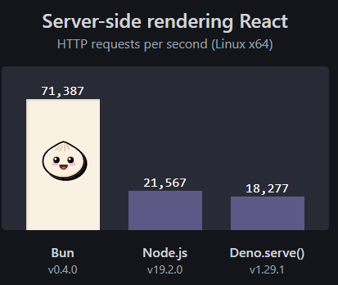
NodeJS Alternatives
Deno
JavaScript, TypeScript, WebAssembly
All-in-one : linter, code formatter, …
By default, no I/O access for packages
Permissions list (network, env. variables, file system)
Bun
Fast, Fast startup
All-in-one
Notes:
We can see integration of tools into a single package. We have this with higher level frameworks, or zero-configuration bundlers.
Deno is using V8, Rust, Tokio. Started as Typescript first project.
Bun is using JavaScriptCore and written in Zig.
NodeJS (19+) now have ts-node a loader for Typescript.

Slide 16
Bun.js
Optional: 2023/2024
Notes:
Resources:
https://bun.sh/

Slide 17
Deno
Optional: 2023/2024
Notes:
Resources:
https://deno.land/

Slide 18
Java
Notes:
ACTIVITY: What do we expect?
Similar to C# , similar concepts in other languages.
There is not global lock or single thread.

Slide 19
Java & Web framework
Why ?
JAX-RS
Specification only !
javax.ws.rs ~ jakarta.ws.rs (as of May 2019)
@Path("/pipeline")
public class PipelineServlet {
@GET
@Path("/list")
public Response getPipelines(@Context HttpServletRequest request) { … }
}
Notes:
Resources:
https://github.com/eugenp/tutorials

Slide 20
Demo
Java & Jetty
(Semi-)Improvised stand up ….
Notes:
java-jetty

Slide 21
Application Server
“An application server is a software framework that provides both facilities to create web applications and a server environment to run them.
...An application server acts as a set of components accessible to the software developer through a standard API defined for the platform itself.
... they implement services like clustering, failover, and load-balancing, … developers can focus on implementing the business logic.” Wikipedia 2023
Notes:
Focus on developers, productivity, all-in-one.

Slide 22
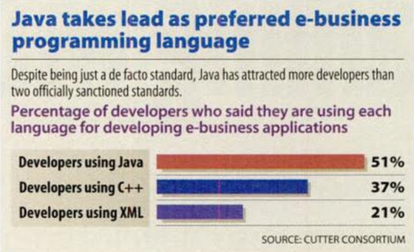
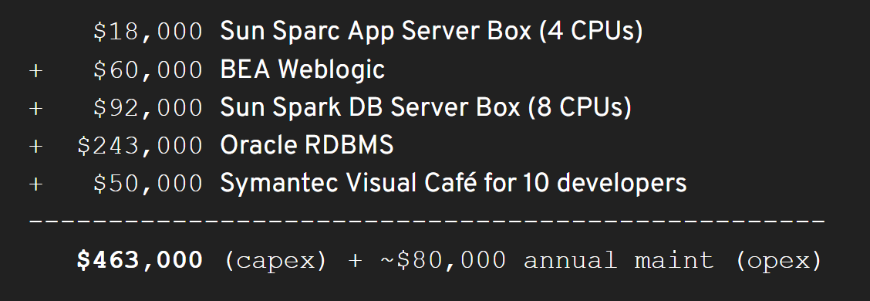
History
Infoworld December 13, 1999
Notes:
Java was dominated the market, also we see XML being used, remember AJAX.
The prices at the bottom are for IDE + compiler, we can still see similar pricing for example for SAP developer licenses.
- - - - - - - - - - - - - - - - - - - -
Cost of Java application (Application server HW, Application server SW, Database HW, Database SW, IDE). You need all of this and only then you would invite somebody to teach your developers how to code using Java.
Resources:
https://www.youtube.com/watch?v=pwxAZWqt4I8
https://docs.google.com/presentation/d/1DFy4ZZdsK2ftREetv_f52E-caZXOGX6GvgzGQlfSLfE
https://adtmag.com/articles/1999/12/27/bea-systems-weblogic-application-server.aspx
https://books.google.cz/books?id=4U4EAAAAMBAJ&pg=PA37&lpg=PA37&dq=1999+most+popular+java+ide&source=bl&ots=z3IYxlq9Hc&sig=KOQXhuDlasyuQDySBwazRW0HSe4&hl=en&ei=WP18TLXrG8GAlAf6y6nrCw&sa=X&oi=book_result&ct=result&redir_esc=y#v=onepage&q&f=true

Slide 23
Java Server
It is Java ! ( Java Enterprise Edition )
Web Server vs Application Server
*.war
Servers:
Apache Tomcat / Apache TomEE
Jetty
WebLogic (Oracle)
WebSphere (IBM)
WildFly (Red Hat)
GlassFish
…
Web Server | Application Server
Servlets | Servlets
JSP | JSP
WebSockets | WebSockets
JTA | JTA
JASPIC | Bean Validation
 | EJB
 | JPA
 | JMS
 | JavaMail
 | JAX-RS
 | JAX-WS
 | …
JAVA SE DEVELOPMENT KIT (JDK), VERSION 6
…
Licensed Software is not designed or intended for use in the design, construction, operation or maintenance of any nuclear facility.
Notes:
Application Server ~ software framework that resides in the middle tier of a server centric architecture. Specification is around 246 pages.
A servlet is simply a class which responds to a particular type of network request - most commonly an HTTP request.
Features:
JSP (Java Simple Pages)
JASPIC (Java Authentication Service Provider Interface for Containers)
Bean Validation (Annotations for value checks)
JTA (Java Transaction API)
EJB(Enterprise Java Beans)
JPA (Java Persistence API)
JMS(Java Message Service)
JAX-RS
JAX-WS
GlassFish is built on OSGI (Equinox OSGi or Knopflerfish OSGi runtimes).
Resources:
https://en.wikipedia.org/wiki/Jakarta_RESTful_Web_Services
https://www.baeldung.com/java-servers
https://blog.idrsolutions.com/2015/04/top-10-open-source-java-and-javaee-application-servers/
https://download.oracle.com/otndocs/jcp/servlet-4-final-spec/index.html
https://www.oracle.com/technetwork/java/javase/downloads/jdk-6u21-license-159167.txt
https://www.javatpoint.com/servlet-tutorial

Slide 24
Java Embedded Server
Run server inside your application!
You are not alone .. (Spring Framework, ...)
Notes:
This is relevant as many application servers now day run a single application.
In addition, the core (Java EE) is becoming less and less complex.
Resources:

Slide 25
Demo
Embedded Java Jetty
(Semi-)Improvised stand up ….
Notes:
java-embeded

Slide 26
Takeaway
Language specifics
General concepts

