Slide 1
Deployment
NSWI153 - Advanced Programming of Web Applications
2023/2024
Petr Škoda
https://github.com/skodapetr
https://www.ksi.mff.cuni.cz

Slide 2
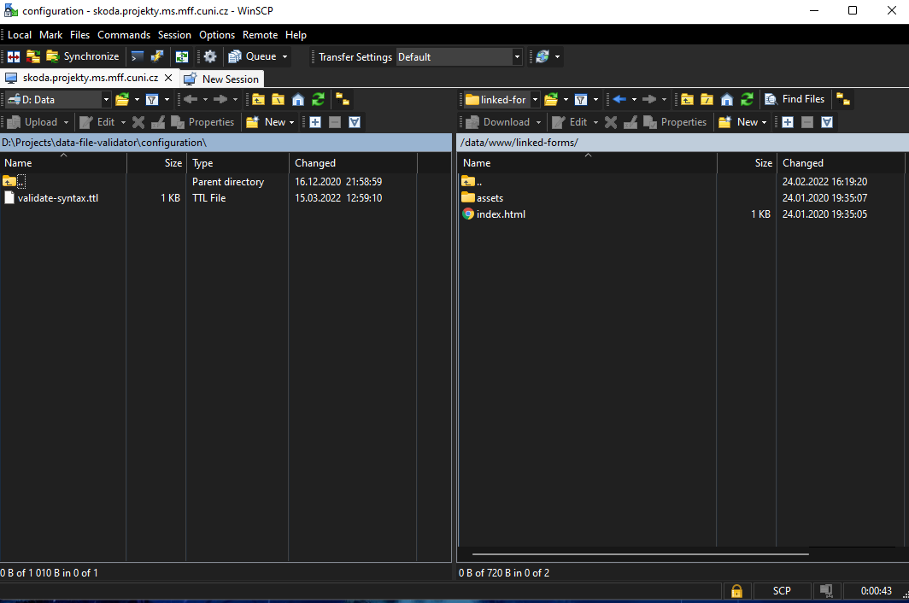
Starting point
Tools: WinSCP / SCP / SSH
Advantages
Near zero setup
Disadvantages
Manual
Single environment
Error prone
Notes:
Before it was about FTP into production.
Resources:
https://winscp.net/eng/download.php

Slide 3
Deployment
Notes:
ACTIVITY:
Where we develop?
What is a deployment?
Who deploys (we get back to this later)?
What we deploy?
Resource:
https://www.geekytees.co.uk/product/it-works-on-my-machine/

Slide 4
Deployment script
Advantages
Easy setup
Shareable
Environment variables
Disadvantages
Manual
Single environment
Dependencies (bash / make)
Team
deploy.sh
#!/usr/bin/env bash
npm run build
scp –r ./dist skoda@server:/opt/script
Makefile
build:
npm run build
deploy: build
scp –r ./dist skoda@server:/opt/script
Notes:
We can use .ssh/config and replace server name with a custom string, in addition we may get rid of the need to employ password. Environment variables can also be used to expand the functionality, for example target different deploy environment (develop, test, … ).

Slide 5
Ansible
Automation platform.
Playbook with YAML syntax.
Inventory with hosts (remote machines).
Use SSH and OS credentials (certificates) to access remote machines.
Task is not executed if the system is in a desired state.
Plugins
- hosts: webik
tasks:
- name: Stop service
service:
name: octopus-service
state: stopped
- name: Pull resources
git:
repo: '.....'
dest: /opt/octopus
version: main
- name: Build
shell: npm ci
args:
chdir: /opt/octopus
- …
Optional: 2023/2024
Notes:
Resources:
https://www.ansible.com/
https://github.com/linkedpipes/etl/tree/develop/deploy/ansible
https://github.com/ansible

Slide 6
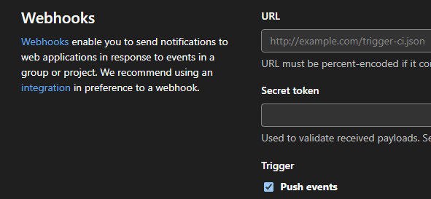
Webhook
Advantages
Automatic
Easy setup
Cloud services
Disadvantages
Single environment
Deployment failures
Localhost
Notes:
We can employ cloud services to deploy from a pull request automatically.
Resource:
netlify.com/pricing/

Slide 7
Deployment
Notes:
Let us think a little bit more about deployment.

Slide 8
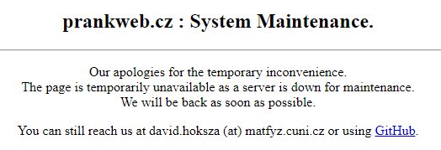
Downtime / New version
Server Maintenance
Fast, easy and functional?
Planned / scheduled maintenance.
Blue-green deployment
Switch from one deployment to another.
Canary deployment
Allows you to roll out new code/features to a subset of users.
Notes:
Resources are mostly popular introduction into the topic.
Resources:
https://www.split.io/glossary/canary-deployment/
https://circleci.com/blog/canary-vs-blue-green-downtime/
https://harness.io/blog/continuous-verification/blue-green-canary-deployment-strategies/

Slide 9
Multiple components
Applications consists of multiple components
Multiple versions of a library / runtime / component / application
<<component>>
web browser
<<component>>
web server
<<component>>
application server
<<component>>
database
Notes:
What does it mean to deploy an application?

Slide 10
Configuration
XML / YAML the whole ideas is to get the application configuration out, so it can be set by the operators.
Sources of a configuration:
Base URL
Database server
Instance name
Service URL
Storage / file system
Environment variable
…
Notes:
What does it mean to deploy an application?

Slide 11
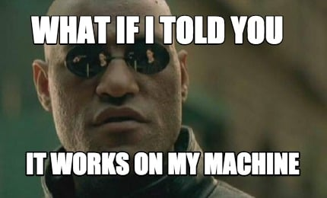
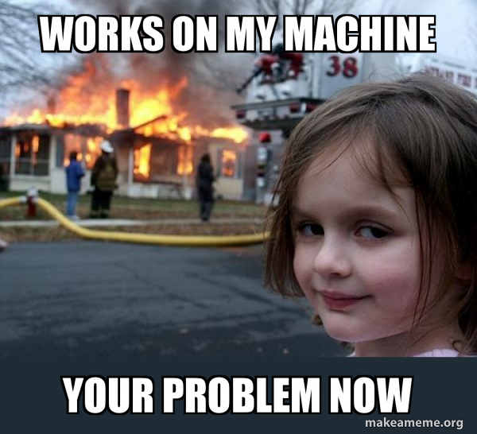
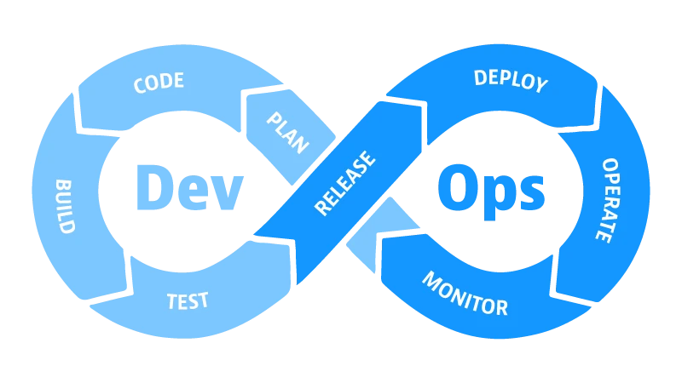
Operator?
Developer vs. Operator
Developer & Operator
with DevOps
Notes:
ACTIVITY:
Who is the operator?
Every role has a different skill set. The deployment is not only about a single component, but there can also be multiple components, specialized libraries even version of OS. Why is this a problem? It works on my machine …
Yet there are ways how to put them together.
Sources:
https://www.memecreator.org/meme/what-if-i-told-you-it-works-on-my-machine/
https://makeameme.org/meme/works-on-my-069a992b9c
https://memegenerator.net/instance/65760293/am-i-the-only-one-around-here-say-works-on-my-machine-one-more-time
https://memeshappen.com/meme/55254/SAY-IT-WORKS-IN-MY-MACHINE
https://makeameme.org/meme/works-on-my-5bc45d
https://www.dynatrace.com/news/blog/what-is-devops/

Slide 12
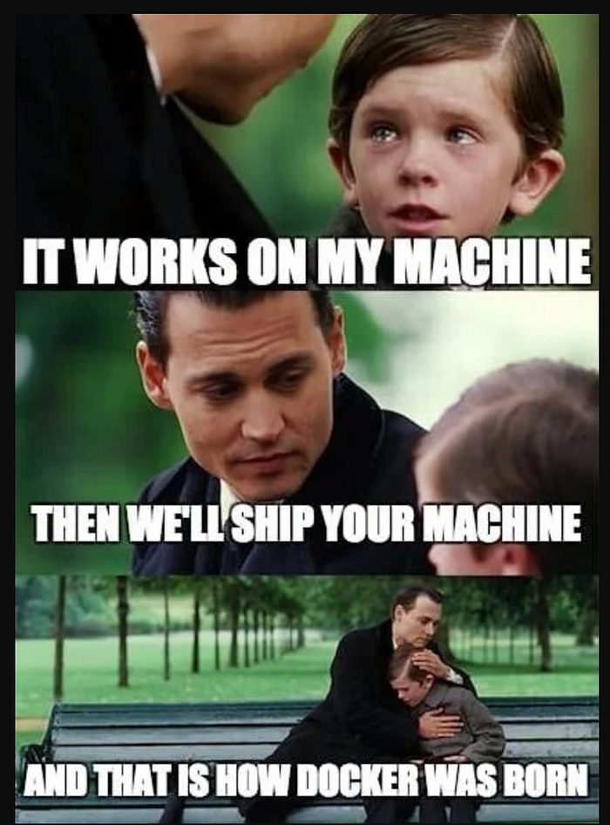
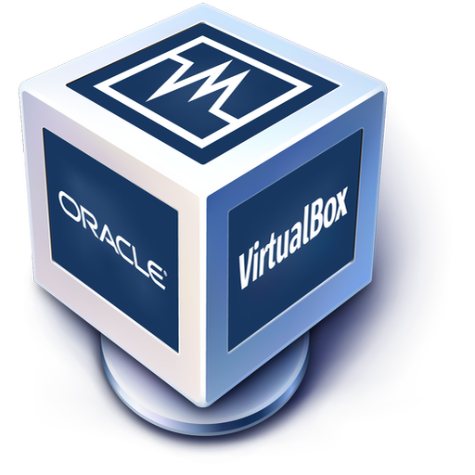
Virtual Machines: Oh, We have been here for the whole time …
Notes:
We already have a way how to ship a computer using virtual machine. The problem was the performance and not easy to use setup, although especially for the later there were attempts made.
Resources:
https://www.vagrantup.com/

Slide 13
Docker
There are other container technologies.
Notes:
Since March 2013.
Resources:
https://www.reddit.com/r/ProgrammerHumor/comments/cw58z7/it_works_on_my_machine/

Slide 14
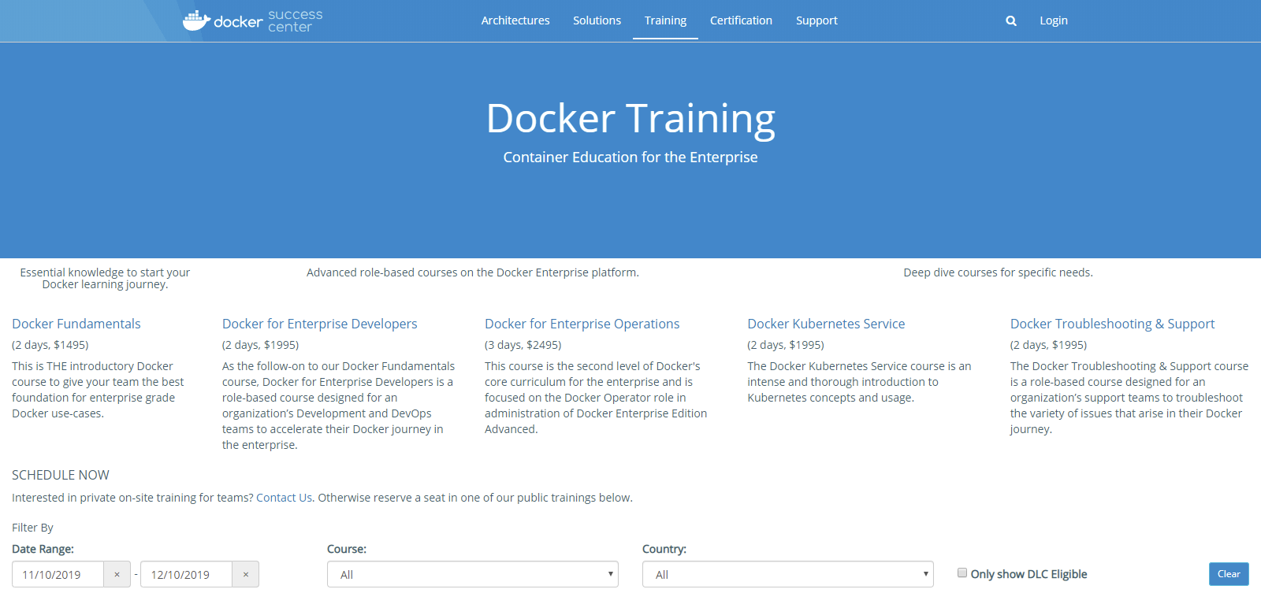
Warning
I want to learn Docker ...
print(“Hello, World!”)
C++ in 21 days
…
Notes:
Image is from 2019, no longer available, here just for illustration.
Sources:
https://success.docker.com/training/ (2019)

Slide 15
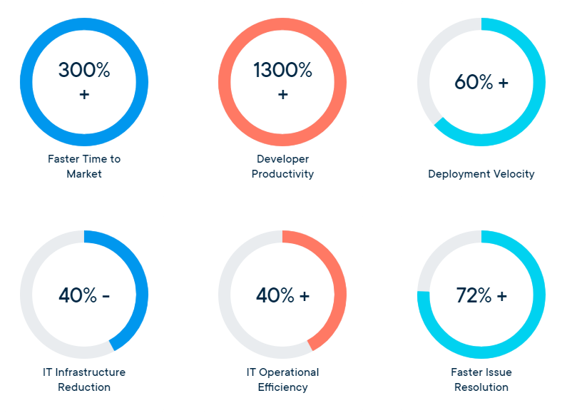
Selling points
Responsive deployment
Standardized environment
Lightweight and fast
Removed: 2023/2024
Notes:
Sources:
https://www.docker.com/why-docker (2019)
https://www.docker.com/resources/what-container (2019)

Slide 16
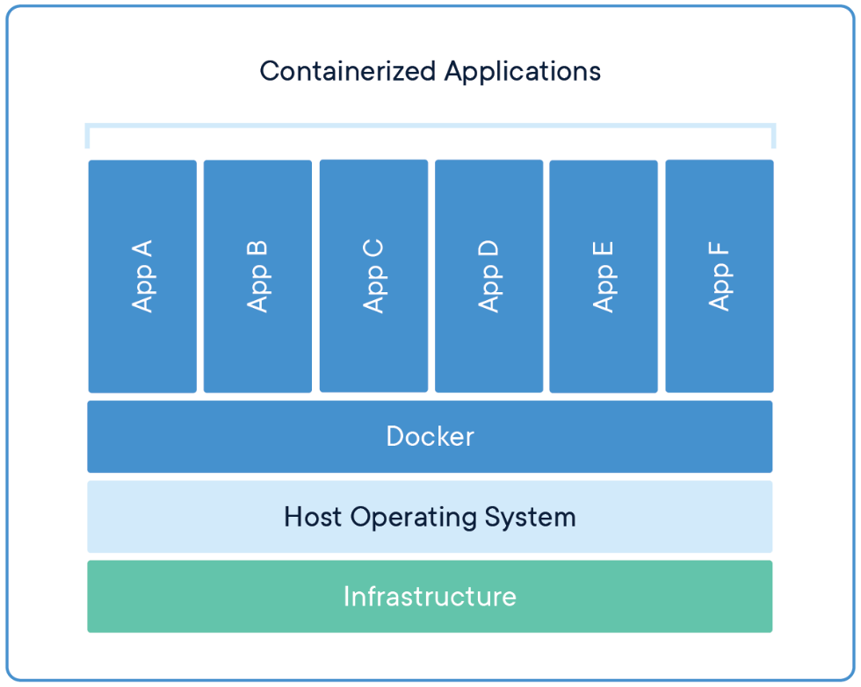
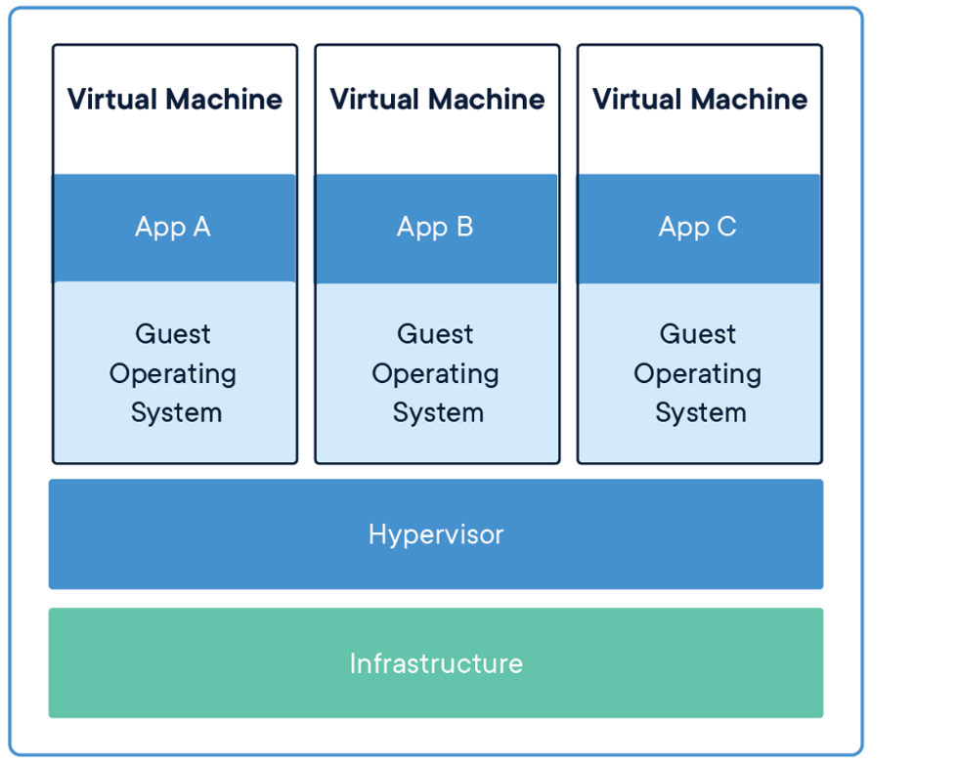
Docker internals
Linux namespaces provide isolated environments: pid, net, ip, mnt, uts
Control groups (cgroups) to limit resources.
Union file system (UnionFS) variants to manage file system.
…
Notes:
Containerization is a lightweight virtualization technology alternative to hypervisor virtualization: Image, Container, Dockerfile.
pid - process isolation
ip - inter-process communication
mnt - filesystem mounting points
uts - isolation of kernel and version identifiers
Source:
https://docs.docker.com/engine/docker-overview/#docker-engine (2019)

Slide 17
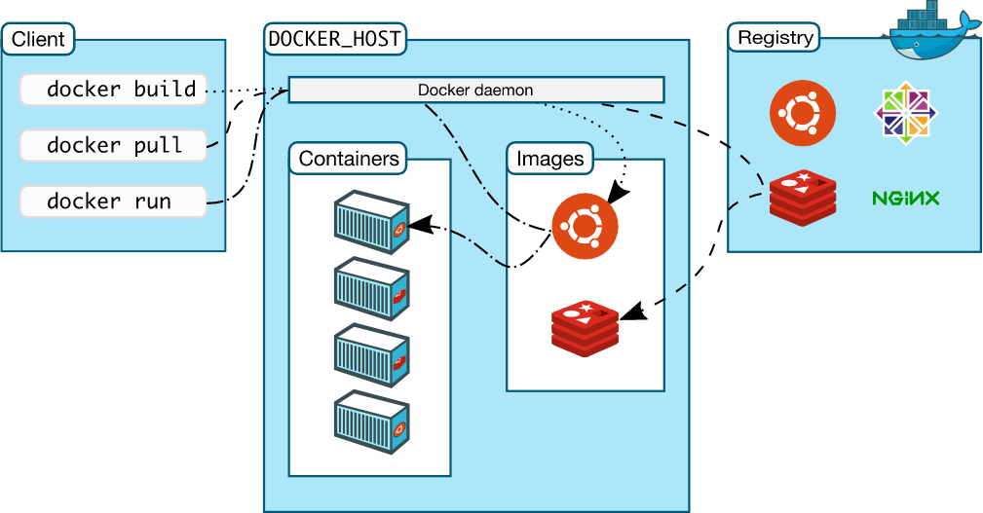
Docker internals
Notes:
Comment on the image: CLI, Deamon, Container, Image.
Source:
https://docs.docker.com/engine/docker-overview/#docker-engine (2019)

Slide 18
Dockerfile
FROM
ARG
ENV
WORKDIR
COPY
RUN
USER
EXPOSE
CMD
FROM node
ARG GOOGLE_ANALYTICS
ENV UID=5988
WORKDIR /usr/src/app
COPY package*.json ./
RUN npm install
COPY ./src ./src
USER ${UID}:${UID}
EXPOSE 8080
CMD [ "node", "./src/server.js" ]
DO NOT TRY THIS AT HOME
Notes:
ARG – build time variable
ENV – environment property
EXPOSE – does not publish the port more of a documentation
CMD – defaults to execute the container, can be replaced from a command line
Sources:
https://nodejs.org/en/docs/guides/nodejs-docker-webapp/

Slide 19
Ecosystem
Pod Manager tool (podman) alias docker=podman
Containerd
Buildah / BuildKit
cri-o
rkt
…
Notes:
Use to be called alternatives, but that is really not the case here.
podman – full engine with all parts, daemon-less (unlike Docker), no root required.
Containerd - daemon, no image building or handling of volumes. Default Docker runtime.
Buildah – just image builder, part used by Podman. Developed by Red Hat Foundation.
BuildKit – image builder, allow for parallel image building.
cri-o – for k8s, lightweight.
rkt ( https://github.com/rkt/rkt/ ) – no longer officially maintained
Sources:
https://openvz.org/
https://podman.io/
https://linuxcontainers.org/
https://containerd.io/
https://buildah.io/
https://docs.docker.com/develop/develop-images/build_enhancements/
https://github.com/GoogleContainerTools/kaniko
https://cri-o.io/

Slide 20
Resources
Docker Captains
Volumes / Networking / …
ADD / MAINTAINER / ENTRYPOINT / LABEL / …
Dockerfile Reference
Multi-stage builds
API (REST, /var/run/docker.sock)
cAdvisor

Slide 21
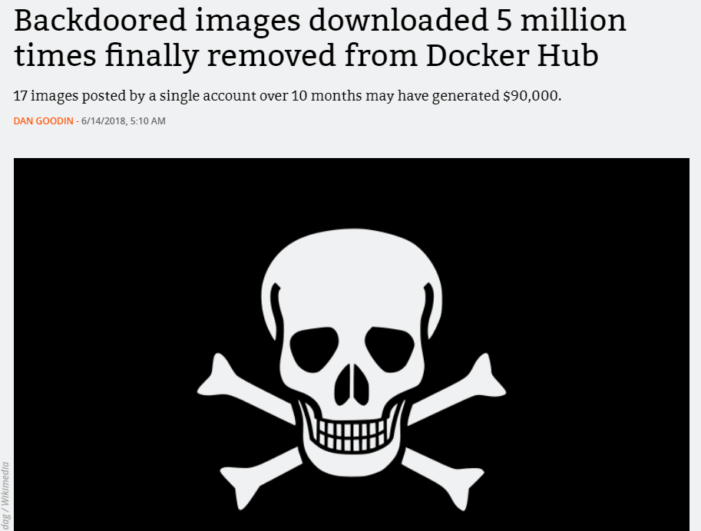
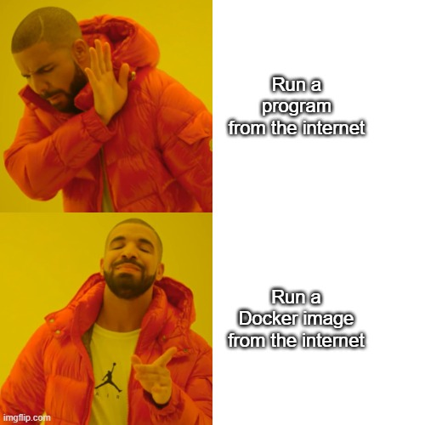
Docker goes wrong … security edition
Would you ..
Notes:
We already see similar yet with library in winter semester.
Source:
https://www.bleepingcomputer.com/news/security/17-backdoored-docker-images-removed-from-docker-hub/
https://arstechnica.com/information-technology/2018/06/backdoored-images-downloaded-5-million-times-finally-removed-from-docker-hub/

Slide 22
Docker goes wrong …
FROM maven:3-jdk-10-slim
RUN apt-get update; apt-get upgrade -y
RUN apt-get install -y curl software-properties-common gnupg; \
curl -sL https://deb.nodesource.com/setup_10.x | bash -
RUN apt-get install -y nodejs
RUN node -v; npm -v
WORKDIR /etl
COPY . .
RUN mvn install -DskipTests
RUN chmod a+x start.sh
CMD ["/bin/bash", "/etl/start.sh"]
EXPOSE 8080
DO NOT TRY THIS AT HOME
exec ./executor.sh & exec ./executor-monitor.sh & exec ./storage.sh & exec ./frontend.sh
Notes:
ACTIVITY: Draw the system on white board discuss the setup.
Sources:
https://github.com/linkedpipes/etl/pull/627

Slide 23
Docker Compose
Declarative
Definition in docker-compose.yml Development vs Production docker files
Multiple isolated environments on a single host
Service discovery
docker-compose vs docker compose

Slide 24
docker-compose.yaml
version: "3.9"
services:
web:
build: .
ports:
- "8000:5000"
volumes:
- .:/code
environment:
FLASK_ENV: development
redis:
image: "redis:alpine"
Notes:
Source:
https://docs.docker.com/compose/gettingstarted/
https://docs.docker.com/compose/compose-file/

Slide 25
Demo
Docker compose PrankWeb / LinkedPipes ETL / NKOD
Notes:
Sources:
https://github.com/cusbg/prankweb/blob/main/gateway/Dockerfile
https://github.com/cusbg/prankweb/blob/main/docker-compose-prankweb.yml (local, server)
https://github.com/linkedpipes/etl/blob/develop/docker-compose.yml
https://github.com/datagov-cz/nkod-deployment

Slide 26
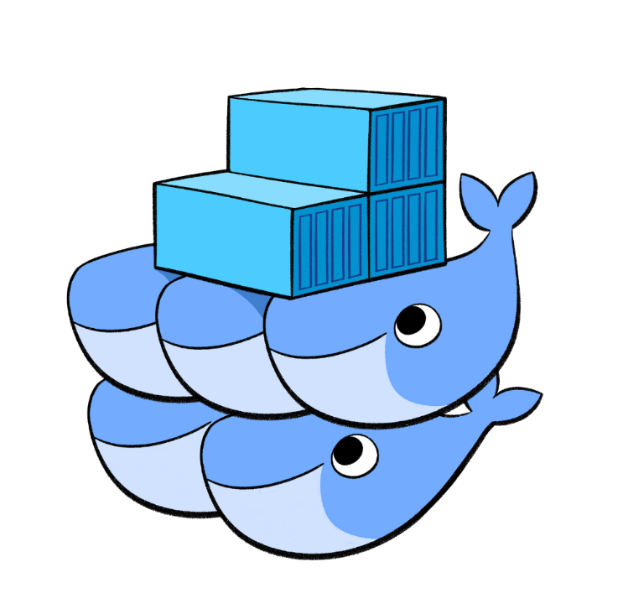
Out of scope
High availability
Infrastructure as a code
Notes:
Swarm / k8s – container orchestration
Infrastructure as a code is for management of resources, such as a k8s cluster, or deployment to a cluster.
Sources:
https://terraform.io/intro/index.html
https://www.ansible.com/

Slide 27
Docker Swarm
Optional: 2022/2023

Slide 28
Kubernetes
Optional: 2022/2023

Slide 29
Nomad
Optional: 2022/2023
Notes:
Resources:
https://www.nomadproject.io/

Slide 30
Composition
<<component>>
web browser
<<component>>
web server
<<component>>
application server
<<component>>
database
Notes:
We now have another level of composition, with well defined API (HTTP).

Slide 31
Demo
Deployment with Docker
Github Actions

Slide 32
Deployment
NSWI150 Virtualization and Cloud Computing
NSWI152 Cloud Application Development (Azure)
Deployment options:
On-premise (internal)
Infrastructure as a Service (hardware)
Virtual machine
Platform as a Service
Software as a Service
Function as a Service (serverless / lambda)
Notes:
infrastructure - we can deploy virtual machines.
platform - just copy the application (html / php / js / … ). May include libraries and frameworks.
software - like database, provider host application with given configuration.
serverless - no persistence or internal state. Best of cloud utilization, probably longer loading time.

Slide 33
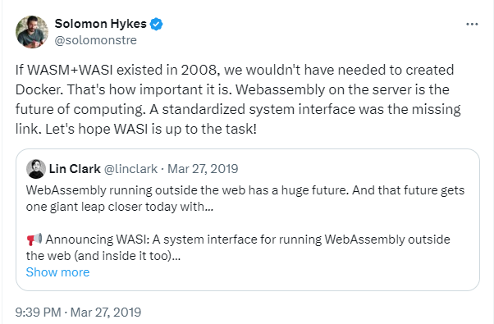
WebAssembly
WebAssembly (WASM, WA) Provides a way to run code written in multiple languages (C++, C#, Rust, ..) on the web at nearly native speed. WASM is a low-level assembly like language with compact binary format (.wasm). There is also a text format (.wat).
Wasmtime is a runtime from ByteCode Alliance. There are bindings for other languages (C++, Python, .Net , …). As a result, we can run WASM in those languages.
WebAssembly Package Manager (WAPM)
WebAssembly System Interface (WASI) A system interface for running WebAssembly in and outside the browser.
WebAssembly GateWay (WAGI) Provides a way to expose WebAssembly code as a web-service (like CGI).
Consider: 2022/2023
Notes:
WebAssembly text format can be converted into WASM binary.
Solomon Hykes is one of the Docker founders. They aim on integration with Docker, so we can run WASM using Docker. This can help with the issues that the code in Docker is compiled for a specific operation system / architecture. Compiled WASM code (image) can be run anywhere.
Fermyon aims to provide a way how to develop cloud native WebAssembly services.
ByteCode Alliance - drives WASM+WASI initiative.
C# can be compiled into WASM, Blazor running in browser is using WASM.
WAGI is using toml files, similar to property files with section to describe the configuration (connect endpoints with WASM executables).
Resources:https://wasmtime.dev/
https://developer.mozilla.org/en-US/docs/WebAssembly
https://wasmer.io/interface/wasi
https://twitter.com/solomonstre/status/1111004913222324225
https://www.youtube.com/watch?v=97yJtD5FKe4 (C# code example)
https://wasmtime.dev/
https://github.com/deislabs/wagi
https://webassembly.sh/

Slide 34
Demo
WebAssembly Runtime
Consider: 2023/2024
Notes:
Resources:
https://webassembly.sh/

Slide 35
Takeaway
Containers (Docker)
Docker compose
Swarm / Kubernetes exists
Composition with containers

