Slide 1
Server
NSWI153 - Advanced Programming of Web Applications
2023/2024
Petr Škoda
https://github.com/skodapetr
https://www.ksi.mff.cuni.cz

Slide 2
Starting point
<<component>>
client
<<component>>
server
<<component>>
database
GET /api/v1/users
SELECT id FROM users
GET /api/v1/users/001
SELECT * FROM users WHERE …
Notes:
Starting point, you already tried this at the lab. Server can be more then just a single program or even a computer.

Slide 3
Web application: full-stack developer
Visual Framework
Angular Material
Reactstrap
Bootstrap
Vuetify
UI Framework
Angular.js
React
Vue.js
Vanilla JS
Redux
Server Language
PHP
Python
NodeJS
Java
HTTP Binding
Flask
Express.js
Jetty
Tomcat
Spring
???
RabbitMQ
Celery
CouchDB
Nginx
<<actor>>
browser
<<component>>
web server
<<component>>
database
user-service
Notes:
First, we can have a service before a database.
----
ACTIVITY: Vote on known technology
Be careful with complexity. You may have experienced that on the lab, yet only with Python and Node.js . Think about complexity of the ecosystem (full stack). Is there a way to do more with a single technology?
----
The answer is yes, you can!
We just need to reduce the complexity of the stack.

Slide 4
Client side
@Route("/home")
public class HomeView extends VerticalLayout {
public HomeView() {
TextField textField = new TextField();
Button addButton = new Button("Add");
addButton.addClickListener(event -> {
Notification.show(textField.getValue());
});
add(textField, addButton);
}
}
TextField textField = new TextField();
Notes:
Source:
https://vaadin.com/

Slide 5
Demo
Vaadin
'Create your UI in Java'
Flow
Events
Components
Pricing
Hilla
Notes:
Vaadin support pure Java components or with HTML templates. Do not focus on client-server communication.
Flow is for building clients from Java.
Events - show Network for clicking a button, talk about payload and RPC.
Components - like UI framework, but here with additional functionality.
Alternative https://demo.vaadin.com/sampler/#ui
For pricing consider localization - example with currency.
Hilla - TS frontend, with UI library, and generated Java backend.
Sources:
https://vaadin.com/examples-and-demos

Slide 6
Event handling
What can go wrong ?
var connection = database.connect();
Button addButton = new Button("Add");
addButton.addClickListener(event -> {
connection.addItem(textField.getValue());
});
connection.close();
public interface Bank {
void transfer(
String from,
String to,
int amount);
}
Notes:
Left:
What about the connection?
Right:
Transactions (we take money from one account and put them to another), synchronization (this can take quite a long time and user is waiting).

Slide 7
Background jobs
Notes:
As a solution to long running tasks or just offsetting the jobs from the web server.

Slide 8
Resource intensive / long running task
Web workers
<<component>>
client
Vertical scaling
<<component>>
server
Horizontal scaling
<<component>>
server
<<component>>
server
Stateless vs Stateful
<<component>>
server
Notes:
Imagine we need to perform something that use a lot of resources, what options do we have?
- - - - - - 1)
We can run it using web workers at the client side.
- - - - - - 2)
We can use the server, yet the server may not be enough. We can get better server.
- - - - - - 3)
We can get better hardware, this can help. Yet you may need to know how to do it (C/C++).
- - - - - - 4)
Stateless vs Stateful is presented later. Yet it is related to horizontal scaling.
The web-server needs to deal with user requests so this offload some of the payload.
Do we want to run our business code at the server responsible for parsing POST requests. No! (next slide)
Source:
https://purple.telstra.com/blog/design-patterns-for-handling-long-running-tasks

Slide 9
Background jobs / message queues
<<component>>
broker
<<component>>
consumer
<<component>>
worker
Task Queue
<<component>>
producer
Task Queue
<<component>>
worker
Task Queue
<<component>>
result backend
Notes:
The broker is the message-routing component of your system.
Sources:
https://www.oreilly.com/library/view/pattern-oriented-software-architecture/9781119963998/chap12-sec005.html

Slide 10
Example: Celery
Python
Asynchronous distributed task queue
Advanced Message Queuing Protocol (AMQP)
Components: Producer, Consumer, Message Broker, Result Backend
from celery import Celery
app = Celery('tasks', broker='...’)
@app.task
def add(x, y):
return x + y
from tasks import add
add.delay(4, 4)
Configuration ….
Notes:
AMQP define content of the message, except the payload.
Sources:
https://github.com/celery/celery
https://www.amqp.org/
https://www.abhishek-tiwari.com/amqp-rabbitmq-and-celery-a-visual-guide-for-dummies/
https://coderbook.com/@marcus/how-to-send-celery-messages-to-remote-worker/
https://docs.celeryq.dev/en/stable/getting-started/backends-and-brokers/index.html
https://docs.celeryq.dev/projects/kombu/en/latest/introduction.html
https://www.distributedpython.com/2018/07/03/simple-celery-setup/
Sources (deprecated):
http://bunkat.github.io/later/
https://github.com/mher/node-celery

Slide 11
Example: Redis Queue
Optional: 2023/2024
Notes:
Sources:
http://resque.github.io/
https://python-rq.org/
https://hevodata.com/learn/redis-message-queue/

Slide 12
Monitoring

Slide 13
Demo
Flower
Notes:
We got some information about the system from previous demo. But what if something go wrong?
Dashboard, Worker, Tasks, Task Detail
Source:
https://prankweb.cz/service/flower/
https://prankweb.cz/www/prankweb-synchronization-report.html

Slide 14
Motivation
<<component>>
service
<<component>>
service
<<component>>
service
<<component>>
service
<<component>>
service
<<component>>
service
<<component>>
service
<<component>>
service
<<component>>
service
<<component>>
service
HTTP/1.1 500 Internal Server Error
Notes:
We have a lot of services, and we have a failure … now we need to search for the reason.
At the end, the reason may be HW failures or a networking issue. Next other components may start to fail as the error propagates.
Perhaps we may have buildup of message for certain components (can be tackled by circuit breaker).
Source:
https://martinfowler.com/bliki/CircuitBreaker.html

Slide 15
Monitoring
What to monitor?
Logs
Logging
Log Aggregation
Metrics
Service Monitoring
Infrastructure Monitoring
How to monitor?
Source
Collector
Processor / Presenter
Notes:
Activity: What to monitor?
Logging - Standard logging know what and why – think about storage space (cloud providers).
Aggregation - We should be able to put together logs for a single request. Logs are sent to a server. We should employ machine readable format (JSON).
Service - Know about endpoints and their status.
Hardware - CPU / Memory
Sources:
https://epsagon.com/observability/5-ways-to-understand-distributed-system-logging-and-monitoring/
https://medium.com/@vagrantdev/
https://bookkeeper.apache.org/docs/getting-started/conceptsdistributed-logging-best-practices-and-lesson-learned-d52143fae266
https://github.com/apache/distributedlog

Slide 16
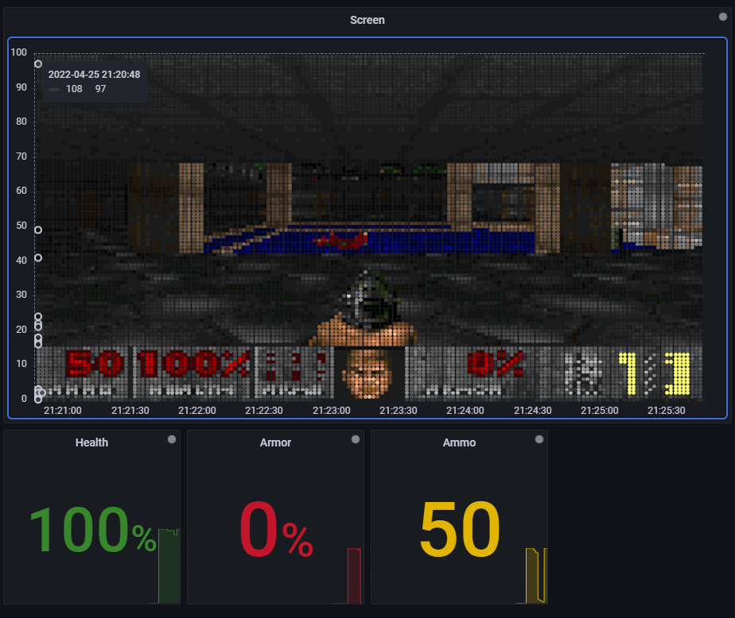
Example
Prometheus
Time series
Multidimensional data
Pull/Push via HTTP
Alerts
…
Grafana
Dashboards
Monitor, analyze, alert
Metrics, logs, traces
…
<<component>>
node_exporter
<<component>>
Prometheus
<<component>>
Grafana
Notes:
Prometheus has expression browser, but that is mostly for querying.
For alerts there is Alertmanager in Prometheus:
Grouping - Grouping categorizes alerts of similar nature into a single notification. For example, multiple components report issues with database.
Inhibition - Suppress notifications of certain alert when other is online. Database server may be down, no reason to get updates about issues with database.
Sources:
https://grafana.com/docs/grafana/latest/getting-started/getting-started-prometheus/
https://grafana.com/
https://grafana.com/blog/2022/03/31/can-grafana-run-doom/
https://prometheus.io/

Slide 17
Architecture
Notes:
The server architecture can be complicated (message queue, monitoring) but what else we can expect?
What are the building blocks at our disposal.

Slide 18
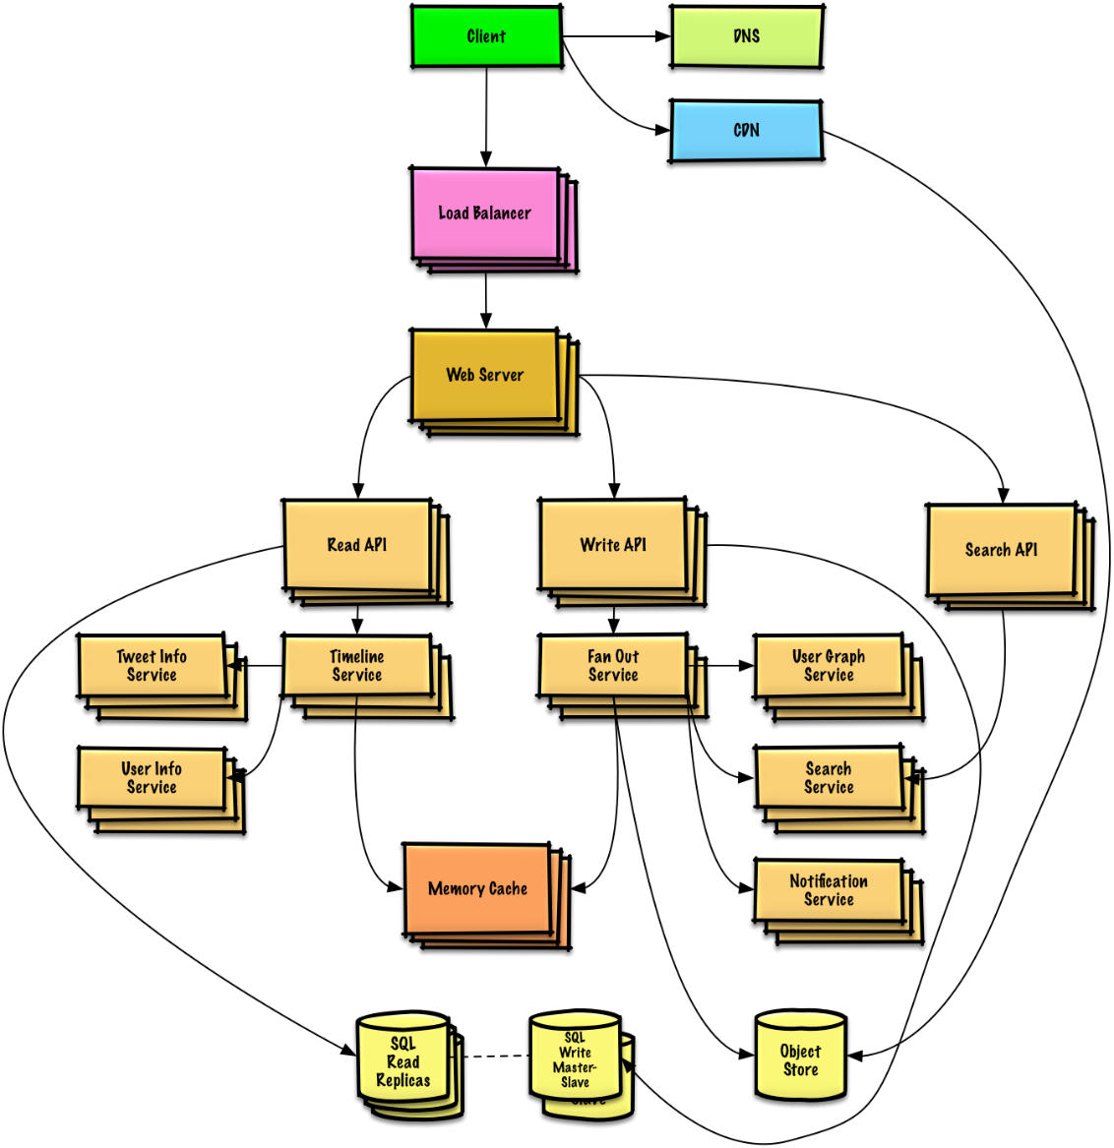
Architecture
Multiple Components Client, Web-Server, Broker, Worker …
Quality Attributes Modifiability, Testability, Integrability, Performance, Availability, …
System design primer
Introduction to Software Engineering - NSWI041
…
Notes:
We have multiple components, and we may need to thing about their composition, how they communicate what are the responsibilities.
Source:
https://github.com/donnemartin/system-design-primer

Slide 19
Starting point
<<actor>>
browser
<<component>>
web server
<<component>>
database
Notes:
This is the basic setup. The server may be running PHP and we have a starting point. This is not limited to web applications, but that is the context we have here. We use this to demonstrate some attributes and solutions, that should be part of your vocabulary / toolbox.
They may be called patterns, but that is not true all the time.

Slide 20
Background Jobs
Message queues Receive hold and deliver messages
(A)synchronous execution
Task queues
Back pressure
<<component>>
message queue
<<component>>
message consumer
<<component>>
client
<<component>>
server
<<component>>
database
Example of our solution with Celery.
Notes:
We have messages that are stored somewhere.
Can be used to execute a remote call (RPC) synchronously or asynchronously. Play nice with threading model of some languages Python / NodeJS. Where it is cheap to wait, and the thread can work on something else in a mean time.
The task queues can be configured from the broker (RabbitMQ) or clients (Apache Kafka).
The objective is to have multiple instances of message consumers.
Performance depends heavily on the broker (queue). Huge performance penalty when secondary memory is employed. Problem for synchronous and tasks. Back pressure - allow to refuse new task if queue is too big. We send back to client 503 Service Unavailable.
Notice that Celery is just an implementation detail.
Source:
https://kafka.apache.org/
https://www.rabbitmq.com/

Slide 21
Application state
Stateful Context of previous transaction.
Stateless No stored information. Every operation is made as if from scratch for the first time.
<<component>>
client
<<component>>
server
<<component>>
database
Application state in the database, servers are stateless.
Notes:
We can have all the state and operations in the database. Some solutions have huge databases with triggers, stored procedures .. database provide us with ACID (atomicity, consistent, isolation, durability).
Servers may just request data and deal with rendering UI.
Source:
https://www.redhat.com/en/topics/cloud-native-apps/stateful-vs-stateless

Slide 22
Proxy
SSL termination, compression, caching, …
Static content
Multiple locations
<<component>>
client
<<component>>
proxy
<<component>>
server
<<component>>
database
Notes:
We already see use of proxy in JS to intercept calls. It allow us to inserted something between “client” and “server”.
We can off load some functionality there, like computing the HTTPS. In addition, HTTPS is not part of our application logic so why to have to deal with it on the server. It is more of an operator thing.
We can also use it for static content, like Nginx server.
Proxy can be on multiple locations in the architecture. It represents an indirection.
We use this as a foundation to build upon.
Source:
https://github.com/donnemartin/system-design-primer
https://refactoring.guru/design-patterns/proxy

Slide 23
Reverse proxy
Centralize internal services and provide unified interface
Hide information about servers (implementation detail)
<<component>>
server
<<component>>
reverse proxy
<<component>>
client
<<component>>
server
<<component>>
database
The reverse proxy provide a unified API, e.g., /api/v1/users and /api/v1/articles.
Notes:
We can have multiple services, on different APIs and provide them from a single endpoint.
Improve security and scalability, client do not need to know server IP or location. Both can change behind the scene.
Source:
https://github.com/donnemartin/system-design-primer

Slide 24
Cache
Improve loading time, reduce server load
Client-side caching
Multiple locations (Client, CDN, Web server, Database, Application, …)
Cache invalidation
<<component>>
cache-aside
<<component>>
client
<<component>>
cache
<<component>>
server
<<component>>
database
Notes:
The idea is to not ask for the same request multiple times. If we know that the results is the same (REST).
We can also cache on the client side, and it is very popular.
On the server side we can cache on multiple places web-server, database, application (RAM). For example, python cache annotation is also a cache, but on a different level.
We may cache database query, but them when an update arrives, we may need to drop the whole cache, or do we?
Another topic is what to put inside the cache, as the cache is often small.
We can have a cache in between (write-behind) or next to (aside) a service/database. For the later it is the server who decide what should be in a cache.
Source:
https://github.com/donnemartin/system-design-primer
https://www.apollographql.com/docs/react/caching/cache-configuration/
https://varnish-cache.org/
https://memcached.org/

Slide 25
Content delivery network (CDN)
Distributed network of proxy servers, minimize distance to user ~ location based
Mostly static content like CSS, HTML, JS, …
Edge computing
<link href="https://cdn.jsdelivr.net/npm/bootstrap@5.1.3/dist/css/bootstrap.min.css" rel="stylesheet“ crossorigin="anonymous">
<<component>>
CDN
<<component>>
client
<<component>>
server
<<component>>
database
Static content is served from a CDN. Our servers only deal with dynamic content.
Notes:
Use DNS resolution to locate server. This is often provided as a service by the infrastructure owner.
Serving content (computation resources/storage) from locations closer to the user, away from the central data store.
Can use CDN to locate nearest server.
We use this to server JS libraries and CSS.
Source:
https://github.com/donnemartin/system-design-primer
https://www.techtarget.com/searchdatacenter/definition/edge-computing

Slide 26
Load balancer
Distribute requests to computing resources Pick a server -> forwards to server -> forwards response to a client
SW or HW implementation
Horizontal scaling
Sticky session
<<component>>
client
<<component>>
load balancer
<<component>>
server
<<component>>
database
Load balancer distribute requests to multiple servers.
Notes:
We have multiple communication resources, yet all requests are to a single endpoint (URL), we need to distribute them.
Implementation can be on multiple levels (transport layer, application layer). May be Nginx server, custom server, or part of the infrastructure setup (Kubernetes).
This is basic for horizontal scaling, as we can add servers behind load balancer at will.
There are different algorithm: Random, Round robin, Least busy, Sticky session (session persistenc) / cookies, application logic.
In addition, a server may fail or become unstable, and we are still capable of serving the requests. The servers are instances of the same component.
Source:
https://github.com/donnemartin/system-design-primer
https://www.haproxy.org/

Slide 27
Database
Modern Database Concepts - NDBI040
Principles of Distributed Systems - NSWI035
Database Applications - NDBI026
…
<<component>>
database
<<component>>
database
Notes:
Database on its own can be quite complex, distributed system. We do not talk about it here, but a database solution may include reverse proxy, load balancer, several instances ….

Slide 28
Example: PrankWeb
<<component>>
monitoring
(NodeJs)
<<component>>
monitoring
(Flower)
<<component>>
administration
<<component>>
frontend
(React)
<<component>>
message consumer
(Python, Java, …)
<<component>>
message queue
(RabbitMQ)
<<component>>
client (browser)
<<component>>
reverse proxy
(Nginx)
<<component>>
web server (Python)
<<component>>
database (File System)
Notes:
Example of a simple architecture.
Source:
https://github.com/cusbg/prankweb

Slide 29
Architecture
Data-driven
Microservices
Event-driven
Service Oriented (SOA)
…
Notes:
These are concepts / styles / … they are not necessary alternatives to one another.
Service - Focus on services to compose an application. Service is self-contained, black box, may compose of other services, represent a repeatable business activity. WSDL, Enterprise service bus (centralized component for integration).
Microservice – compose of small independent and deployable microservices. Each has its own data(base) and server particular business goal. Modern take on SOA, using containers, DevOps, …
Event-driven - event is a change in a state. Mostly build on top of message-driven architecture. State may be saved only in events. There is even Event-driven SOA.
Data-driven – database stands in the center as data are the key assets of any organization. We just build around them as data are self-describing, in open formats. Application just visits the data perform magic (user interaction) and store results back into the data layer.
Sources:
https://www.ibm.com/cloud/learn/soa
https://docs.microsoft.com/en-us/azure/architecture/patterns/sidecar
https://microservices.io/
http://datacentricmanifesto.org/

Slide 30
Takeaway
There is a JavaScript alternative (more later)
Background jobs
Stateless services
Software architecture
Cache
Proxy
Reverse-Proxy
Load Balancer
…

