Slide 1
Write once Run anywhere
NSWI153 - Advanced Programming of Web Applications
2023/2024
Petr Škoda
https://github.com/skodapetr
https://www.ksi.mff.cuni.cz

Slide 2
Showcase
Is Java/* taking over web applications?
https://znalosti.gov.sk
IDSKHeaderWebNav
PyScript
PyScript Example
Notes:
We can see that “desktop” developers can now develop and deploy web applications.

Slide 3
Multiplatform
iOS, Android, Linux, Windows, Web, …
Shared code ~ business logic
Unified experience
Native applications JavaScript, HTML, and CSS ?
Experience with native development … optional?
Responsive (display) vs Adaptive (inputs)
Notes:
Is a browser running a web page a native application? What about Python ..
Examples on following slide are from “web” to “native” based approach.

Slide 4
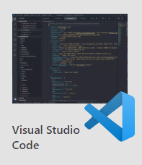
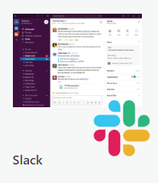
Container
Electron (since 2013)
Electron & Node & Chromium
Linux, macOS, Windows
Built with Electron
Electron Forge (full build pipeline)
npm init
npm install --save-dev electron
…
npm install --save-dev @electron-forge/cli
npx electron-forge import
npm run make
Notes:
Source:
https://www.electronjs.org/
https://www.electronforge.io/

Slide 5
Electron
Entry point (main.js) is running in Nodejs
webPreferences.preload
Context Isolation
Inter-Process Communication
Web Workers
const { app, BrowserWindow } = require('electron')
const createWindow = () => {
const win = new BrowserWindow(
{ width: 800, height: 600 });
win.loadFile('index.html’)
}
app.whenReady().then(() => createWindow() });
app.on('window-all-closed', () => { app.quit() });
…
const { contextBridge } = require('electron’);
contextBridge.exposeInMainWorld('myAPI', {
doAThing: () => {},
});
window.myAPI.doAThing();
Notes:
app – control life cycle
BrowserWindow – manage application window
As a result, we need to add listen for activate to whenReady. In reaction new window should be open if none is.
We can also employ additional options to BrowserWindow such as webReferences. preload that execute given
script in the browser. It has access to browser Window as well as Node.js API. You can not set anything to the Window
object ~ Context Isolation. There are ways to share this (contextBridge). [Example after animation]
Each window have separate rendering process, Inter-Process Communication. Using Structured Clone Algorithm .
In addition, there is single main process managing the application state. It runs in Node.js (see require used for import).
Standard Web Workers for multithreading.
Source:
https://www.electronjs.org/
https://www.electronjs.org/docs/latest/tutorial/context-isolation
https://www.electronjs.org/docs/latest/tutorial/ipc

Slide 6
Showcase
Electron
Governance
Introduction
Notes:
Governance of a project. We see GraphQL / React with GitHub and RFC. This is next example.
Extension for introduction from previous slide, alternatively this is described in the quick-start.
Show source code example. We can see it is like our SPA, we have index.html. In main.js we have createWindow function, it creates the window and load the page. Yet this can be called only when application is ready, so we need to wait before calling it.
Next, we need to deal with closing the application when all windows are closed.
The ‘activate’ method is for some platforms where the application remain in background (Darwin - macOS). Platform specific here.
We can then add script tag to HTML and just use our JS client code.

Slide 7
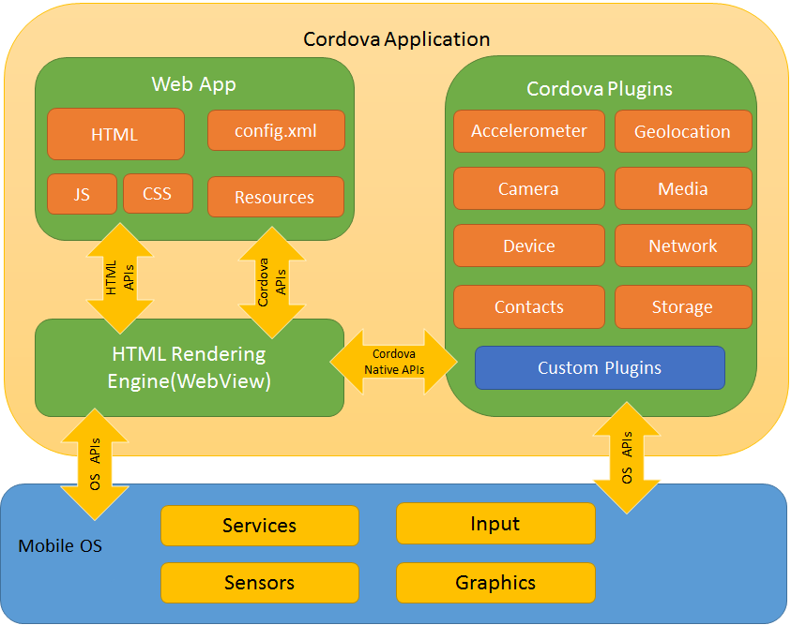
Container
Cordova
Only runtime
HTML5, CSS3, JavaScript
Android, iOS, (OS X), (Windows), Electron
Custom events: pause, backbutton, ..
Ionic
Framework
Custom components
Vue, React, Angular
Compatible with third-party libraries
Notes:
WebView – native container running out application, specific per platform.
Web App – user application.
Plugins – provide integration with native API. May be C++/C#/ …, API exposed on Window object.
Cordova:
Cordova does not provide any UI widgets or MV* frameworks
Deprecated for Windows, OS X
Ionic
Can be used with Cordova as well as Capacitor
Components for each platform
Source:
https://cordova.apache.org/
https://ionicframework.com/

Slide 8
Demo
Cordova & Ionic
Cordova
Ionic
Ionic Tab Layout
XAML

Slide 9
JavaScript bridge
React Native
React style rendering, JavaScript
React primitives render to native platform UI
Native Modules for access to native API Part of legacy architecture, next Turbo Native Modules and Fabric Native Components.
React Native for Web
import React from 'react';
import {Text, View} from 'react-native’;
…
const [text, setText] = useState("");
return (
<View>
<TextInput onChangeText={value => setText(value)} defaultValue={text} />
</View>
);
React Developer != React Native Developer
Notes:
We have rendering, we just wrap the code to render native UI. We employ JavaScript. Closer to Native code.
You can employ Native Components created for given platforms. You can not employ your web component libraries. Native components implemented for specific runtime.
Modules are written in platform specific language like C++. We have ability to detect platform even in the JavaScript using Platform.OS from react-native import. Alternatively, we can have multiple files with different extensions.
By default, there was support for Web. There is now.
There used to be Vue Native - now deprecated.
Source:
https://reactnative.dev/
https://reactnativepaper.com/
https://necolas.github.io/react-native-web/docs/

Slide 10
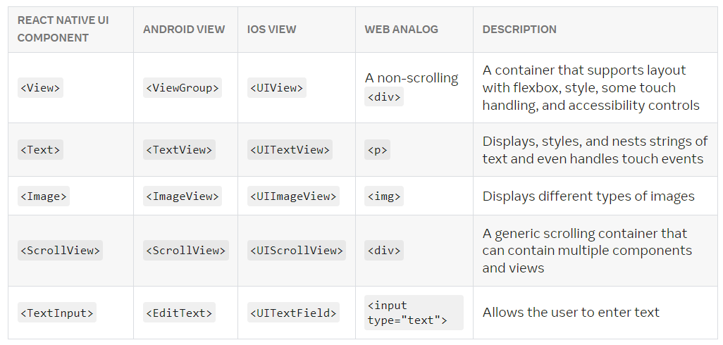
React Native
Selected core components:
Notes:
Resources:
https://reactnative.dev/docs/intro-react-native-components

Slide 11
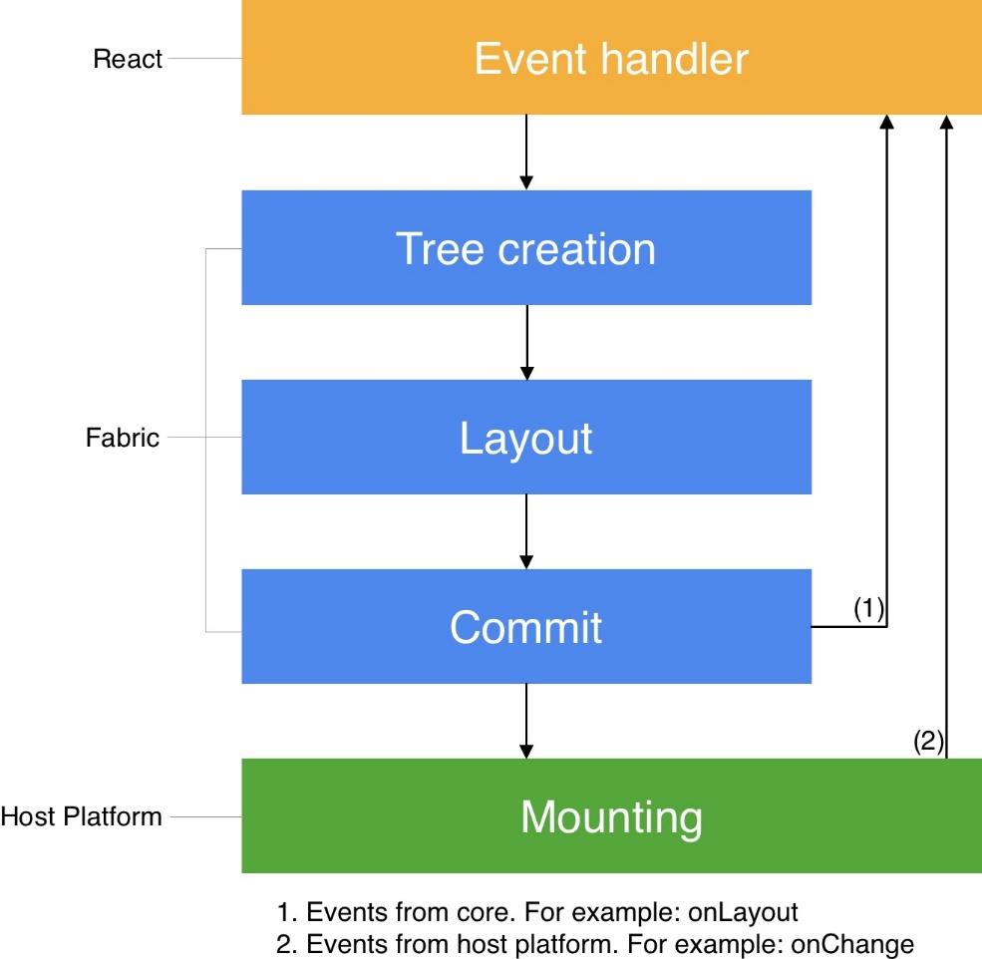
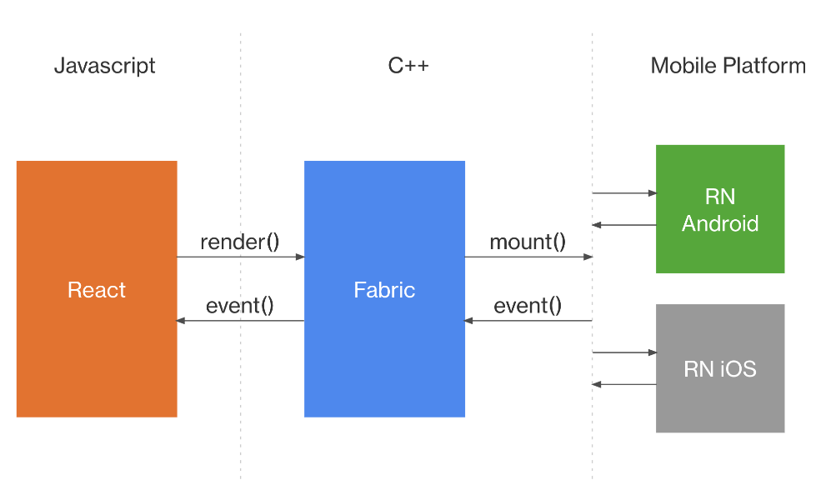
React Native
Rendering system (Fabric) implemented in C++
Render pipeline: render, commit, mount
View Flattening
Threads: UI thread, JavaScript, Background
Notes:
Fabric as of 05.2022
Phases can be computed in different threads: render – execute JS and get the tree to render, with native components commit - layout can be computed (using Yoga), mark tree an “next to be mounted” in next tick of UI thread (or synch if executed in UI thread) mount - transform tree and layout into host user-interface. View is flattened, to not created nested views and diff algorithm Is employed.
Flattening - multiple nested views should not be rendered. Views are merged, rather then removed (like merge margins).
Threads – safety using immutable and C++ const UI - the main thread, only one who can manipulate the host UI. JS - execute JavaScript Background – for layout Overall, each thread can do multiple things (except host UI) depending on the event priority. For example, UI may execute the whole pipeline.
Fabric share the core, before the core was specific for each platform.
JavaScript may not be source of all the information (like scroll position).
Highlight layout computation – normally handled by the browser. This time handled by Yoga - a portable layout engine. Yoga is capable of producing a layout from nodes with CSS styles.
Source:
https://reactnative.dev/architecture/overview
https://www.yogalayout.dev/

Slide 12
Compile to native code
Flutter (since 2017)
Mobile, Web, Desktop, Embedded
Dart compiled to Native Code
Widgets: AppBar, Center, Column, Text, Icon …
pubspec.yaml
Future<http.Response> fetchAlbum() {
return http.get(Uri.parse('https://localhost:8080/users/001'));
}
Notes:
Flutter was described in 2015, release by 2017 by Google.
Deployment may be customized for each platform – part of your project. Designed for this purpose not adopted.
Dart has some JavaScript concepts Future vs Promise. Dart was used in Angular, there was a split for TypeScript in 2016. It is a strongly typed language, functions are first class citizens (callbacks). Object-oriented (with GC), class based, C-like syntax. Workers with isolated memory to achieve concurrency, communication with messages. We can see example of Dart source code.
We have core set of Widgets, that need to have native implementation. All is a Widget .. we just compose widgets. Each Widget has specific properties.
We also have a file with dependencies like package.json
MS have Xamarin - not targeting the web.
Source:
https://flutter.dev/

Slide 13
Flutter
return MaterialApp(
title: 'Welcome to Flutter',
home: Scaffold(
appBar: AppBar( title: const Text('Welcome to Flutter’) ),
body: Column(
children: [
Center( child: Text('Hi!’) ),
ElevatedButton (
onPressed: () { …. },
child: Text('Next’),
),
],
),
),
);
import 'package:flutter/material.dart';
void main() { runApp(const MyApp()); }
class MyApp extends StatelessWidget {
const MyApp({super.key});
@override
Widget build(BuildContext context) {
….
}
}
Notes:
How may a Flutter application look like.
There is nice support for Visual Studio Code.
Right side is content of the build method.

Slide 14
Flutter
Stateful / Stateless components in the build function. State extracted to State class.
ChangeNotifier / ChangeNotifierProvider / Consumer
return ChangeNotifierProvider(
create: (context) => MyState(),
child: …
)
My App
class MyState extends ChangeNotifier {
var current = WordPair.random();
void getNext() {
current = WordPair.random();
notifyListeners();
} }
Page
Watches & Uses
var appState = context.watch<MyState>();
…
Text(appState.current.asLowerCase
…
appState.getNext()
Widget
Widget
Notes:
Like React, using setState - takes callback to execute. Widgets can be destroyed; state must be in State class. State is in a Widget, sharing state is by elevating.
First one is a base class we can extend; it can hold the state and we can listen for a change ( .notifyListeners() ). Other methods are like React context.
We see similar shape as we have in React or other frameworks. We deal with state in similar fashion.
------
First, we need to define the state. Here we declare a state together with actions, like in Redux or Pinia.
------
Next, we can ask for the “context” and pass it down.
------
Last, we can use the state.
Consider show: https://pinia.vuejs.org/introduction.html (state as a properties and functions) or React Context (we need reference to the same variable).

Slide 15
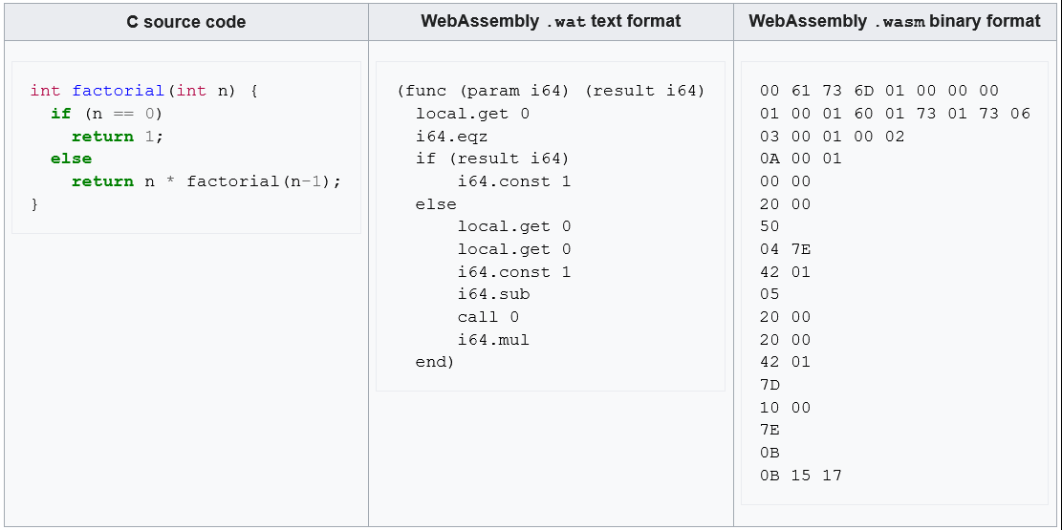
WebAssembly
Open standard for portable executables *.wat (text), *.wasm (binary)
Code can be interpreted, but typically uses Ahead-of-Time (AOT) or (Just-in-Time) JIT compilation
Notes:
There used to be asm.js – a subset of JavaScript, designed to be used as a bytecode for other languages. Browsers may provide specific implementations. Deprecated in favor of WebAssembly.
Defines binary code as well as its text representation. Objective is to allow save execution with high performance. Bounded to JS interoperability and sandboxing.
Browsers provide API to compile the code.
On the other hand, we may call JS code from Assembly. Assembly modules like ES2015 modules.
Sources:
https://developer.mozilla.org/en-US/docs/WebAssembly/

Slide 16
WebAssembly
C, C++, Rust, etc..
Near-native speed across different platforms
Concepts (JS Interface): Module, Memory, Table, Instance, …
WebAssembly.instantiateStreaming(fetch('myModule.wasm'), importObject)
.then(obj => {
// Call an exported function:
obj.instance.exports.exported_func();
// or access the buffer contents of an exported memory:
var i32 = new Uint32Array(obj.instance.exports.memory.buffer);
// or access the elements of an exported table:
var table = obj.instance.exports.table;
...
});
Notes:
C/C++, Rust, C#, F#, Go, Kotlin, Swift, D, Pascal, Zig, Grain – something may be harder to code, like importing a memory object.
For example, C++ with Emscripten, given to clang+LLVM may compile to .wasm.
Module: Represents a WebAssembly binary that has been compiled by the browser into executable machine code. Compiled module can be sent to a worker.
Memory: A resizable ArrayBuffer that contains the linear array of bytes read and written by WebAssembly's low-level memory access instructions.
Table: A resizable typed array of references (e.g., to functions) that could not otherwise be stored as raw bytes in Memory (for safety and portability reasons).
Instance: A Module paired with all the state it uses at runtime including a Memory, Table, and set of imported values. An Instance is like an ES2015 module that has been loaded into a particular global with a particular set of imports.
WebAssembly can not access DOM. Plan is to allow calls of APIs.
We can employ with browser, CLI (wasmtime) or NodeJS (Stability: 1 - Experimental).
There is W3C draft proposal for version 2.0. Initial design in 2017 after API was agreed upon by four major browsers.
Last core spec from 2019.
Sources:
https://developer.mozilla.org/en-US/docs/WebAssembly/
https://developer.mozilla.org/en-US/docs/WebAssembly/Loading_and_running
https://webassembly.org/
https://nodejs.org/api/wasi.html
https://www.w3.org/TR/2019/REC-wasm-core-1-20191205/
https://www.w3.org/TR/wasm-core-2/
https://webassembly.github.io/spec/
https://reneeshah.medium.com/how-webassembly-gets-used-the-18-most-exciting-startups-building-with-wasm-939474e951db

Slide 17
Takeaway
Container (Electron, Cordova)
Bridge (React Native)
Compile to Native (Flutter)
WebAssembly

Slide 18
Optional: 2023/2024

