Slide 1
Closing statements
NSWI153 - Advanced Programming of Web Applications
2024/2025
Petr Škoda
https://github.com/skodapetr
https://www.ksi.mff.cuni.cz

Slide 2
Seminar/team project
Send me an email when ready
10 – 15 minutes with “all“ team members
Presentation
Architecture
Deployment / Demo
Q&A

Slide 3
Related work …
Agile
Documentation
Writing tests
Scalability
Clean code
User
Time to Market
User Interface Design
Database
Bugs
Notes:
Security
See context in which the application is created, user expectations, resources.

Slide 4
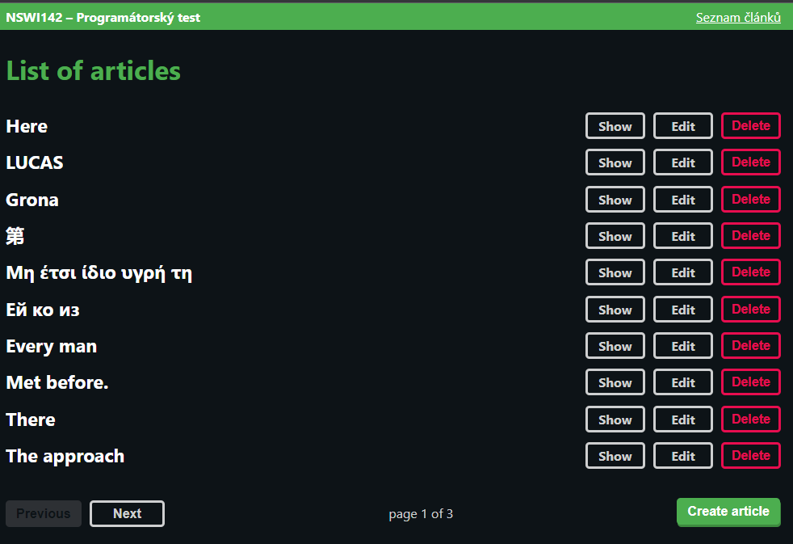
Are We There Yet?
?
PHP / NodeJS / Python / …
REST API / GraphQL / …
React / Vue / Svelte / …
JavaScript / TypeScript / Java / …
Docker
Proxy / Load Balancer / CDN / …
Electron / Flutter / …
…

