Slide 1
Data
NSWI153 - Advanced Programming of Web Applications
2023/2024
Petr Škoda
https://github.com/skodapetr
https://www.ksi.mff.cuni.cz

Slide 2
Data storage
Where can / should you store application data?
MSSQL / MySQL / Oracle / …
Relational database
NoSQL database
On-premise
Cloud (IaaS, PaaS, SaaS, DBaaS)
architecture / design / …
Notes:
ACTIVITY?
IaaS - only hardware
PaaS - with middleware, for example Azure MSQL up to data database with backups, monitoring, …
SaaS - software as a service
DBaaS - DataBase as a service
Ripple effect for changes in the architecture.
Sources:
https://docs.microsoft.com/en-us/azure/azure-sql/database/sql-database-paas-overview?view=azuresql

Slide 3
Case-study: Open data portal catalog
Virtuoso (SPARQL)
Apache Solr
CouchDB
Memory
API
Notes:
Components:
Solr is highly reliable, scalable and fault tolerant, providing distributed indexing, replication and load-balanced querying, automated failover and recovery, centralized configuration and more.
CouchDB has HTTP/JSON API.
We have data and we expose them using API.
Source:
https://data.gov.cz/datové-sady
https://solr.apache.org/
https://couchdb.apache.org/

Slide 4
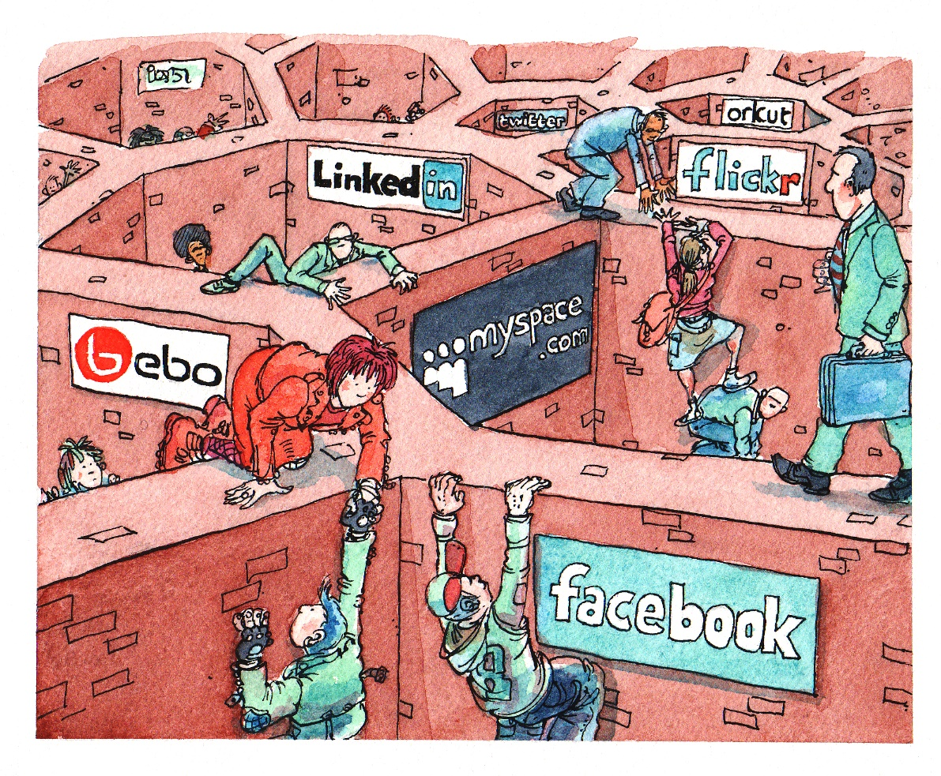
Motivation
Data coupled with applications
Data silos
Glory of REST
NSWI144 - Data on the Web
Who is in charge?
Programmer
Developer
Software Engineer
Data Engineer
Notes:
Sources:
https://www.w3.org/2010/Talks/0303-socialcloud-tbl/#(2)

Slide 5
Semantic web
The Semantic Web, sometimes known as Web 3.0, is an extension of the World Wide Web through standards set by the World Wide Web Consortium (W3C).
The goal of the Semantic Web is to make Internet data machine-readable.
Schema.org Schema.org is a collaborative, community activity with a mission to create, maintain, and promote schemas for structured data on the Internet, on web pages, in email messages, and beyond.
We can store data in a webpage using Microdata or JSON-LD.
Employ URL for resources instead of documents (RDF).
Notes:
For example, how user search for vacations. Can you just ask what you need? To certain extend yes, but that is by work of indexing services and providers.
Berners-Lee originally expressed his vision of the Semantic Web in 1999:
I have a dream for the Web [in which computers] become capable of analyzing all the data on the Web – the content, links, and transactions between people and computers. A "Semantic Web“ …
Additional information is often harvested by search engines and can improve search results, Search-Engine-Optimization (SEO).
Source:
https://en.wikipedia.org/wiki/Semantic_Web
https://schema.org/

Slide 6
Decentralization
Centralized Internet
SOLID (Tim Berners-Lee)
Web 3.0 / 2.5 / ..
OpenPGP (web of trust)
Resource Description Framework(RDF) URL as a data identifier
Blockchain
This is not an investment recommendation!
Notes:
Who is the authority here? If user can save any data, where is the business logic.
Sources:
https://cryptography.fandom.com/wiki/Web_of_trust

Slide 7
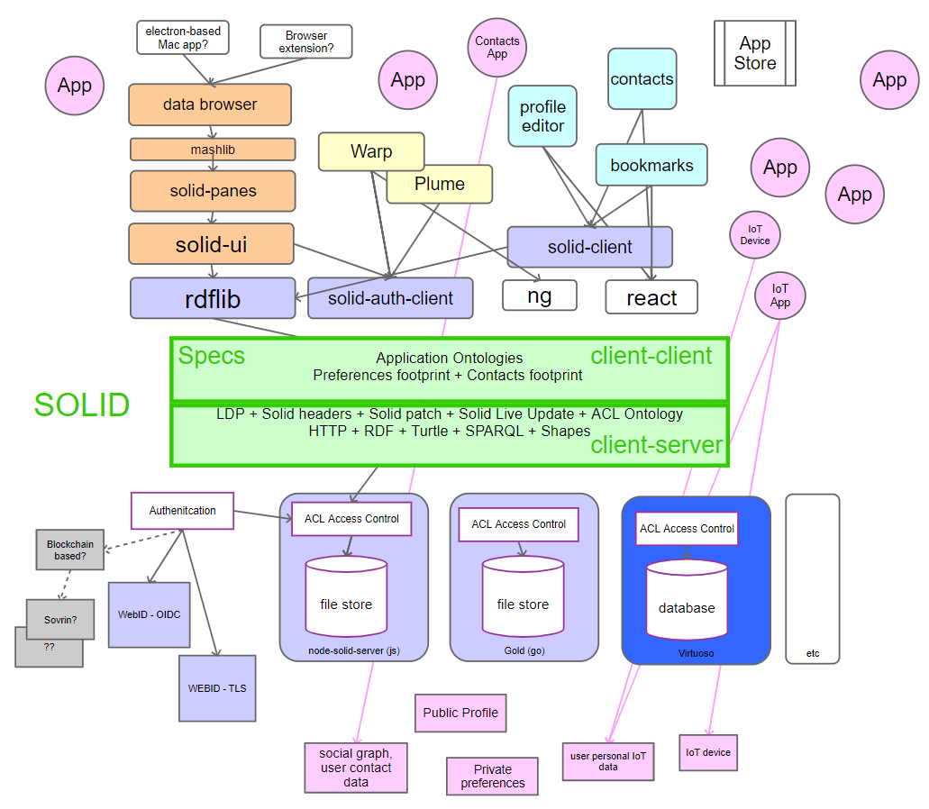
Data/Document storage
SOLID
Set of conventions and tools
Decoupling of data from applications
User choice (Pods)
Dereferenceable, REST API, SPARQL
Application profiles
Technology
RDF, SPARQL, Linked Data Platform, Linked Data Notifications, WebID, WebID ACLs, WebID-TLS, WebID-OIDC, FOAF, Schema.org, …
Notes:
SOcial LInked Data
User can select who have access to the data and where the data are stored Pods are like secure personal web servers for data.
WebID-TLS or WebID-OIDC authentication
Complicated yet there are some interesting pieces of technology, that may be helpful (WebID, LPD, .. ). Yet now we are talking architecture.
Sources:
https://solidproject.org/
https://rawgit.com/solid/solid/master/diagrams/solid-architecture.svg

Slide 8
File System
InterPlanetary File System (IPFS)
Location-based vs Content-based addressing Cryptographic hash of the content.
DNSLink
InterPlanetary Name System (IPNS)
Database
// Listen for updates from peers
db.events.on("replicated", address => {
console.log(db.iterator({ limit: -1 }).collect())
})
// Add an entry
const hash = await db.add("world")
console.log(hash)
// Query
const result = db.iterator({ limit: -1 }).collect()
console.log(JSON.stringify(result, null, 2))
const ipfs = await IPFS.create()
const orbitdb = await OrbitDB.createInstance(ipfs)
// Create / Open a database
const db = await orbitdb.log("hello")
await db.load()
Optional: 2023/2024
Notes:
InterPlanetary File System (IPFS) is a distributed system for storing and accessing files, websites, applications, and data. Focus on peer-to-peer. Designed in 2015 with objective to revolutionize the internet. Stanford Seminar 2016.
When you add a file to IPFS, your file is split into smaller chunks, cryptographically hashed, and given a unique fingerprint called a content identifier (CID). New version is given new CID as it has a new hash.
URL is based on location, when the file may move around, we can not employ that (sorry RDF). Instead, the identifier is a cryptographic hash of the content at that address. Content can be a single file, piece of file or metadata (in theory even snapshot of a file system). This also serve as a protection, as it is hard to modify the content provided. We need to be able to address the parts, that is outside of scope of this slides.
DNSLink – alternative to IPNS, just using TXT in DNS to specify the current CID
IPNS - based on public key of the hash
Requires adoption to work, it need users. IPFS is used by Pinata a Web 3 startup, NFT data stored in IPFS.
Sources:
https://ipfs.io/
https://filecoin.io/blog/posts/introducing-web3-storage/
https://www.youtube.com/watch?v=94HH5D23WWI
https://www.pinata.cloud/
https://github.com/orbitdb/orbit-db
https://docs.textile.io/threads/

Slide 9
Decentralized application (DAPP)
Smart Contracts
Runs on Ethereum blockchain
Solidity / Vyper / …
Accessible and transparent
contract Coin {
address public minter;
mapping (address => uint) public balances;
constructor() { minter = msg.sender; }
function mint(address receiver, uint amount) public {
require(msg.sender == minter);
balances[receiver] += amount;
}
...
emit Sent(msg.sender, receiver, amount);
…
}
Coin.Sent().watch({}, '', function(error, {args}) {
console.log("Coin transfer " +
args.from + " -> " +args.to);
console.log("Balances now:\n" +
"Sender: " + Coin.balances.call(args.from) +
"Receiver: " + Coin.balances.call(args.to));
});
Optional: 2023/2024
Notes:
Term coined by Nick Szabo, two publications 1994 and 1996. For contract we need trusted parties, here the network execute the contract when criteria are met. In addition, human contracts are interpreted by layers a judges, here the outcome is strictly predefined.
Specific type or account which have balance and can send transactions over the network, yet they are deployed to the network. Users can interact by submitting transactions to the smart contracts. Blockchain is a distributed database of transactions.
Deployment of code in smart contract language, is paid by Ether (gas) or Wei (1 ETH = 10**18 Wei).
Solidity (static types, C-like, object oriented), Vyper (inspired by Python),
DAPP are build using smart contracts as backends with Java Script for frontend.
Example (right):
constructor is evaluated upon contract is created. We store the author, later only the author can mint new coins. We can declare events and errors and emit them. ‘address’ is a type. The ‘public’ create function that allow others to read the state. The send function (missing) can be used by anyone who already have some coins.
Example (left):
We should check for an error. We can listen for an event, and we can read data from the network.
Sources:
https://ethereum.org/en/smart-contracts/
https://ethereum.org/en/developers/docs/smart-contracts/
https://docs.soliditylang.org/en/latest/introduction-to-smart-contracts.html
https://github.com/ChainSafe/web3.js

Slide 10
Decentralized application (DAPP)
Use cases:
DEcentralized Finance
NFTs
Gaming
Web 3.0
Why
Decentralization
Censorship resistant
Trustless
Transparency
ERC-20 Tokens build on Smart contracts often Ether.
Application
Backend - Smart Contracts (hardhat, ..)
Frontend - JS, CSS, HTML, .. (web3.js)
Optional: 2023/2024
Notes:
Examples of DAPP.
Use-case:
Custom coin, Flash loans, stable coins
NFT - chain can force scarcity, no more token can be created. Images lives at IPFS. Idea is to promote a “drop” (like IPO) and people come to website to byu this …
Gaming - earn something in a game and export it out of the game
Why
Decentralization - word wide computer.
Censorship - once something is on the chain, it can not be removed. Data are immutable.
Trust - We can see sources
Benefit: One bad actor can not change your balance.
Application:
httsp://uniswap.org
https://github.com/Uniswap
https://etherscan.io/ - we can see contracts for given coins there
https://www.openzeppelin.com/
https://www.argent.xyz/ - Best application for block chain is a wallet …
Developer:
https://hardhat.org/ - Framework
https://trufflesuite.com/ - Framework
https://web3js.org/#/ - Library for communicating with Smart contracts
https://github.com/ethers-io/ethers.js - Library for communicating with Smart contracts
https://trufflesuite.com/ganache/ - Your local bock chain

